Slide 1

Development of a High-Performance Avionics System for Real-Time Guidance and Control in High-Power Vehicles
Cheng (Robin) Liu, Mohammed Abdeen, Kanav Chugh
Georgia Institute of Technology
20245 AIAA Region II Student Conference, 04/04/2023​
Copyright © by Cheng Liu​, Mohammed Abdeen, and Kanav Chugh
Published by the American Institute of Aeronautics and Astronautics, Inc., with permission.​

Slide 2
Motivation | Objective
Achieving thrust-vectoring by using jet-vanes technology
Safety measures and real time power monitoring
Modular systems
  Power Management System
  Flight Computer
Copyright © by Cheng Liu​, Mohammed Abdeen, and Kanav Chugh
Published by the American Institute of Aeronautics and Astronautics, Inc., with permission.​

Slide 3
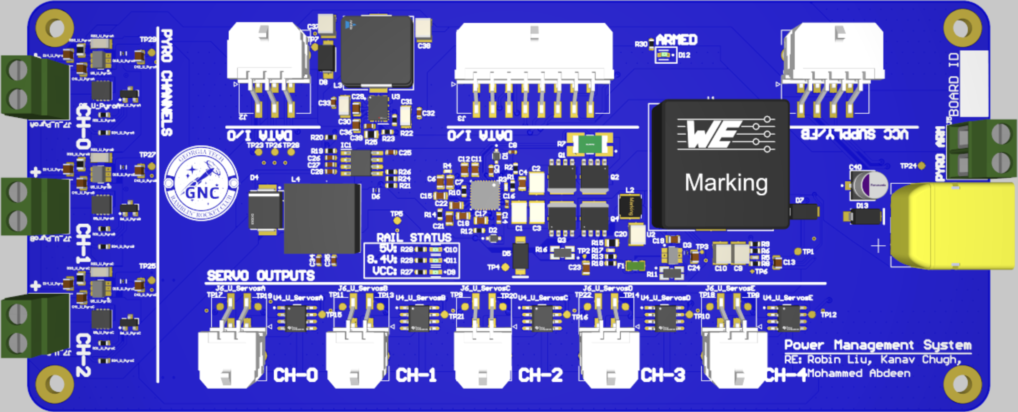
Subsystem | Power Management System
Power Management System
Copyright © by Cheng Liu​, Mohammed Abdeen, and Kanav Chugh
Published by the American Institute of Aeronautics and Astronautics, Inc., with permission.​

Slide 4
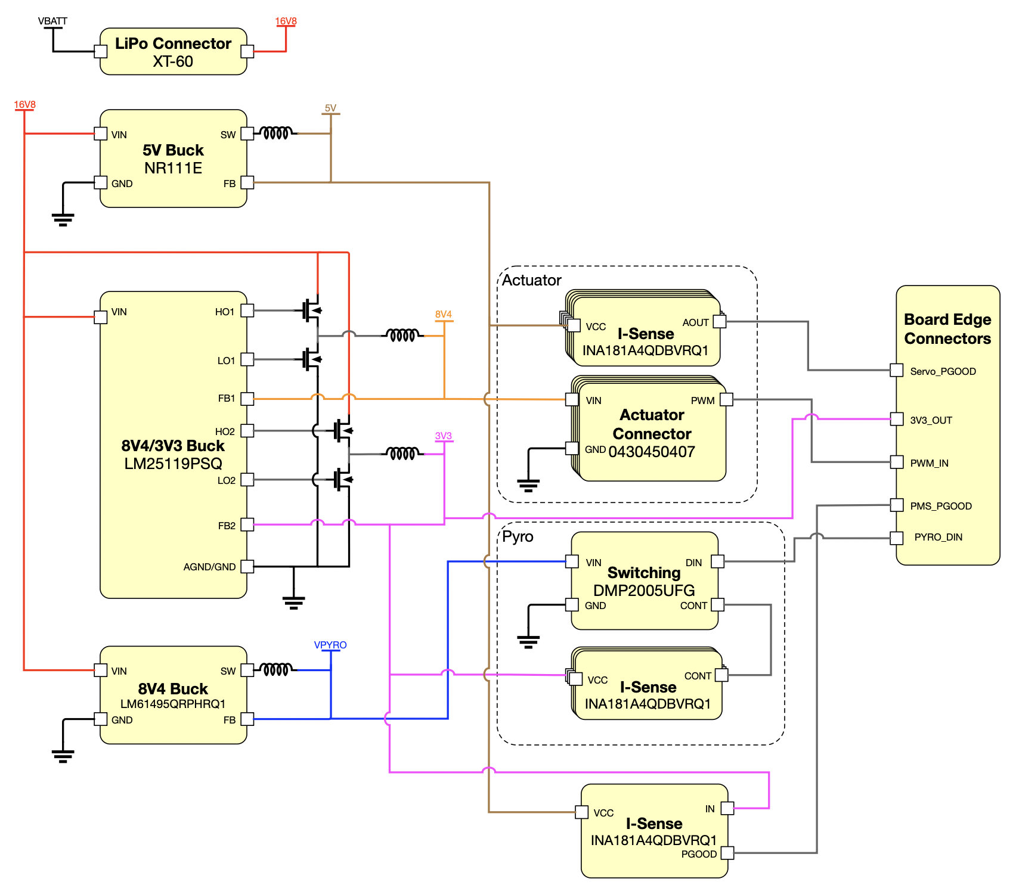
Subsystem | Power Management System
Architecture
Copyright © by Cheng Liu​, Mohammed Abdeen, and Kanav Chugh
Published by the American Institute of Aeronautics and Astronautics, Inc., with permission.​

Slide 5
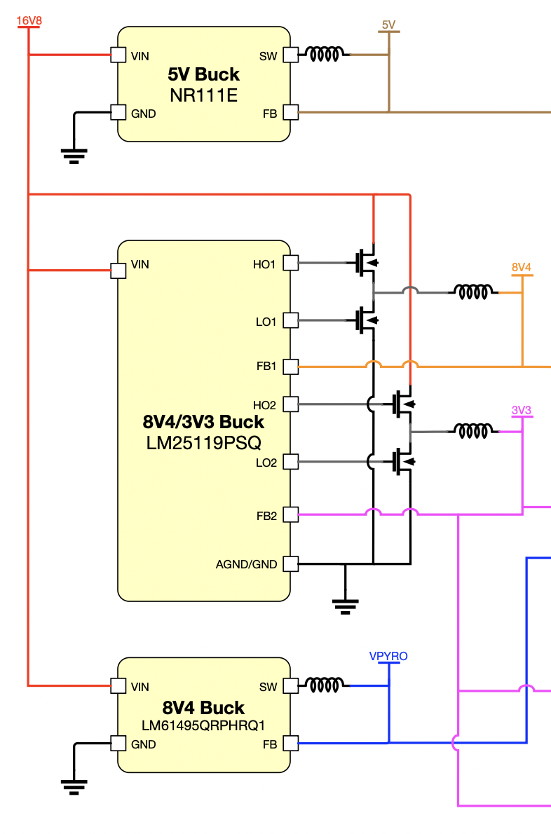
Subsystem | Power Management System
DCDC Converters
16.8V => 8.4V at 10A and 16A
16.8V => 5V at 4A
16.8V => 3.3V at 1A
Copyright © by Cheng Liu​, Mohammed Abdeen, and Kanav Chugh
Published by the American Institute of Aeronautics and Astronautics, Inc., with permission.​

Slide 6
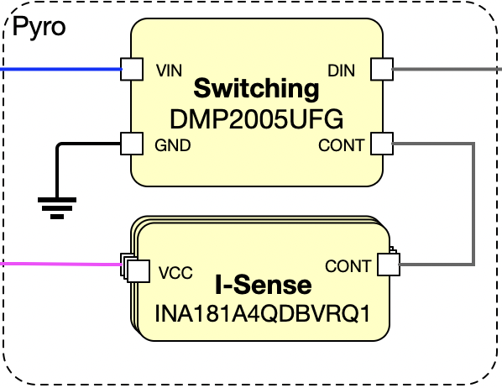
Subsystem | Power Management System
Pyrotechnic Channels
Utilized for charge deployment
Supplying 84W of total power in less than one millisecond
Safety check by verifying successful connection and ignition
Copyright © by Cheng Liu​, Mohammed Abdeen, and Kanav Chugh
Published by the American Institute of Aeronautics and Astronautics, Inc., with permission.​

Slide 7
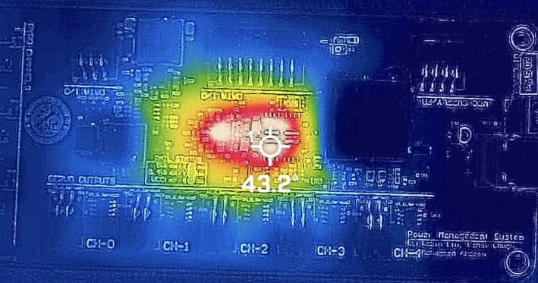
Subsystem | Power Management System
Thermal Analysis
4-layer copper pours enhancing thermal dissipation
Live power monitoring for power fails and overcurrent protection
Power
Ground
Ground
Power
PMS Layer Stack Up
Thermal Imagining of PMS
Copyright © by Cheng Liu​, Mohammed Abdeen, and Kanav Chugh
Published by the American Institute of Aeronautics and Astronautics, Inc., with permission.​

Slide 8
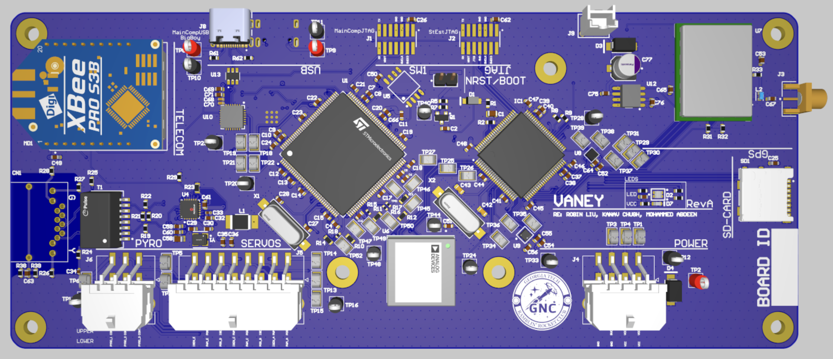
Subsystem | Flight Computer
Flight Computer
Copyright © by Cheng Liu​, Mohammed Abdeen, and Kanav Chugh
Published by the American Institute of Aeronautics and Astronautics, Inc., with permission.​

Slide 9
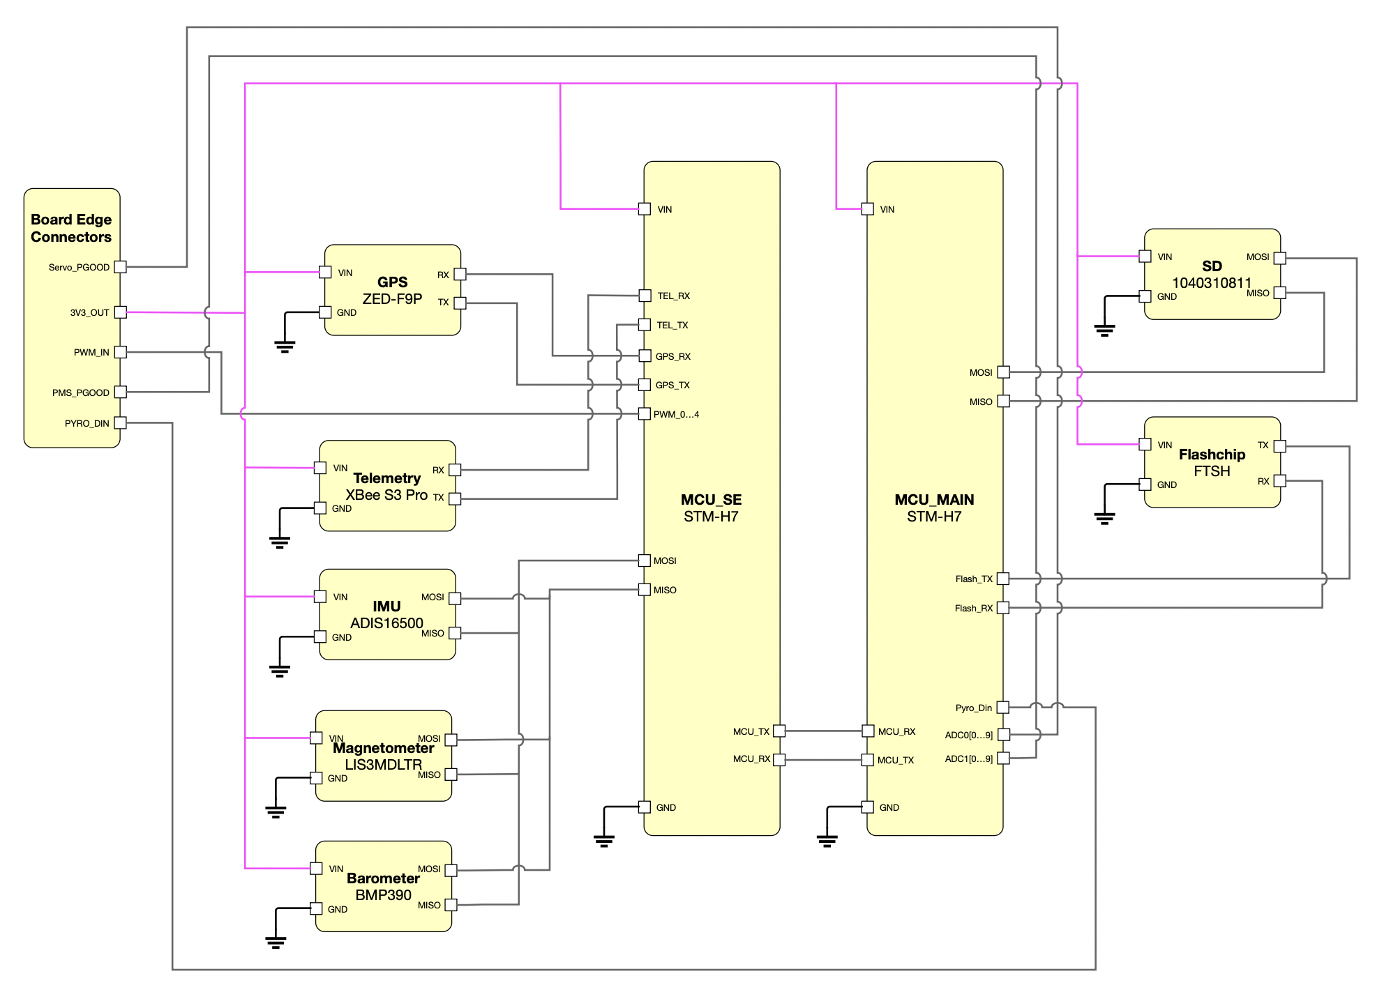
Subsystem | Flight Computer
Architecture
Copyright © by Cheng Liu​, Mohammed Abdeen, and Kanav Chugh
Published by the American Institute of Aeronautics and Astronautics, Inc., with permission.​

Slide 10
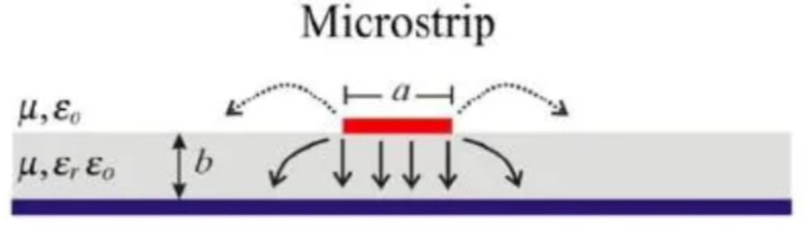
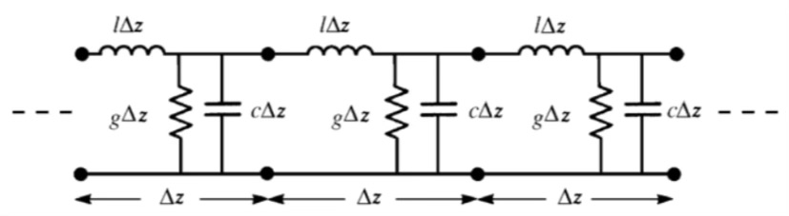
Subsystem | Flight Computer
Impedance Matching
Impedance: the opposition to alternating current caused be reactance and resistance
Matching transmission line and load impedance is critical for preserving signal integrity
Impedance matching is important for high speed data protocols
Modifying trace width and length to set transmission line impedance
Microstructure trace on PCB
Transmission Line Theory
Copyright © by Cheng Liu​, Mohammed Abdeen, and Kanav Chugh
Published by the American Institute of Aeronautics and Astronautics, Inc., with permission.​

Slide 11

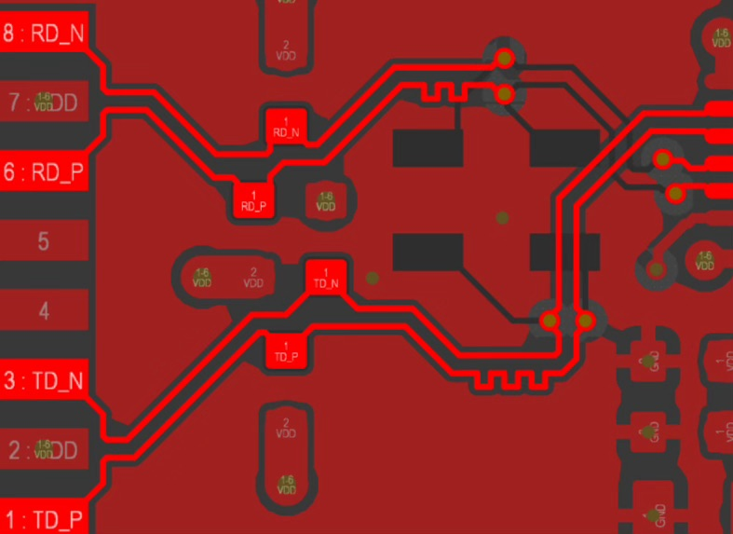
Subsystem | Flight Computer
Routing considerations
Routing to reduce Electromagnetic Interference (EMI)
Reasonable spacing between traces (respecting impedance configuration)
Surrounding high-frequency signal with ground copper pours
Keeping signal traces reasonably short and parallel
SPI routing
Differential pair length tuning
Copyright © by Cheng Liu​, Mohammed Abdeen, and Kanav Chugh
Published by the American Institute of Aeronautics and Astronautics, Inc., with permission.​

Slide 12
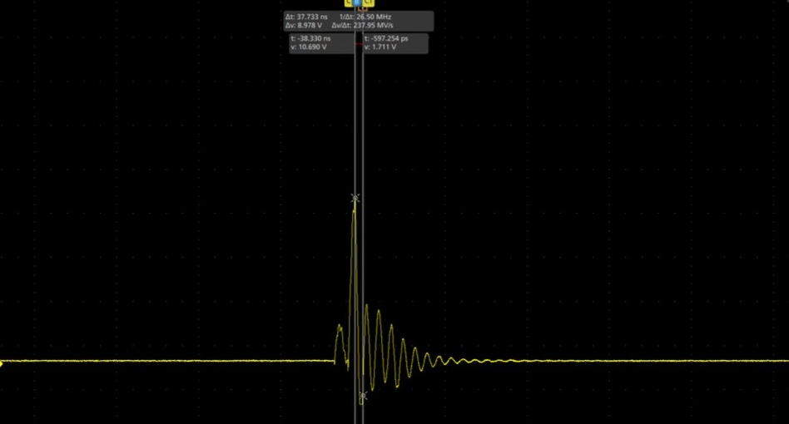
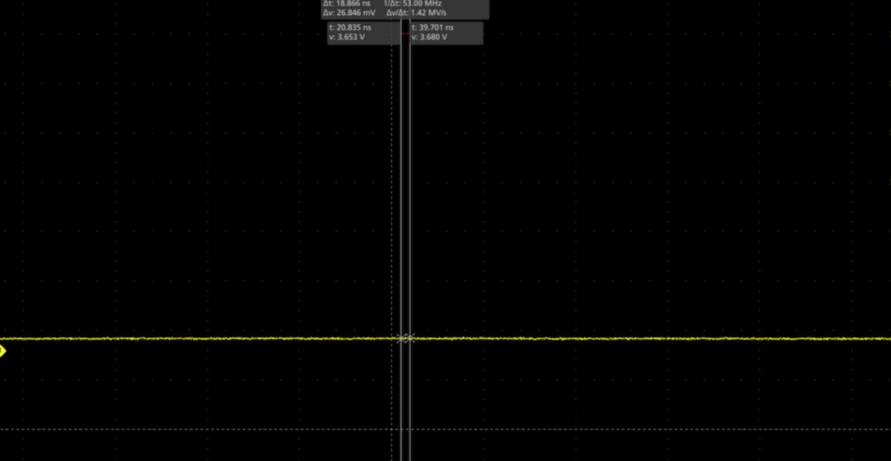
Issue | Misfiring
Transient Response Analysis
Initial issues with pyro arming process
Voltage spikes on pyro channel during the first 5ms can cause misfire
Fixing the issue by adding a voltage regulator
Initial arming voltage spikes
Initial arming eliminated voltage spikes
Copyright © by Cheng Liu​, Mohammed Abdeen, and Kanav Chugh
Published by the American Institute of Aeronautics and Astronautics, Inc., with permission.​

Slide 13
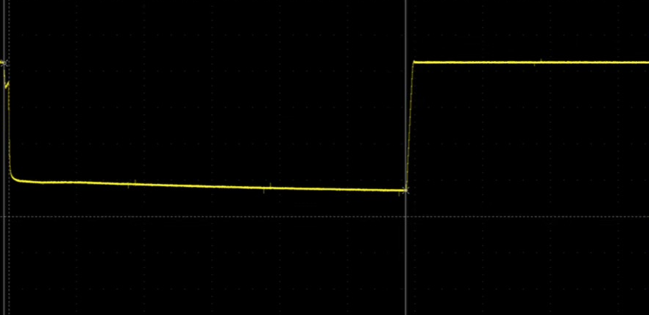
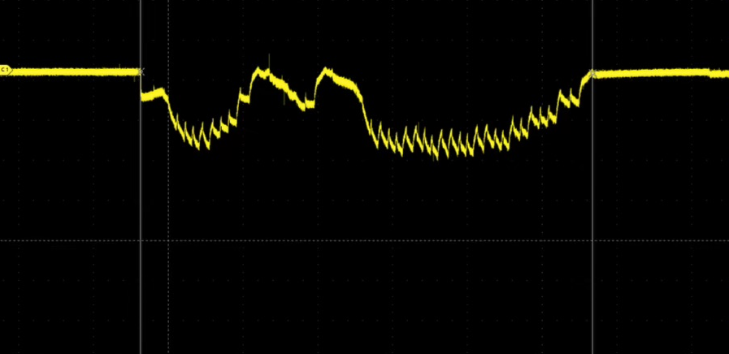
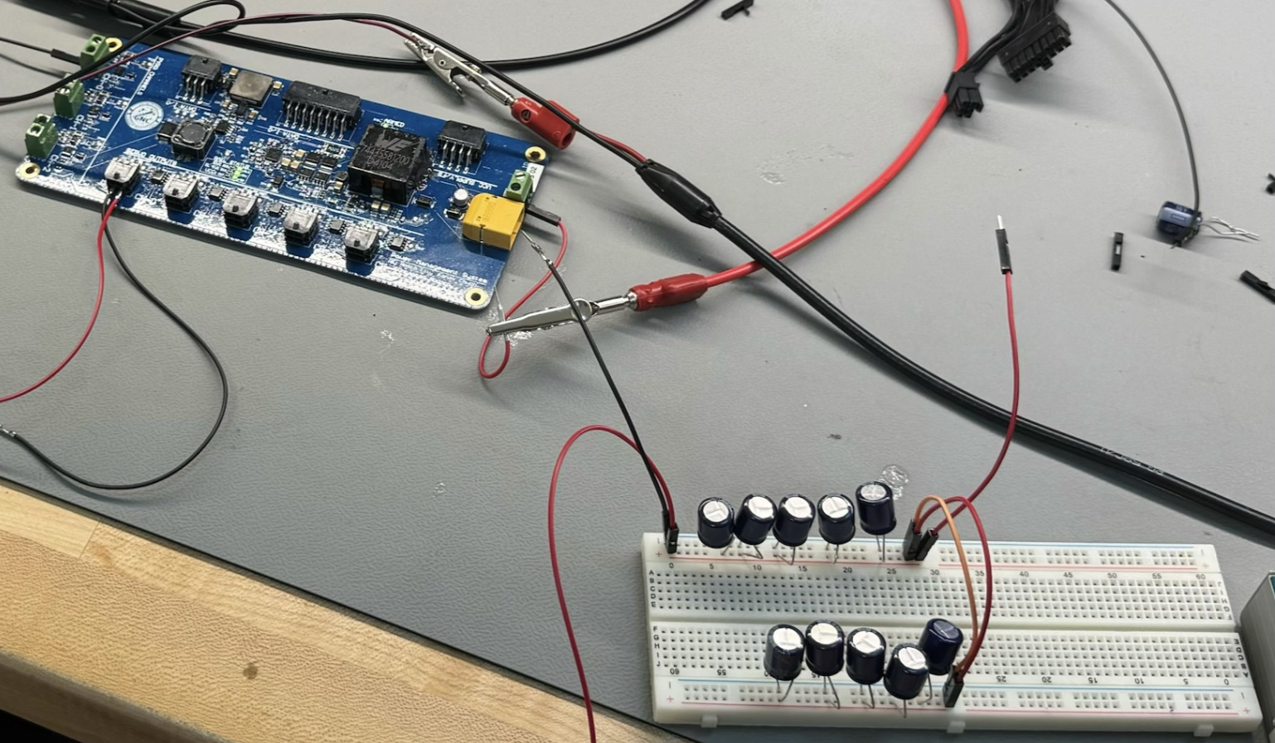
Issue | Power Coma
Load Transient Response
60 ms power coma occurs when servo actuates, causing jittering
Fixing the issue by connecting a significantly sized capacitor bank
Buck Converter raw transient response
Transient response with capacitor bank
Picture of bench testing setup
Copyright © by Cheng Liu​, Mohammed Abdeen, and Kanav Chugh
Published by the American Institute of Aeronautics and Astronautics, Inc., with permission.​

Slide 14
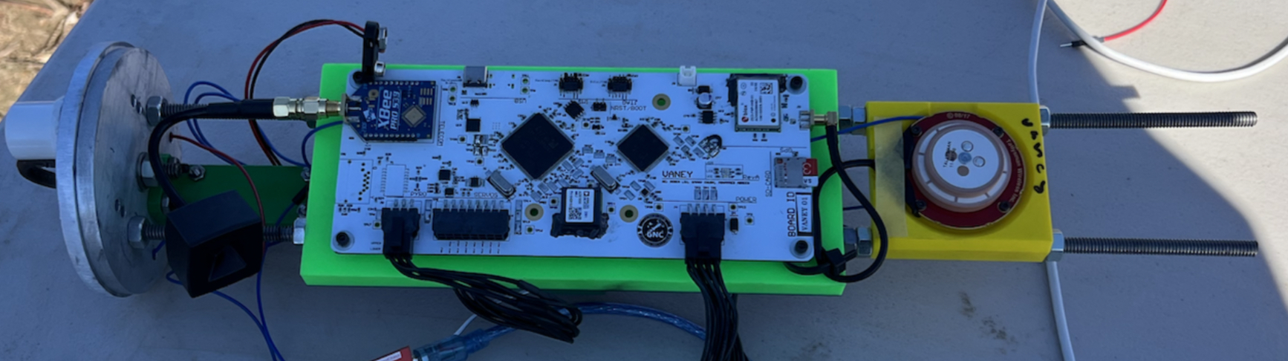
Performance | Test Flight
Integration
PCBs powered under sunlight for 60 minutes and high G-forces
Despite significant heating, system stayed fully operational
Picture of bench testing setup
Copyright © by Cheng Liu​, Mohammed Abdeen, and Kanav Chugh
Published by the American Institute of Aeronautics and Astronautics, Inc., with permission.​

Slide 15
Conclusion | Future Improvements
Enhance transient response with a multiphase power supply
Improve high-frequency noise filtering with additional decoupling capacitors
Integrate temperature sensors for thermal monitoring
Implement a Faraday cage around high-frequency components
Modularize with a separate RF module and high-speed protocols
Use flex cables for impedance-controlled interboard connections
Copyright © by Cheng Liu​, Mohammed Abdeen, and Kanav Chugh
Published by the American Institute of Aeronautics and Astronautics, Inc., with permission.​

Slide 16
Copyright © by Cheng Liu​, Mohammed Abdeen, and Kanav Chugh
Published by the American Institute of Aeronautics and Astronautics, Inc., with permission.​

