Slide 1
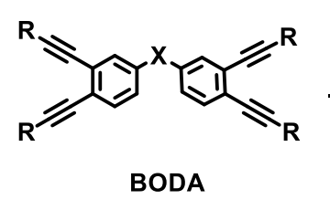
Compression Molding Fabrication of C/C Composite Produced via Highly Processable BODA-Derived Precursor Resin System
Joshua M. Brown, Patrick A. Madden, Joshua F. Griffin, James T. Armstrong
Mississippi State University
2025 Region II Student Conference, 4-5 April 2025
Notes:
JB

Slide 2
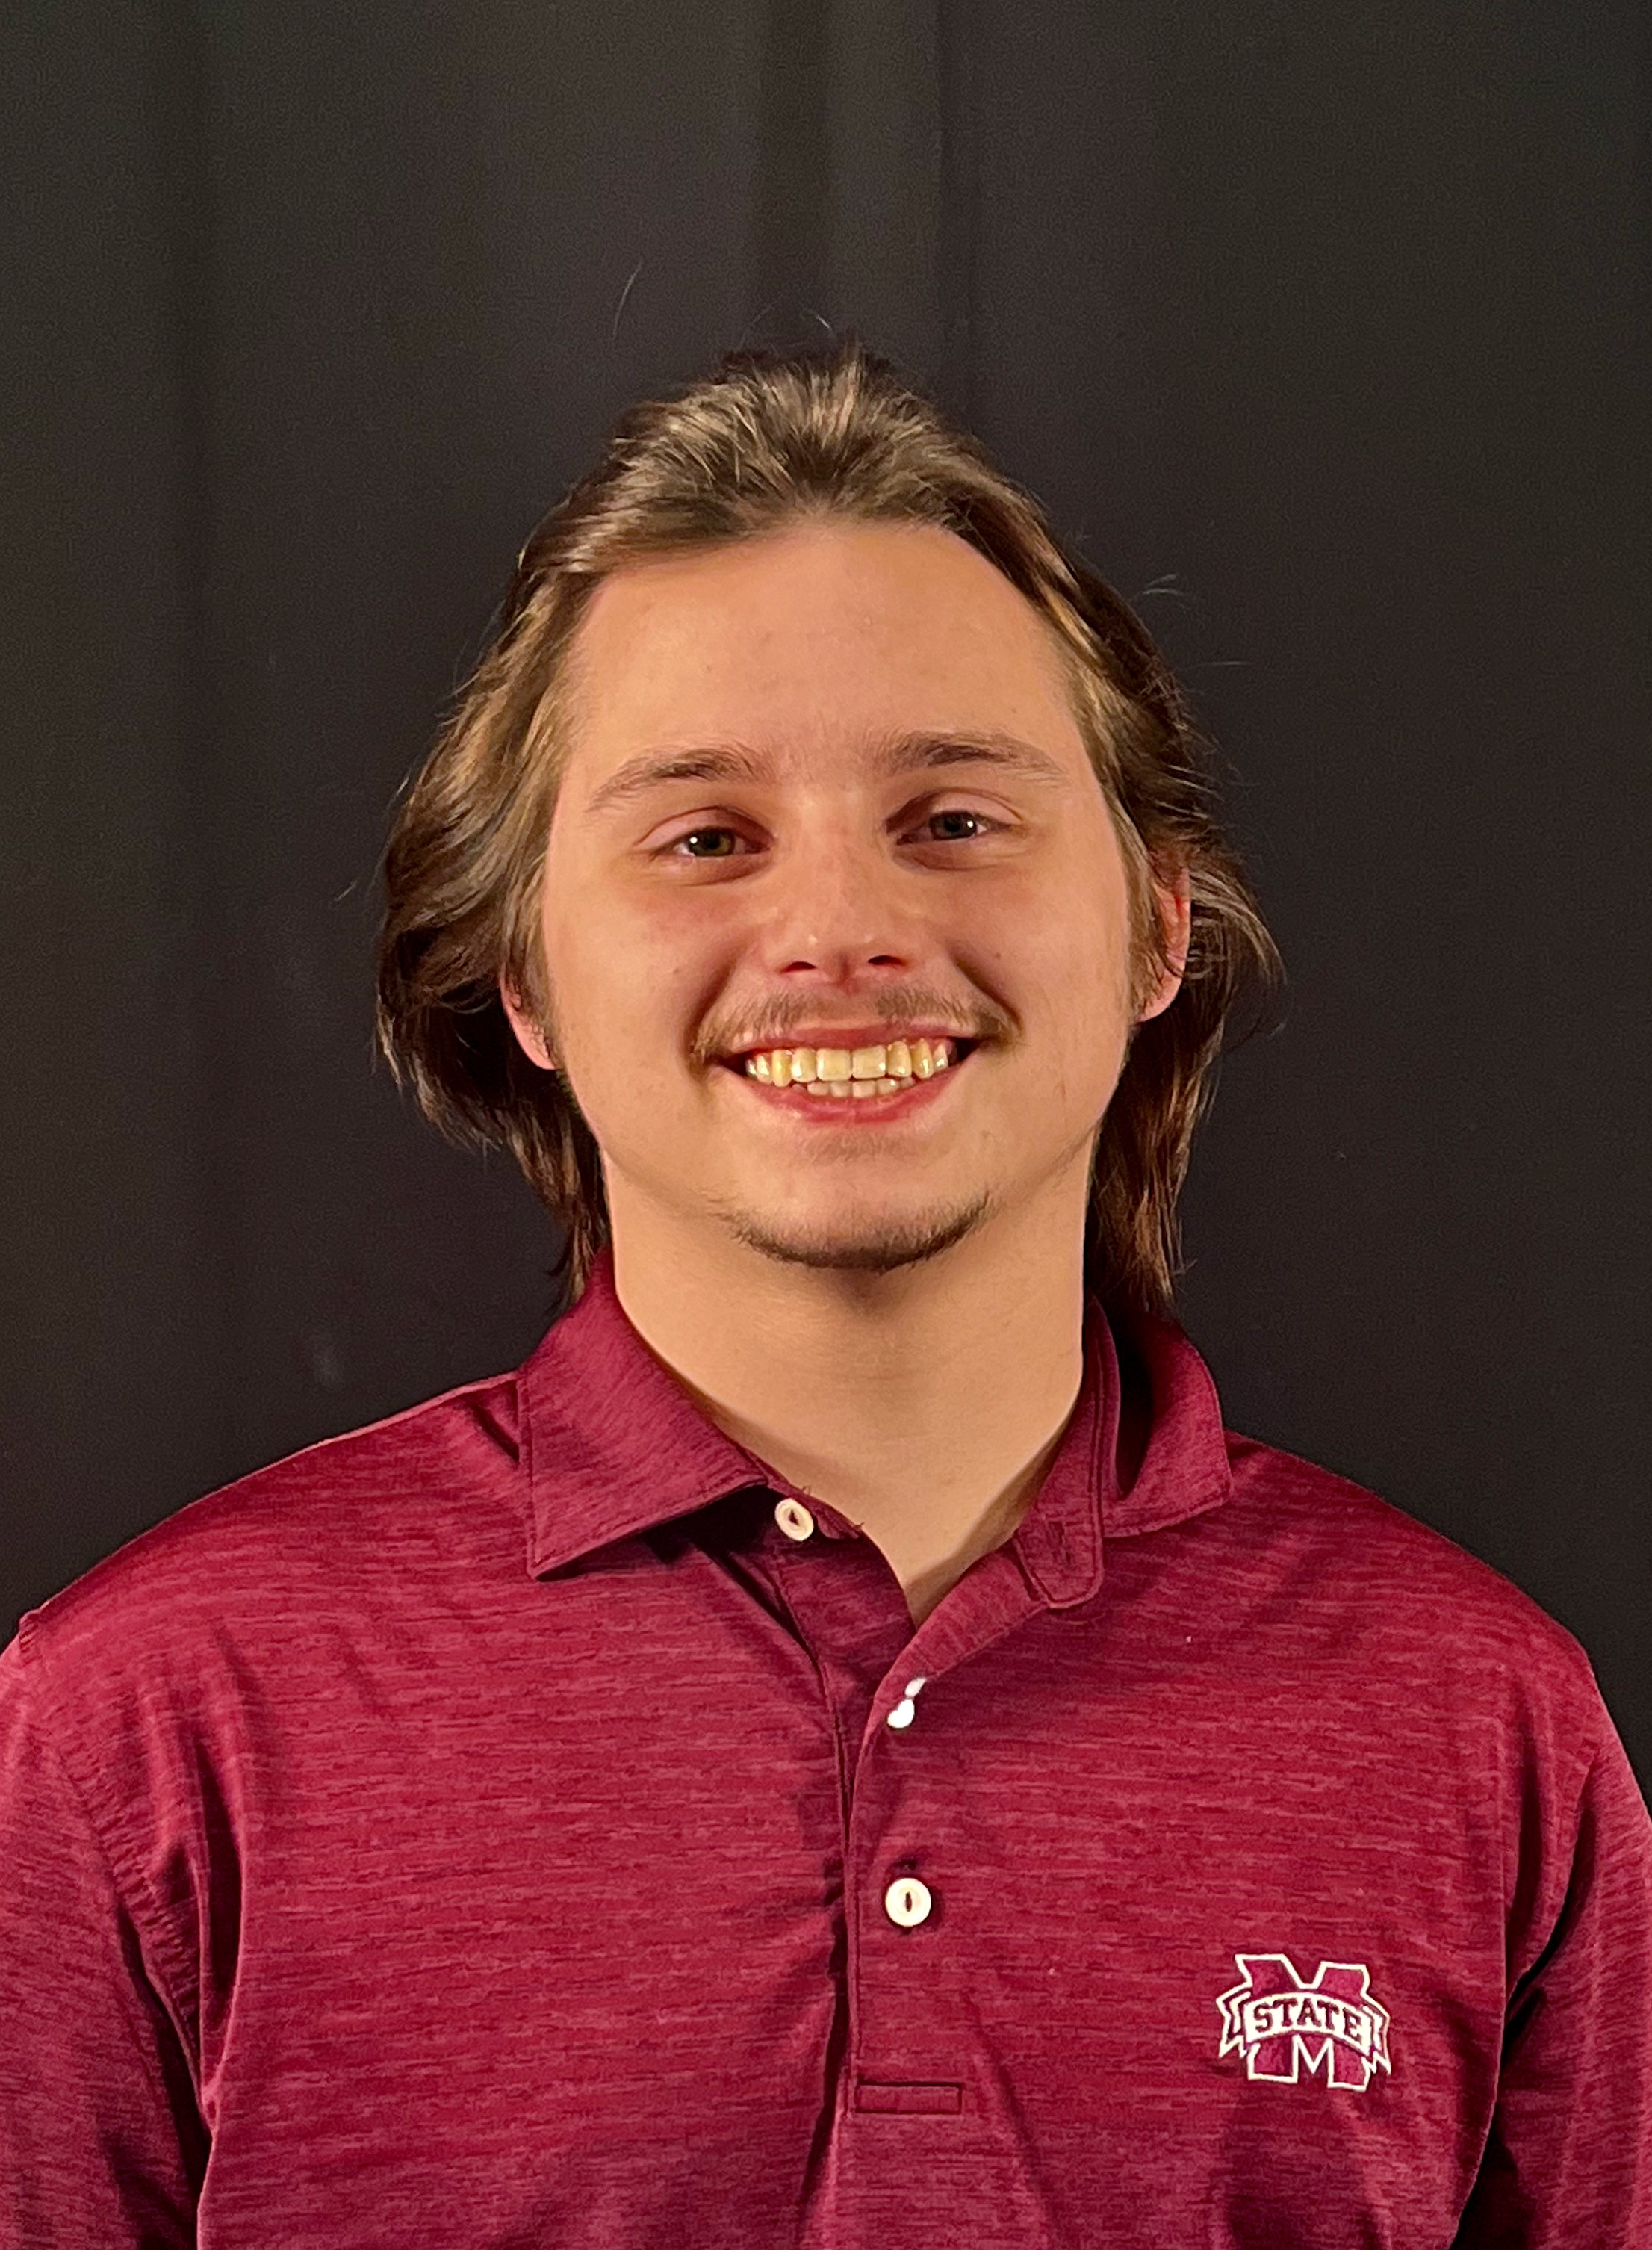
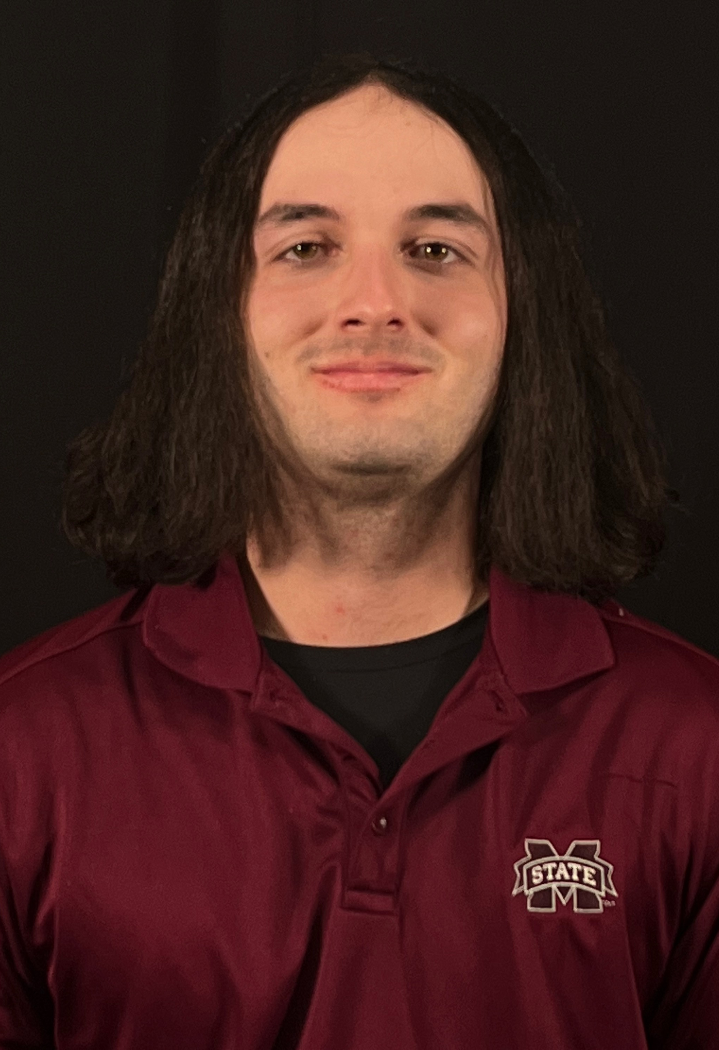
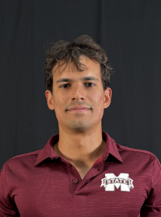
Introductions
Josh Brown
Senior (Astronautics)
Brookhaven, MS
Joshua Griffin
Senior (Astronautics)
Raleigh, NC
James Armstrong
Senior (Astronautics)
Brandon, MS
Patrick Madden
Senior (Astronautics)​
Manaus, Brasil
Notes:
JB

Slide 3
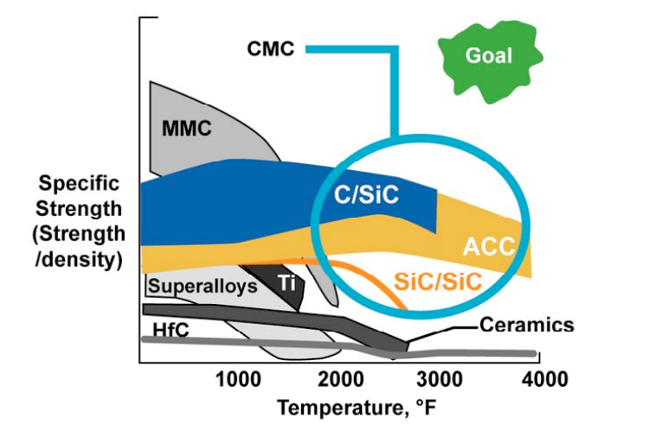
What is Carbon/Carbon?
Carbon Fiber/Carbon Matrix
Material Properties
High Specific Strength
High Thermal Stability
Low CTE
Applications
Leading Edge of Space Shuttle
High Performance Brakes
Rocket Motor Nozzle Throats
Nuclear Fusion
D. E. Glass, "Ceramic Matrix Composite (CMC) Thermal Protection Systems (TPS) and Hot Structures for Hypersonic Vehicles," 15th AIAA Space Planes and Hypersonic Systems and Technologies Conference, Dayton, OH, Apr. 28–May 1, 2008, AIAA-2008-2682.

Slide 4
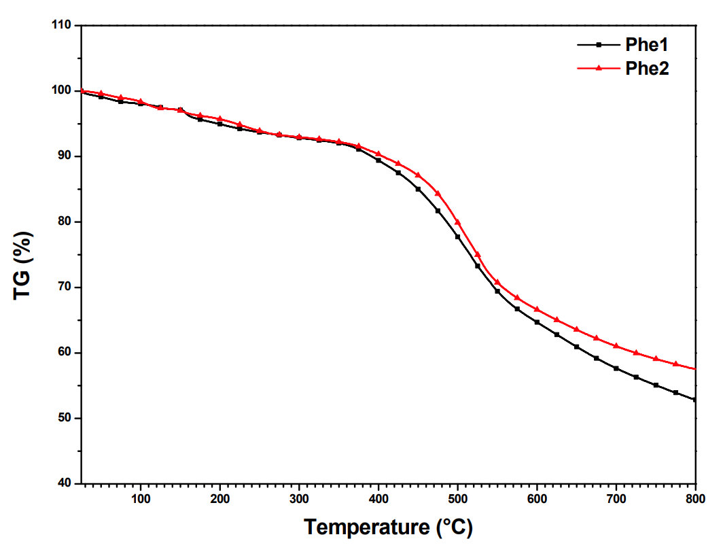
Carbon Matrices Are Expensive...
Phenolic Resin TGA
Carbon/Carbon (C/C) manufacturing
Long Manufacturing Time
Decades Old Precursor Technology
Manufacturing Methods
Chemical Vapor Deposition
Mesophase Pitch
Synthetic Precursor Resin
Precursor resins have the greatest room for improvement
~60%
~53%
Di Gregorio, Luca; Ronchetti, Silvia; Onida, Barbara (2015).

Slide 5
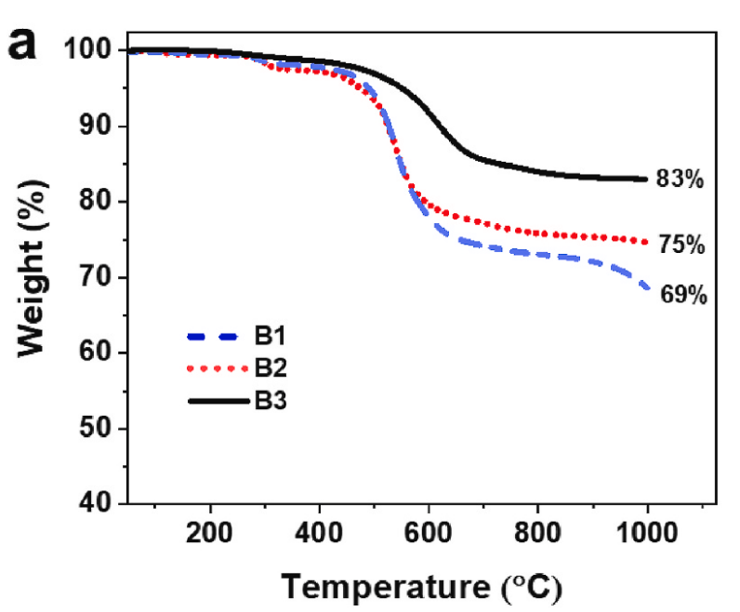
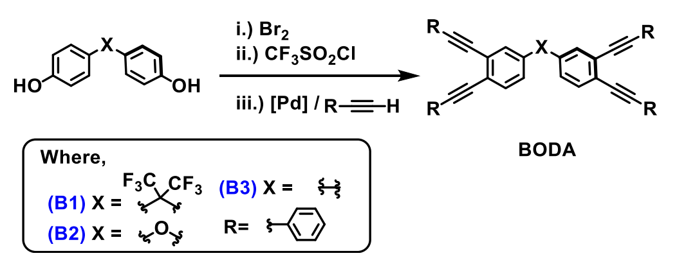
Bis - ortho – diynylarene (BODA)
BODA-derived resins (BDR) have high char yield and high oxidative stability as a polymer
Properties allow for one-step infusion and carbonization greatly reducing processing time for a finished C/C part.
BODA-Resin
TGA​
10°C/min under Ar flow
Borrego et. Al (2022)
Notes:
BODA-Derived Resin (BDR), an emerging carbon precursor has high char yield (show TGA) and high oxidative stability as a polymer (DSC) and doesn't blow off under fast temp ramp rates.
These properties allow for one-step infusion and carbonization greatly reducing processing time for a finished carbon/carbon part.

Slide 6
Composite manufacturing w/BODA
BDR has limited composite manufacturing (TRL 4-5).
Create a process for compression molding BDR C/C parts
Get hands-on composite manufacturing experience

Slide 7
Overview
"One-step powder-melt infusion and compression molding"
Mold (designed for ASTM D3039 coupons and fabricated)
Fiber and Resin Layup
Cure schedule
Co-developed by chemists, iteratively improved by and for ASE students and instrument capability
Demolding
Processing
Carbonization

Slide 8
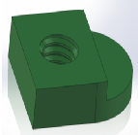
Mold Design
Mold Design Features:
Draft angle
Male and female mold
Thermocouple port
Access pieces

Slide 9
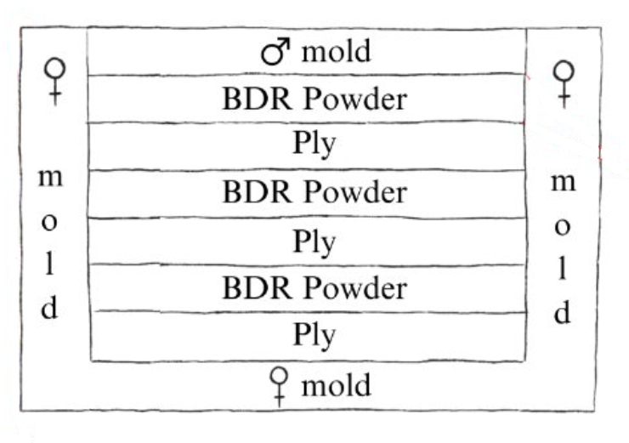
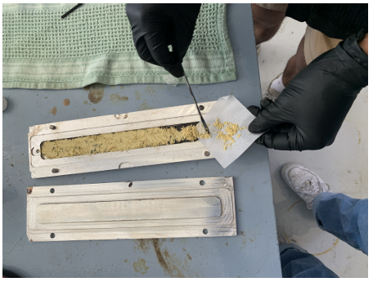
Mold Prep and Fiber/Resin Layup
Mold prepped with 5 layers of Loctite Frekote 900-NC
Notes:
Highlight melting into fibers. (low amount of lamina, vacuum bagging rendered superfluous)

Slide 10
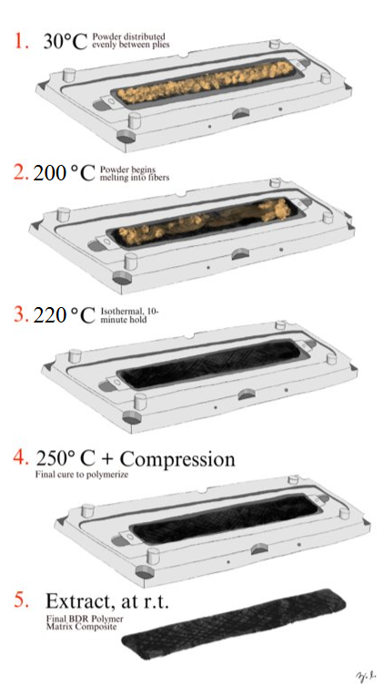
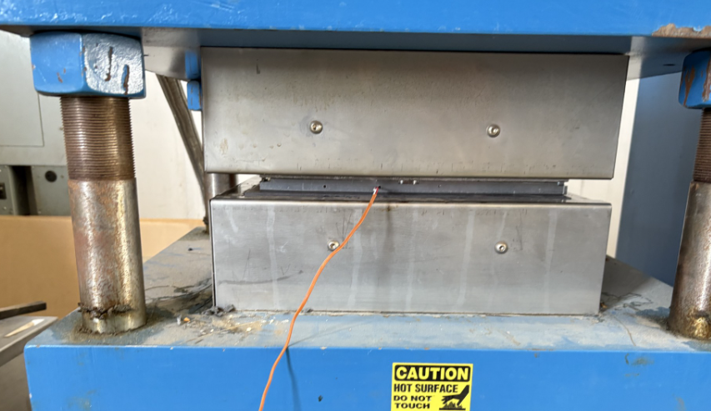
Curing for Thermoset
Heat Press
Mold
To thermocouple

Slide 11
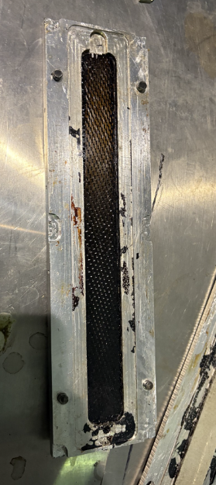
Demolding and Carbonization
Coupon pried from mold
Cut to size
Carbonized at 1000°C
in a tube furnace

Slide 12
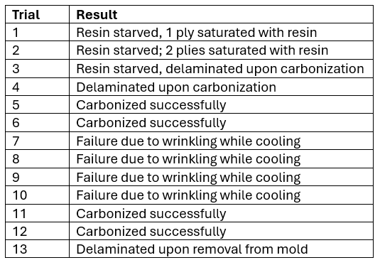
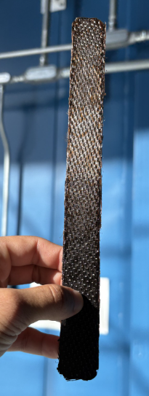
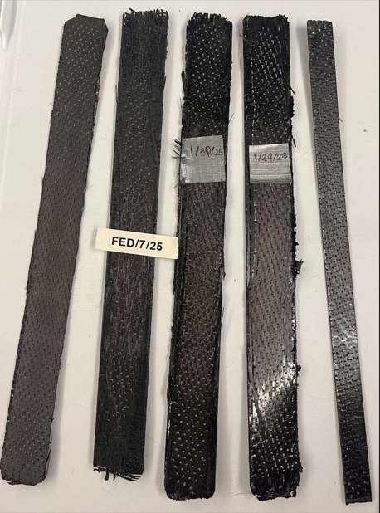
Results

Slide 13
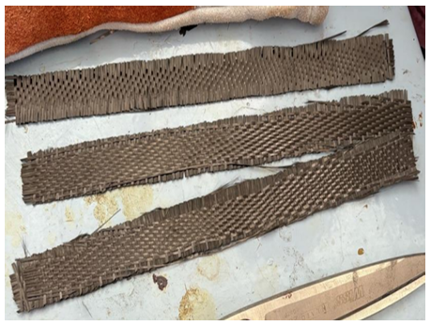
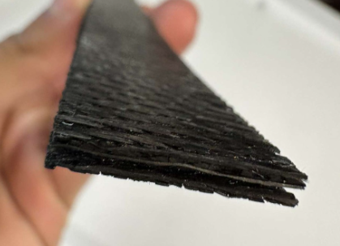
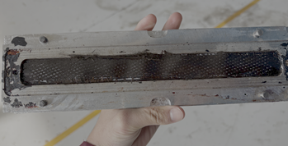
Challenges
Demolding CTE Mismatch Buckling
Resin starvation
Delamination

Slide 14
Conclusions
Novel Undergrad Student-Led C/C Composite Manufacturing Process
Findings:
Machine-cut fiber layers
Evenly spread carbon precursor
Accurate temperature measurements within the mold
Demold part before cooled to room temperature
Fabricate large pieces
Fall-away mold design
Future Work
Scanning Electron Microscopy
Porosity testing
Tensile testing

Slide 15
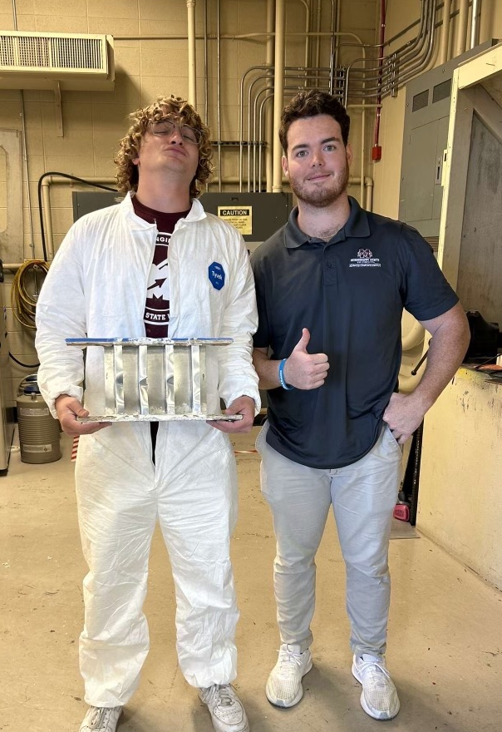
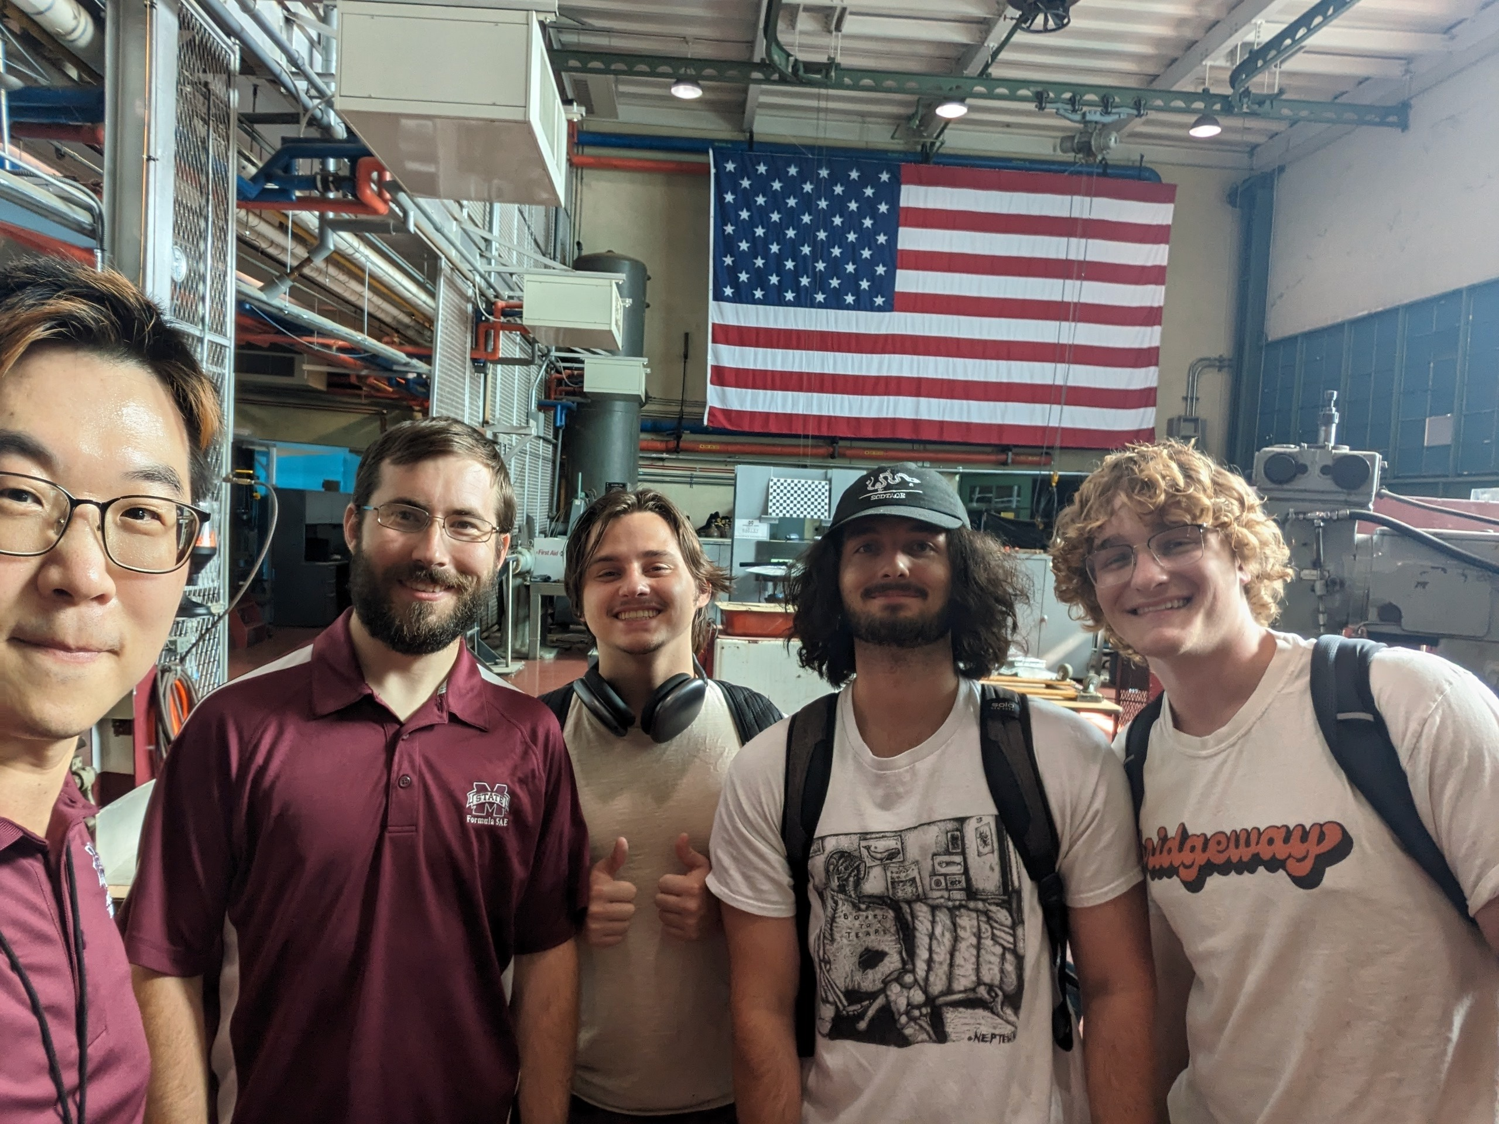
Acknowledgments
Ernesto Borrego Ph.D., Hand Technologies LLC
Han-Gyu Kim, Ph.D., Mississippi State University
Alejandro Martinez, Mississippi State University
Matthew Roberson, Advanced Composites Institute
Brandon Warner, Mississippi State University

Slide 16
References
[1] Agarwal, N., Rangamani, A., Bhavsar, K., Virnodkar, S. S., Fernandes, A. A. A., Chadha, U., Srivastava, D., Patterson, A. E., & Rajasekharan, V. (2024). An overview of carbon-carbon composite materials and their applications. In Frontiers in Materials (Vol. 11). Frontiers Media SA. https://doi.org/10.3389/fmats.2024.1374034
[2] Borrego, E. I., Athukorale, S., Gorla, S., Duckworth, A. K., Baker, M., Rosales, J., Johnson, W. W., Kundu, S., Toghiani, H., Farajidizaji, B., Pittman, C. U., & Smith, D. W. (2022). High carbon yielding and melt processable bis-ortho-diynylarene (BODA)-derived resins for rapid processing of dense carbon/carbon composites. Composites Part B: Engineering, 242. https://doi.org/10.1016/j.compositesb.2022.110080
[3] Iacono, S. T., Perpall, M. W., Wapner, P. G., Hoffman, W. P., & Smith, D. W. (2007). Carbonization and thermal expansion of glassy carbon derived from bis-ortho-diynylarenes. Carbon, 45(5), 931–935. https://doi.org/10.1016/j.carbon.2007.01.002
[4] Natali, M., Kenny, J. M., & Torre, L. (2016). Science and technology of polymeric ablative materials for thermal protection systems and propulsion devices: A review. In Progress in Materials Science (Vol. 84, pp. 192–275). Elsevier Ltd. https://doi.org/10.1016/j.pmatsci.2016.08.003
[5] Ohlhorst, C. W., Glass, D. E., Bruce, W., Lindell, M., Vaughn, W. L., Smith, R., Dirling Jr, R. B., Kowbel, W., Vice President MER Corp, S., & J Sullivan, A. B. (n.d.). Cleared for Public Release DEVELOPMENT OF X-43A MACH 10 LEADING EDGES. Retrieved February 18, 2025, from https://ntrs.nasa.gov/api/citations/20050240163/downloads/20050240163.pdf
[6] Test Method for Tensile Properties of Polymer Matrix Composite Materials. (2014). ASTM International. https://doi.org/10.1520/D3039_D3039M-14
[7] Vasiliev, V. v., & Morozov, E. v. (2018). Introduction-Advanced Mechanics of Composite Materials. Advanced Mechanics of Composite Materials and Structures, xvii–xxv. https://doi.org/10.1016/B978-0-08-102209-2.00022-0
[8] Wu, H., & Koo, J. H. (2021). High-temperature polymers and their composites for extreme environments: a review. In AIAA SCITECH 2022 Forum. American Institute of Aeronautics and Astronautics. https://doi.org/doi:10.2514/6.2022-1606
[9] Di Gregorio, Luca; Ronchetti, Silvia; Onida, Barbara (2015). Phenolic resins emissions upon thermal degradation. In: EuroBrake 2015, Dresden Germany, 4-6 My 2015.

Slide 17
Questions?
Our website - https://seniorseminar25.github.io/

