Slide 1




On the Multipole Vortex (MpV) Motion in a Circular-Port Hybrid
Rocket Engine
Mitchell E. Sisk
Graduate Research Assistant
Advisor: Dr. Joe Majdalani
AIAA Student Conference 2025
High Point Marriott Airport, Greensboro, NC
April 3, 2025

Slide 2
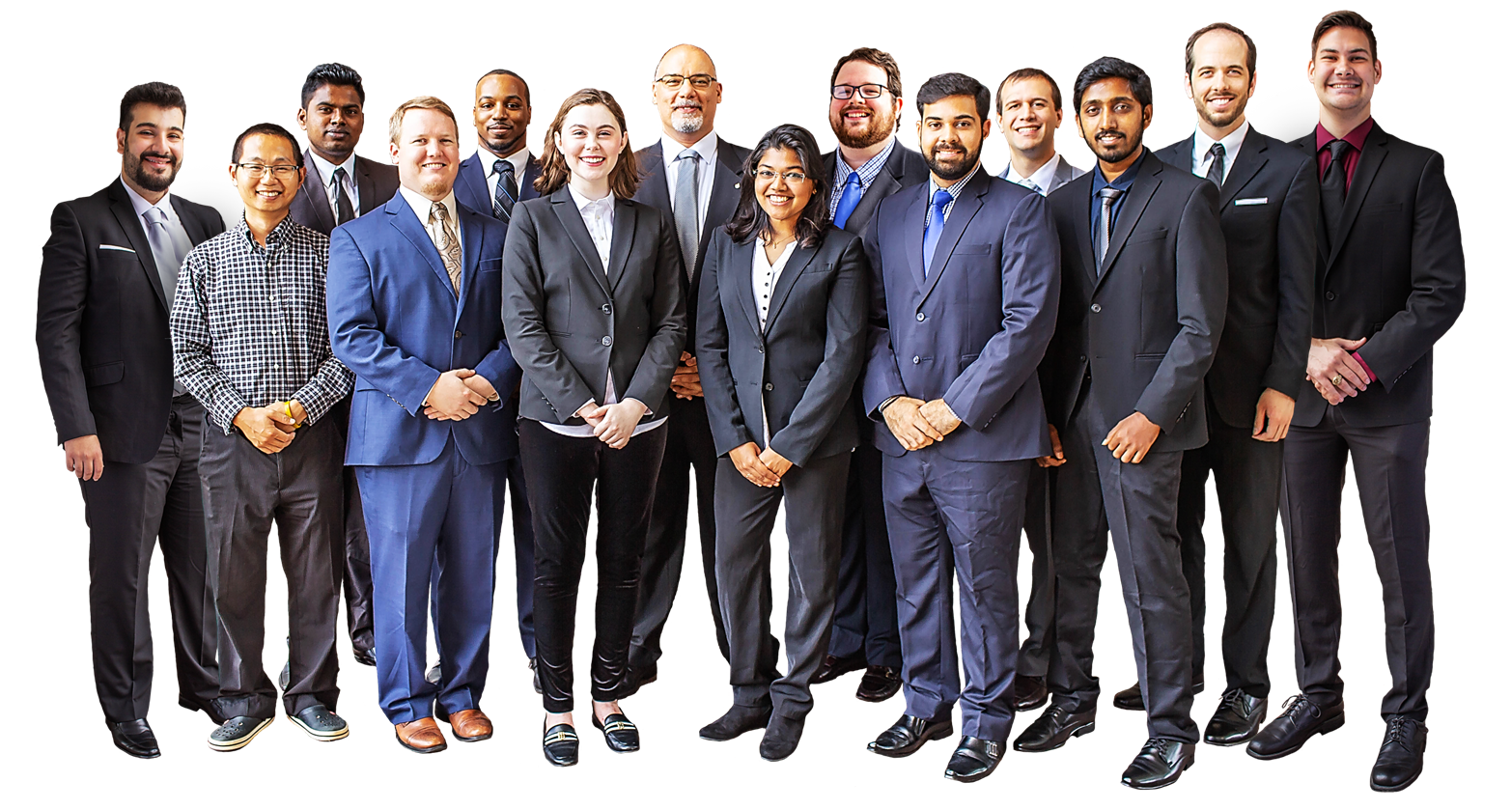
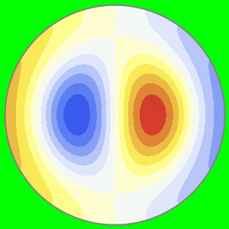
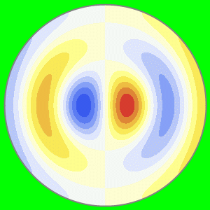
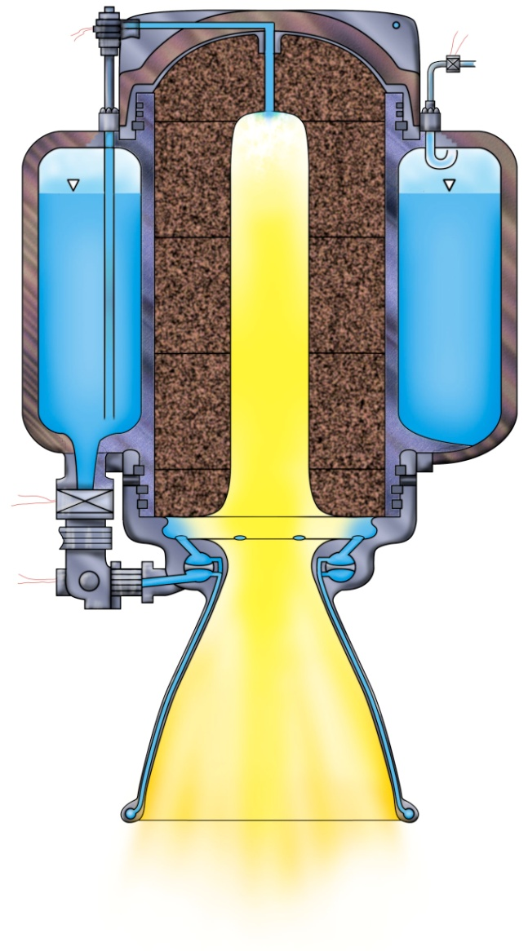
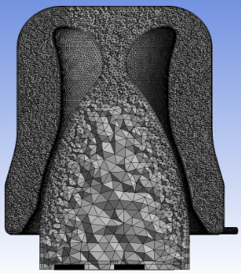
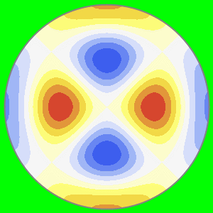
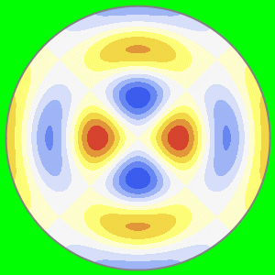
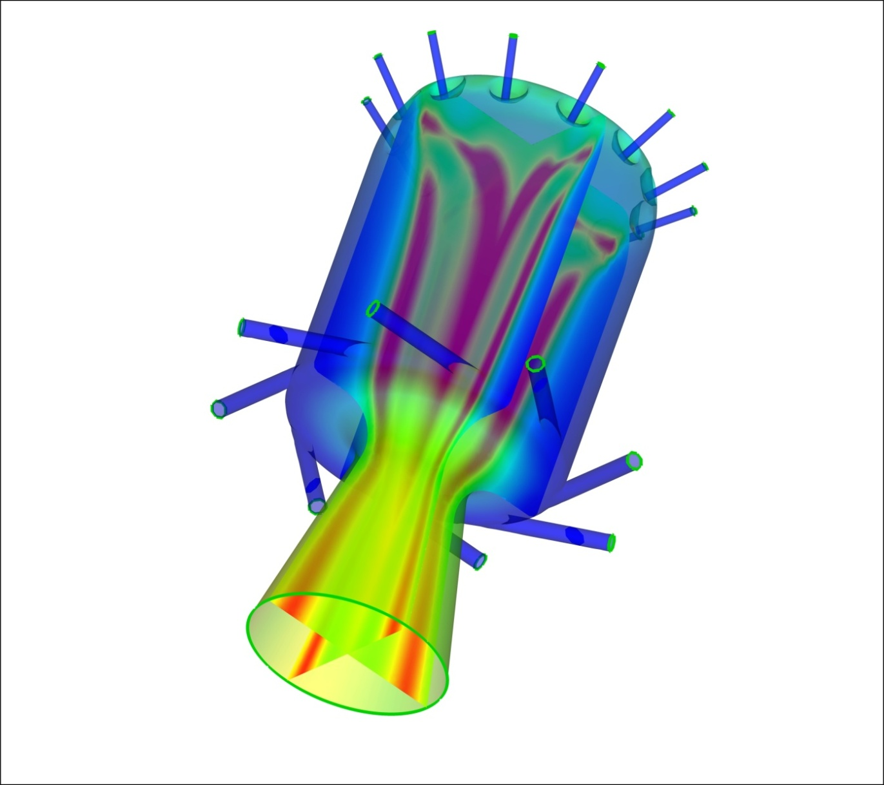
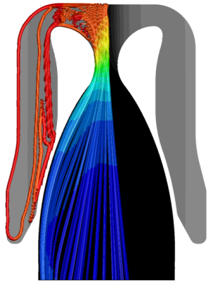
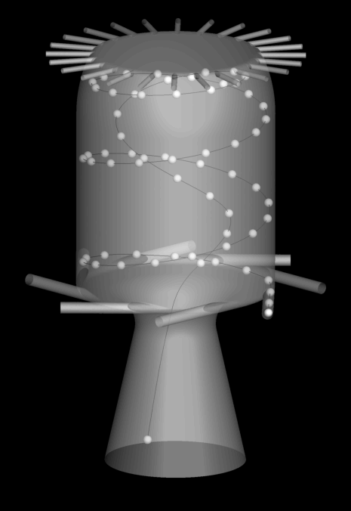
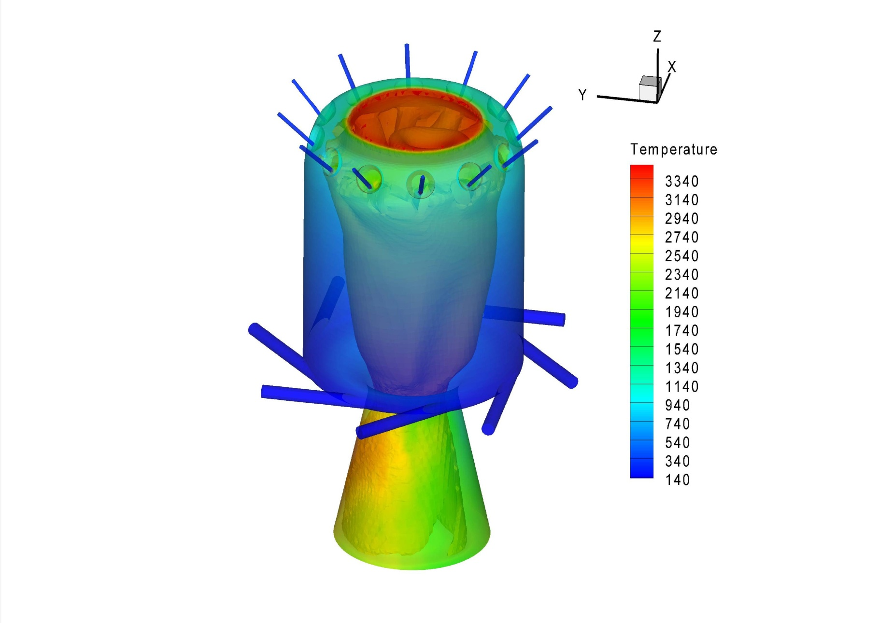
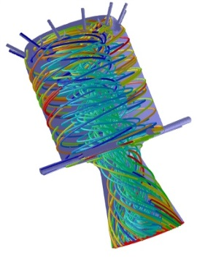
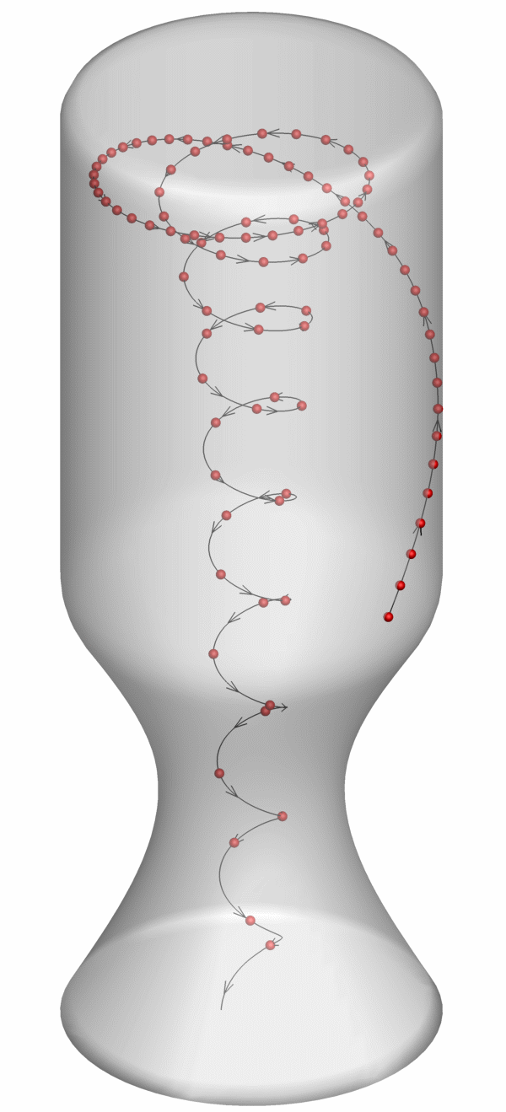
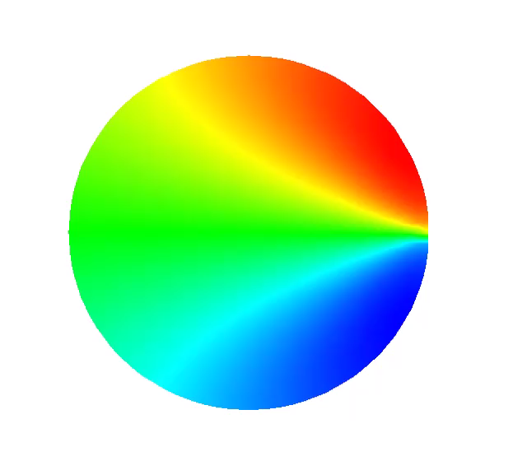
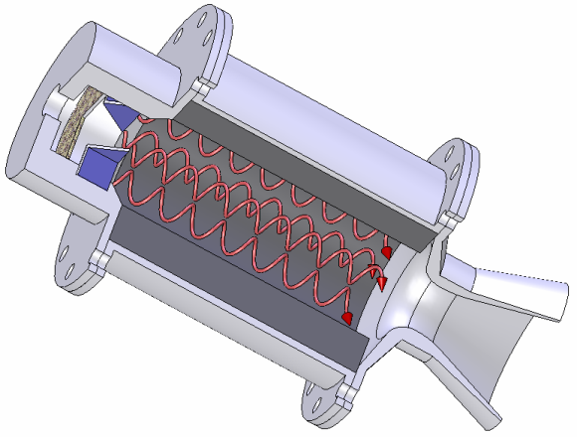
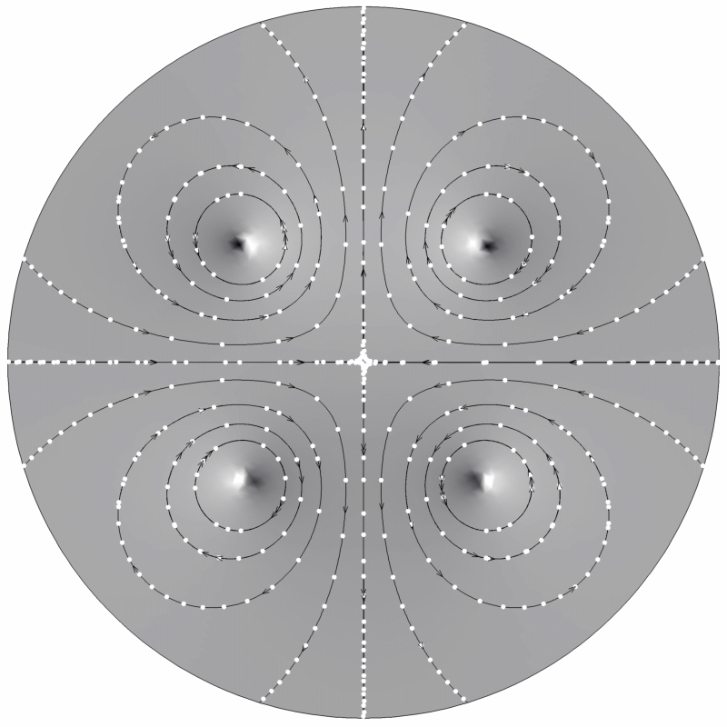
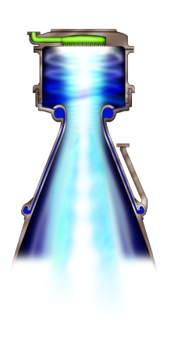
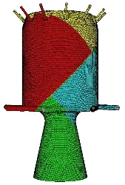
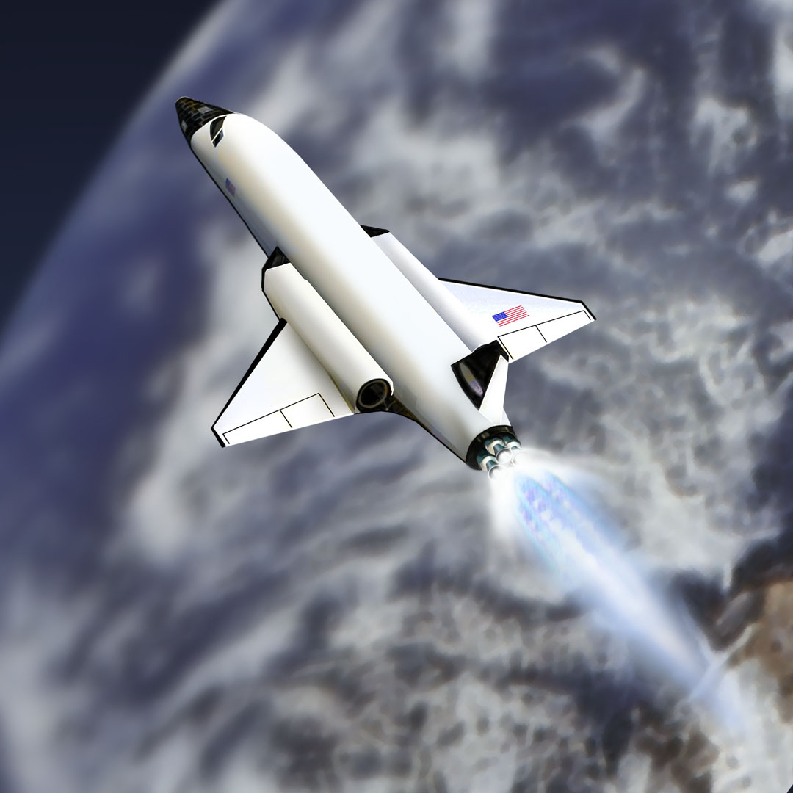
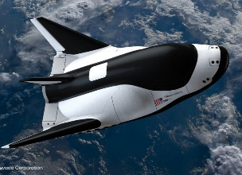
Our Team
Improve the performance and stability of advanced rocket engines, especially those that are swirl driven
Notes:
Talk about the lab
A cross-section of focus areas of research.
Make concise

Slide 3
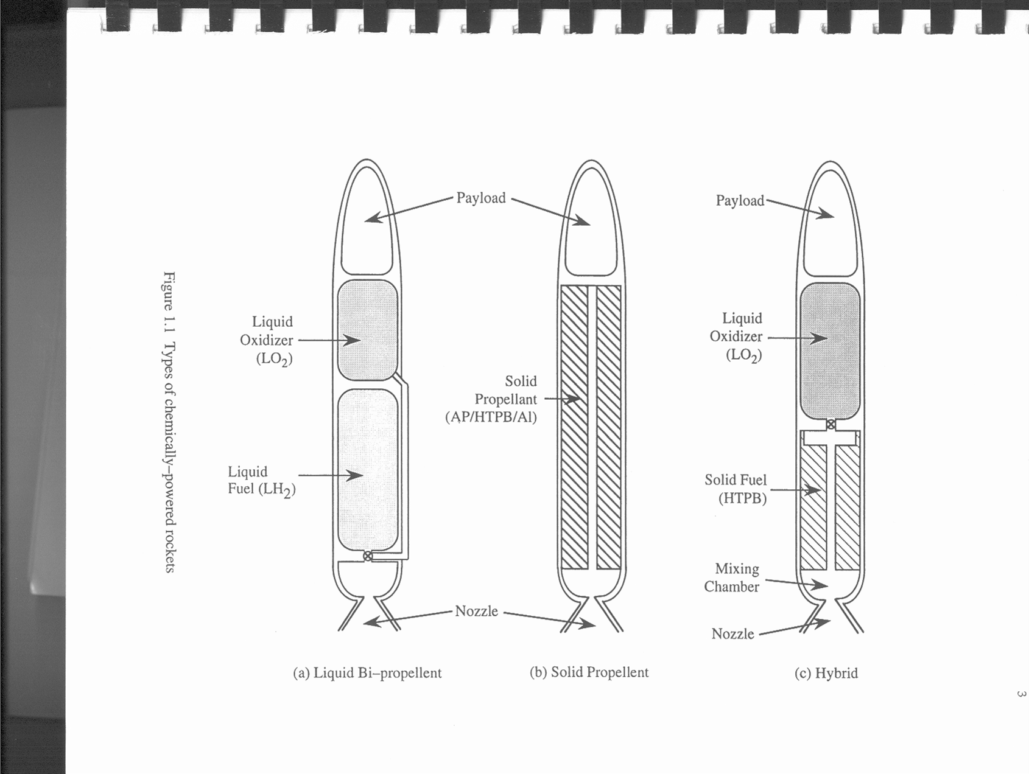
Overview of Rocket Engines Types
Liquid
Solid
Hybrid
Notes:
Vigorous premixed flame

Slide 4
Advantages of Hybrid Rocket Engines
Simpler and cheaper than many liquid systems
Safety benefits due to non-reactive storage
Throttling and restart capabilities
Applications in research, STEM, and interplanetary missions
Higher specific impulse than solids
Ease in manufacturing

Slide 5
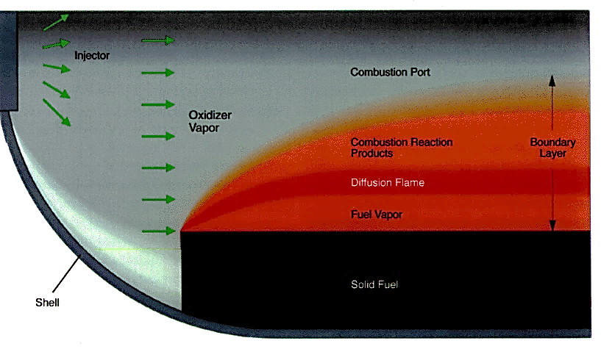
Limitations of Traditional Hybrid Rockets
Diffusion-limited combustion issues
  Low combustion efficiency
  Slow fuel regression rate
  Reduced volumetric propellant loading
  Susceptibility to combustion instabilities
  Slow diffusion driven flame
Notes:
Achilles Heel
Diffusion balance Oxidizer diffusion balance
Solids - > fuel and oxidizer together, premixed
Liquids -> injector mixes
Hybrid -> Inert Similar to a candle Diffusion limited flame -> not large regression rates -> low Mass Flux

Slide 6
Limitations of Traditional Hybrid Rockets
Diffusion-limited combustion issues
  Low combustion efficiency
  Slow fuel regression rate
  Reduced volumetric propellant loading
  Susceptibility to combustion instabilities
  Slow diffusion driven flame
Challenges of multi-port grain designs
  Increased residual slivers
  Reduced Propellant Volume

Slide 7
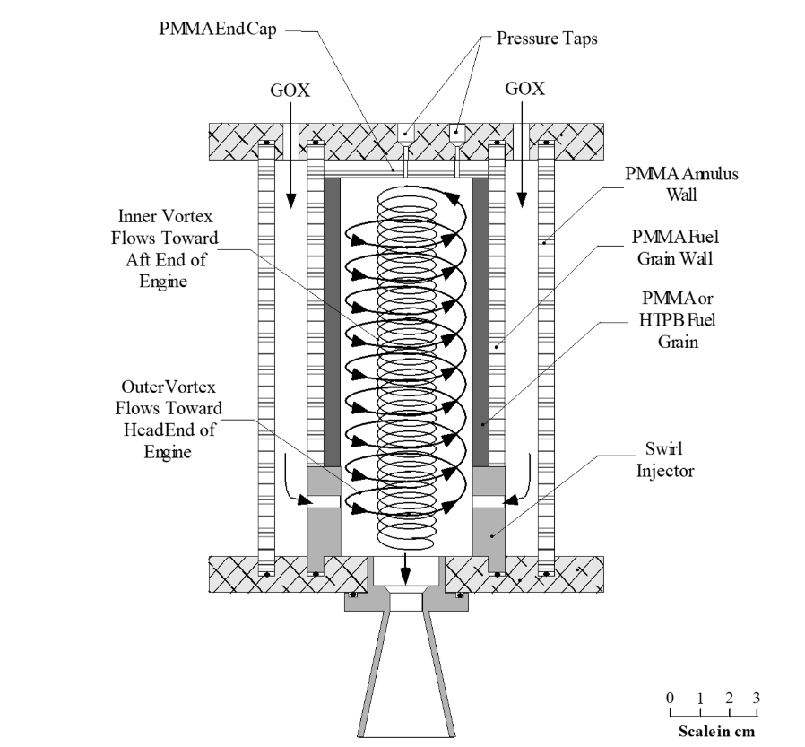
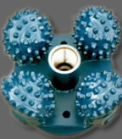
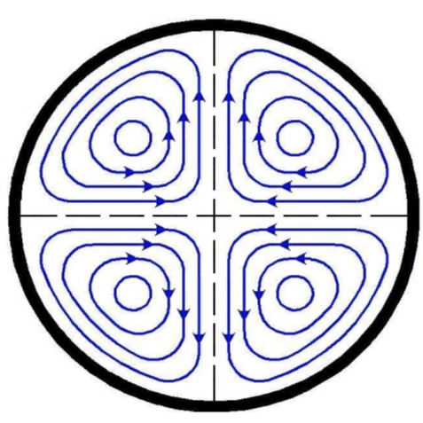
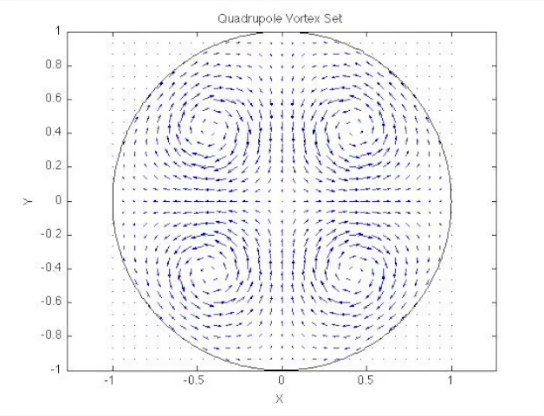
Innovations in Hybrid Rocket Technology
Paraffin-based liquifying fuels for improved burning rates (SPG at Stanford)
Nanometals (Aluminum, Boron, Crystalized Ox) and other energetic fuels
Tangential Swirl Injection
  Vortex Injection Hybrid Rocket Engine (VIHRE)
    Enhances fuel regression through cyclonic swirling
    Achieves up to 7x higher regression rates
    Issues with centrifugal forces forming cool gas layers
  Multipole Vortex (MpV) Hybrid Rocket Engine
Notes:
Add a figure

Slide 8
Vortex Injection Hybrid Rocket Engine (VIHRE)
Knuth, W. H., Bemowski, P. A., Gramer, D. J., Majdalani, J., and Rothbauer, W. J. (1996), “Gas-Fed, Vortex Injection Hybrid Rocket Engine,” NASA Marshall Space Flight Center, SBIR Phase I Final Technical Rept. NASA/MSFC Contract NAS8-40679, Huntsville, AL.

Slide 9
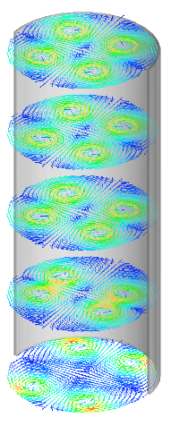
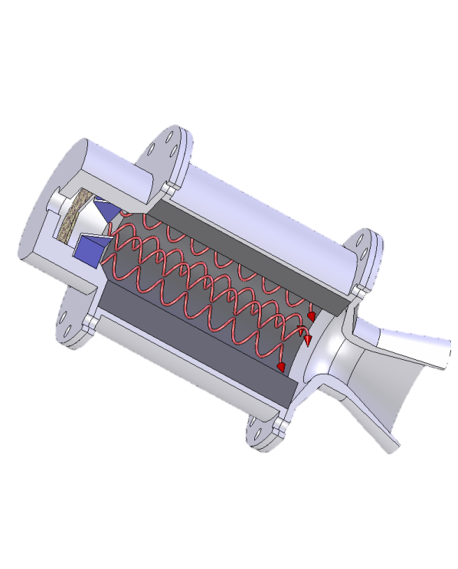
Multipole Vortex (MpV) Hybrid Rocket Engine
Generation of multiple swirling vortex pairs
Thermal uniformity improvements over VIHRE
Improved combustion stability
Increased flame temperature and combustion efficiency
Substantial improvement in regression rates
Notes:
Mathematical model
Don’t just have figures or words

Slide 10
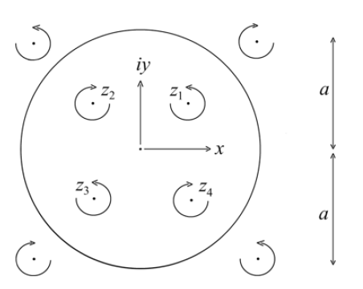




Milne-Thomson Circle Theorem
Complex Potential Function
$$f\left(z\right)=ik ln\left(z−z_{n}\right)$$
$$k=\frac{1}{2}r_{R}^{2}ω=\frac{1}{2π}Γ$$
Vortex Strength
$$F\left(z\right)=f\left(z\right)+\overline{f}\left(\frac{a^{2}}{z}\right)$$
Complex Potential of a Cylinder
$$\frac{dF}{dz}=−u_{x}+{iu}_{y}$$
Bulk Flow Velocity
$$f\left(z\right)=\sum_{j=1}^{n}{ik_{n} ln\left(z−z_{j}\right)}$$
Mult vortex Complex Potential Function
Multi vortex Potential function of a Cylinder

Slide 11

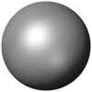
Bounded Complex Potential Function
By applying the Circle Theorem to the quadrupole vortex set, we arrive at the following expression for n = 4
$$F(z)=ik_{1}\ln\left(z−z_{1}\right)−ik_{1}\ln\left(z−\frac{a^{2}}{{\bar{z}}_{1}}\right)+ik_{2}\ln\left(z−z_{2}\right)−ik_{2}\ln\left(z−\frac{a^{2}}{{\bar{z}}_{2}}\right)$$
$$+ik_{3}\ln\left(z−z_{3}\right)−ik_{3}\ln\left(z−\frac{a^{2}}{{\bar{z}}_{3}}\right)+ik_{4}\ln\left(z−z_{4}\right)−ik_{4}\ln\left(z−\frac{a^{2}}{{\bar{z}}_{4}}\right)$$

Slide 12
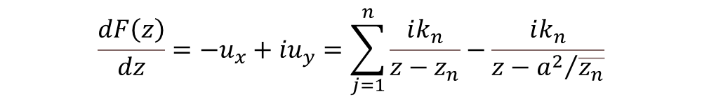
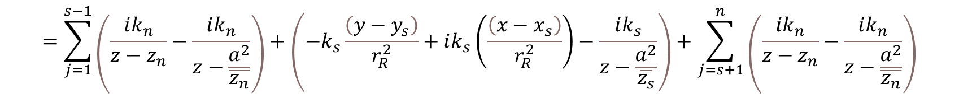
Velocity Components
$$\frac{dF\left(z\right)}{dz}=−u_{x}+{iu}_{y}=\sum_{j=1}^{n}{\frac{ik_{n}}{z−z_{n}}−\frac{ik_{n}}{z−{a^{2}}/{\overline{z_{n}}}}}$$
$$=\sum_{j=1}^{s−1}{\left(\frac{ik_{n}}{z−z_{n}}−\frac{ik_{n}}{z−\frac{a^{2}}{\overline{z_{n}}}}\right)}+\left(−k_{s}\frac{\left(y−y_{s}\right)}{r_{R}^{2}}+ik_{s}\left(\frac{\left(x−x_{s}\right)}{r_{R}^{2}}\right)−\frac{ik_{s}}{z−\frac{a^{2}}{\overline{z_{s}}}}\right)+\sum_{j=s+1}^{n}{\left(\frac{ik_{n}}{z−z_{n}}−\frac{ik_{n}}{z−\frac{a^{2}}{\overline{z_{n}}}}\right)}$$
Notes:
Too empty

Slide 13
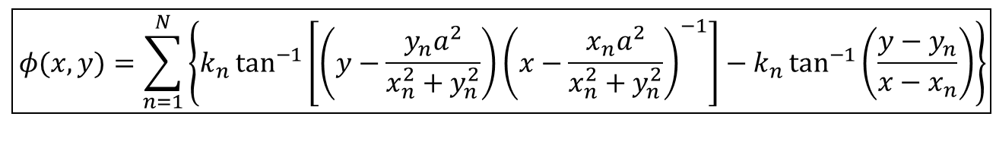
Velocity Components
For programming purposes, this result is sufficient
To extract an exact analytical solution, we must separate the real and imaginary parts
  Writing the complex variables in modulus-amplitude form allows for the identification of the real part, which is the potential function
$−u_{x}+iu_{y}=\frac{ik_{1}}{z−z_{1}}−\frac{ik_{1}}{z−\frac{a^{2}}{{\bar{z}}_{1}}}+\frac{ik_{2}}{z−z_{2}}−\frac{ik_{2}}{z−\frac{a^{2}}{{\bar{z}}_{2}}}+\frac{ik_{3}}{z−z_{3}}−\frac{ik_{3}}{z−\frac{a^{2}}{{\bar{z}}_{3}}}+\frac{ik_{4}}{z−z_{4}}−\frac{ik_{4}}{z−\frac{a^{2}}{{\bar{z}}_{4}}}$ $+$…
$$\boxed{φ(x,y)=\sum_{n=1}^{N}{\left\{k_{n}\tan^{−1}\left[\left(y−\frac{y_{n}a^{2}}{x_{n}^{2}+y_{n}^{2}}\right){\left(x−\frac{x_{n}a^{2}}{x_{n}^{2}+y_{n}^{2}}\right)}^{−1}\right]−k_{n}\tan^{−1}\left(\frac{y−y_{n}}{x−x_{n}}\right)\right\}}}$$
Notes:
Obtain formulation for an arbitrary

Slide 14
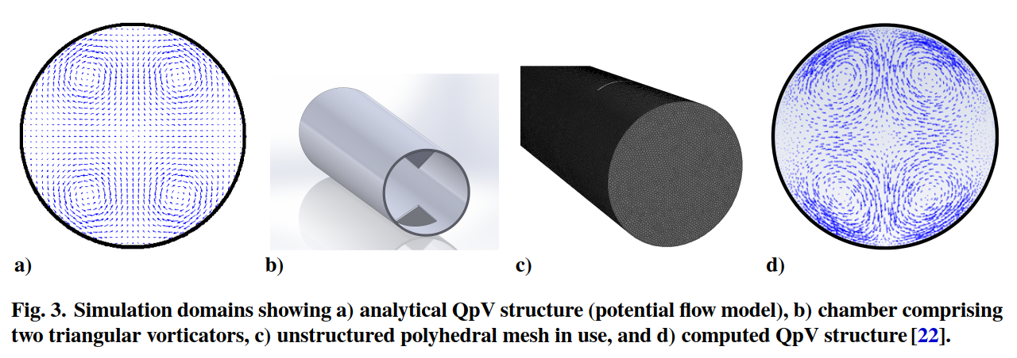
CFD vs. Analytical Solutions
Notes:
How did we do?
Use CFD to verify the potential theory programed into matlab
Have Consistent title fonts

Slide 15
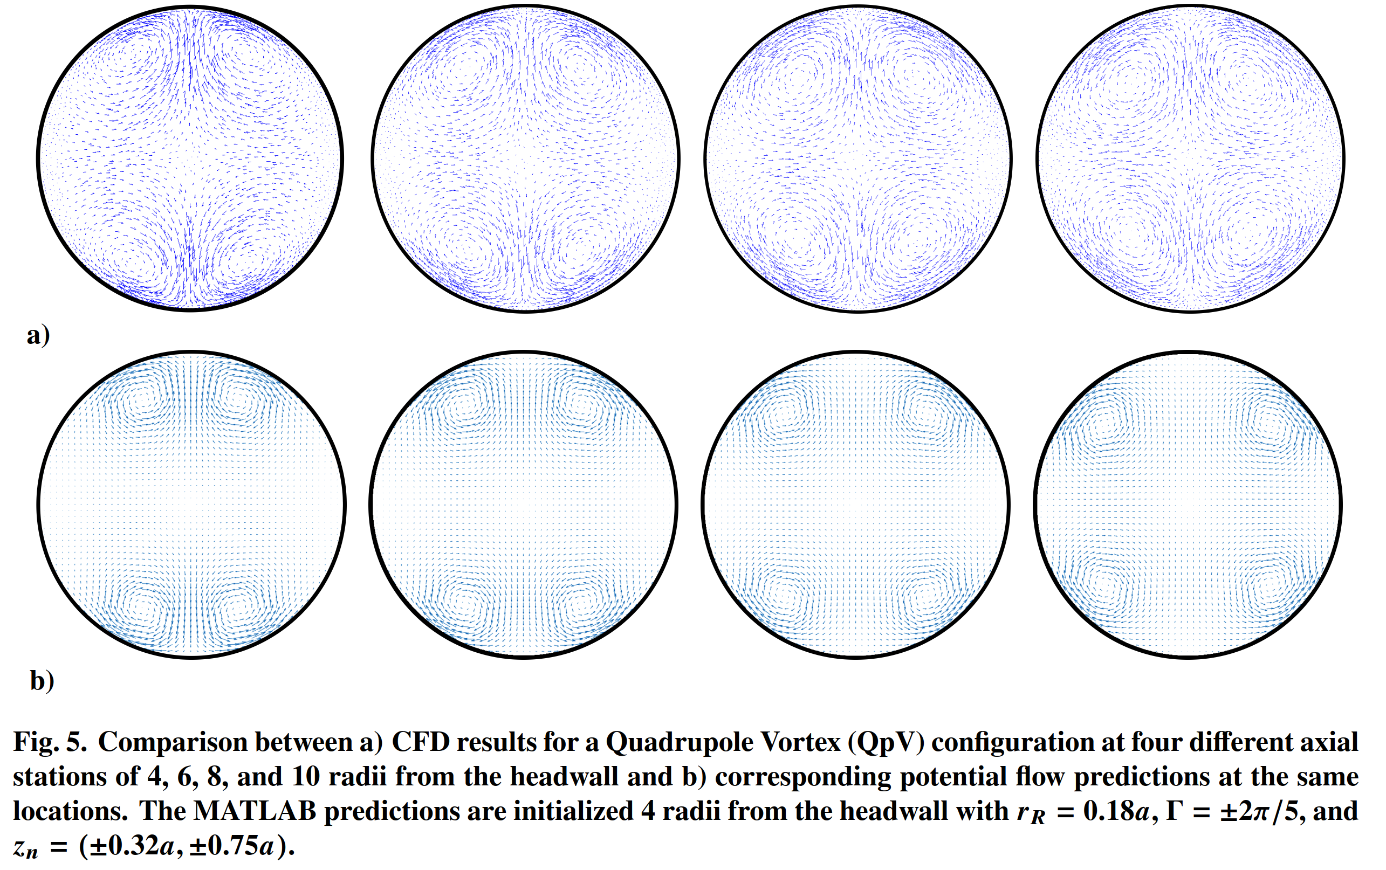
CFD vs. Analytical Solutions (Quadrupoles)
Notes:
N = 4

Slide 16
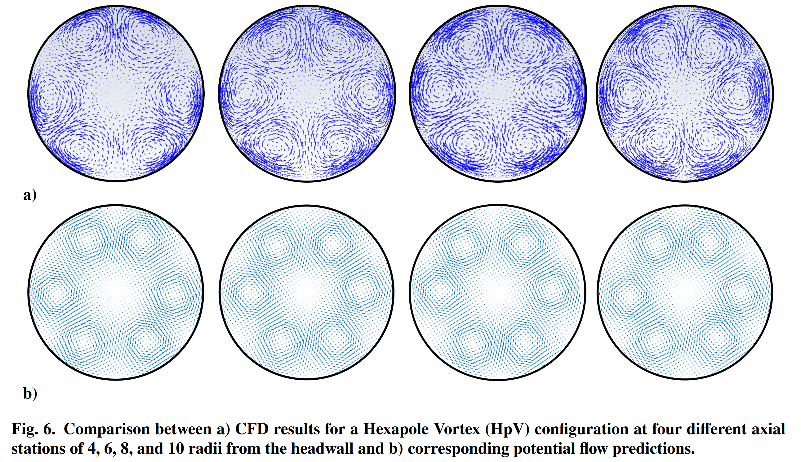
CFD vs. Analytical Solutions - Hexapoles
Notes:
N = 6

Slide 17
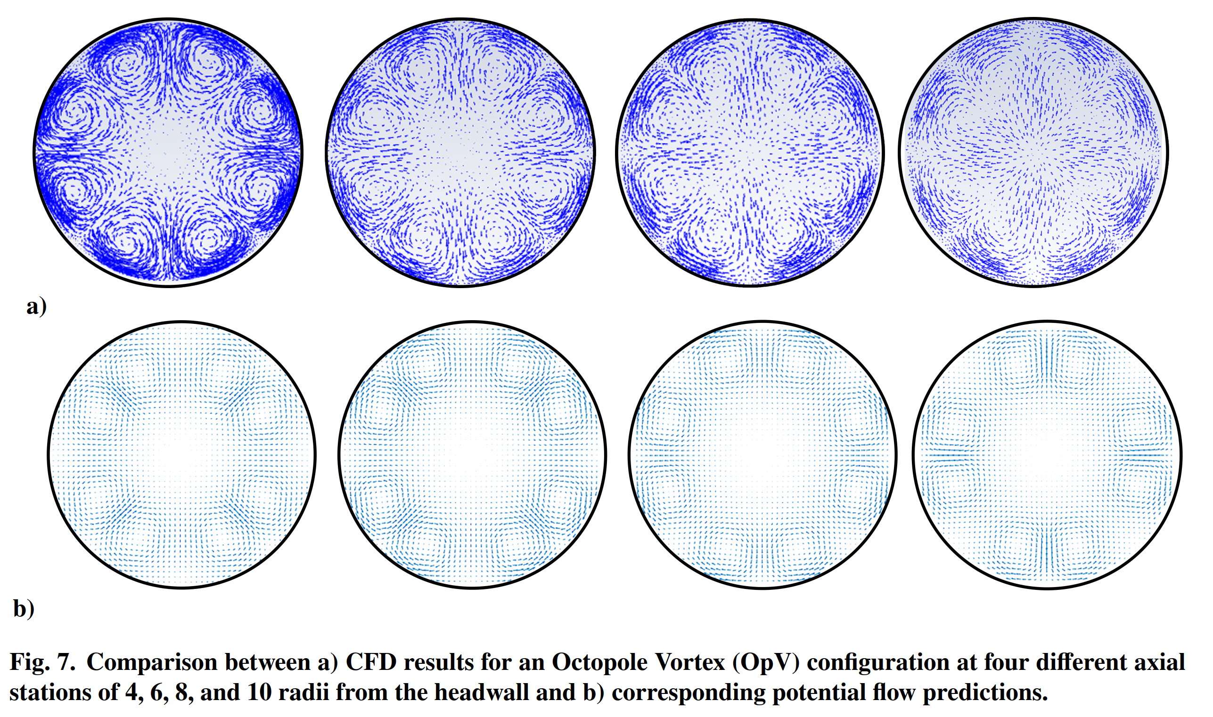
CFD vs. Analytical Solutions - Octupoles
Notes:
N = 8

Slide 18
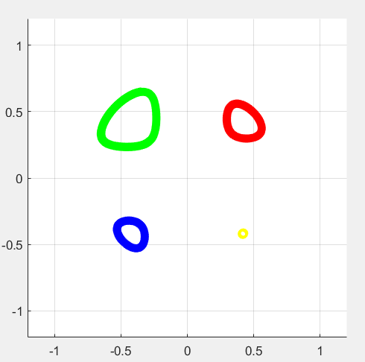


Quadrupole Equilibrium Points
With increasing vortices, the Equilibrium points become closer to the wall
$\frac{dF\left(z\right)}{dz}=$ 0
x₂ = –0.2828
y₂ = 0.2828
x₁ = 0.5
y₁ = 0.5
$$Λ^{4}−8Λ^{2}−Λ=0$$
x₃ = –0.3536
y₃ = –0.3536
x₄ = 0.4243
y₄ = –0.4243
Figure 1. Movement path of the vortices with respect to initial positions of vortices
($k_{1}=1, ω_{1}=50 , r_{R}=0.2$)
Main Equilibrium Point (0.419, 0.419)

Slide 19
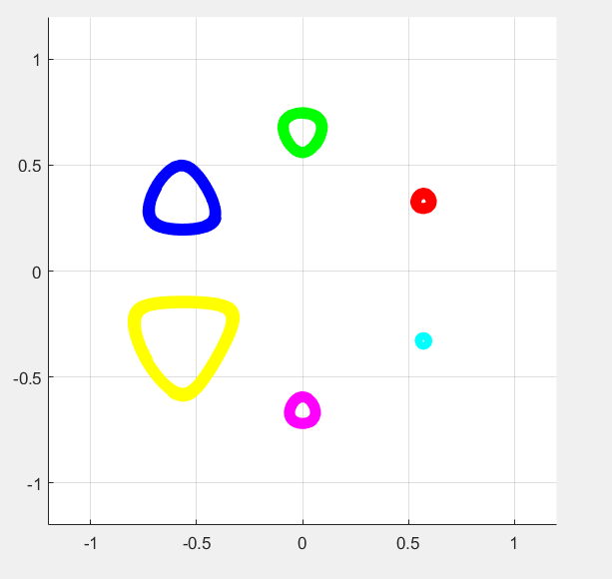

Hexapole Equilibrium Points
x₂=0.64
y₂=0.375
x₃=-0.685
y₃=0.4
x₁=0.6
y₁=0.35
$$0=Λ^{6}−12Λ^{2}−Λ$$
x₄=-0.728
y₄=-0.425
x₆=0.5571
y₆=-0.325
x₅=0.5143
y₅=-0.3
Path of vortex centers for chosen distances from tube center. Keep in mind that equilibrium position is x₁ = 0.57 y₁ = 0.33

Slide 20
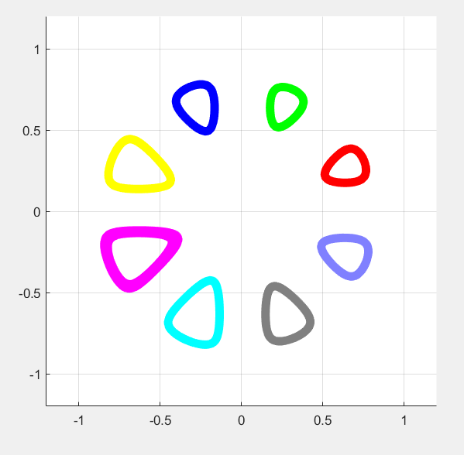

Octapole Equilibrium Points
x₂=0.685
y₂=0.4
x₁=0.64
y₁=0.375
x₃=0.728
y₃=0.425
x₈=0.6
y₈=0.35
$$0=Λ^{8}−16Λ^{2}−Λ$$
x₄=0.428
y₄=0.25
x₇=0.5571
y₇=0.325
x₅ =0.4714
y₅ = 0.275
x₆=0.5143
y₆=0.3
Path of vortex centers for chosen distances from tube center. Keep in mind that equilibrium position is x₁=0.653 y₁=0.2705
Notes:
It’s important to notice that the equilibrium point shifts outward

Slide 21
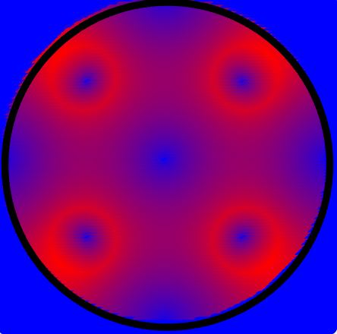
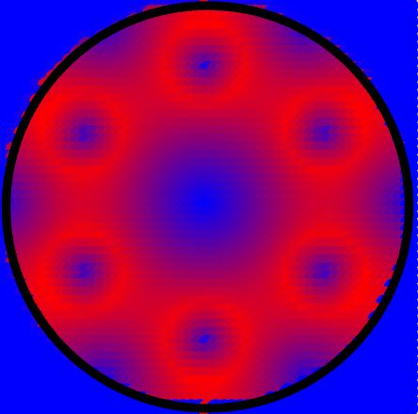
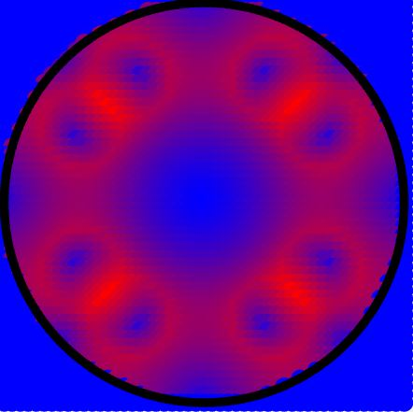
Isovorticity Contours
0
Max (50 Hz)
Vorticity magnitude reflected by color gradient.
Notes:
The more vortices the higher the regression rate – continuous ring of vorticity
ADD RADIUS

Slide 22
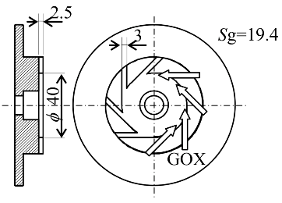
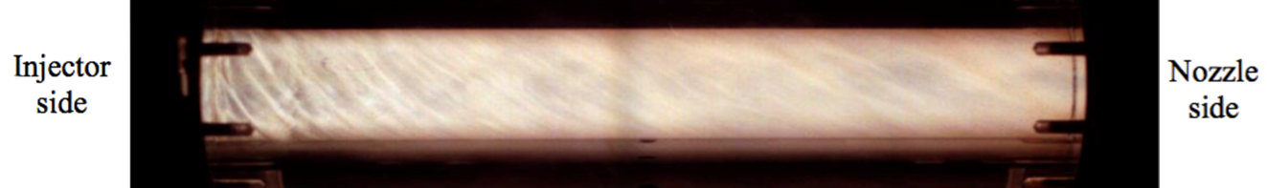
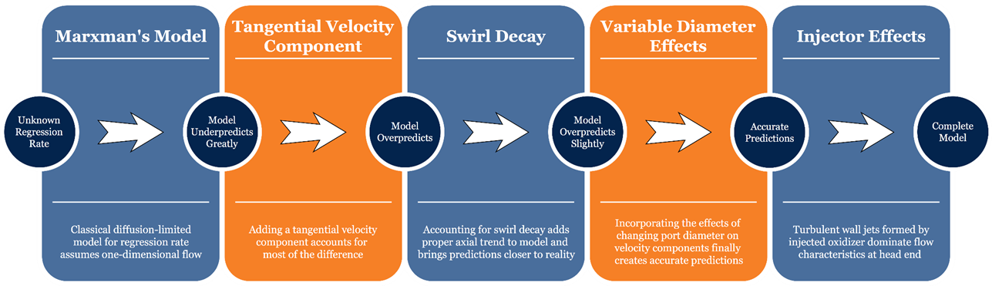
Hybrid Rocket Regression Rate Modeling
Swirl injection increases regression rates and is easy to accomplish
Our Team has developed a highly accurate regression rate formulation for swirling hybrids:

Slide 23
Regression Rate Enhancement
Regression rate enhancement factor:
  QpV 3 × 1.6= 4.8
  HpV 3 × 1.9 = 5.7
  OpV 3 × 2.2 = 6.6
Increasing the number of vortices reduces gaps and increases tangential speed at the wall
Leads to higher regression and more uniform burning
Reduces sliver formation
This concept is a game changer as it produces an order of magnitude increase in regression rate
Notes:
Tri-cone fluid drill analogy

Slide 24
Conclusion and Key Takeaways
Summary of key takeaways
  Substantial regression rate improvement (~ an order of magnitude)
  Equilibrium points to design
  Successfully verified this concept using CFD

Slide 25
Future Prospects
Theoretical
  Capture viscous effects using asymptotics
  Develop an improved regression rate model based on Marxman’s diffusion-limited theory that takes into account the swirl characteristics of multipoles
  Improve the present formulation by accounting for the axial decay characteristics of actual multipoles
Computational
  Further investigate decay characteristics of multipoles in progressively elongated chambers
  Investigate the MpV structure and heat transfer characteristics under chemically reactive flow conditions
  Evaluate the effect of various chamber aspect ratios on MpV stability and breakdown
Experimental
  Construct MPV experimental rig using PMMA (plexiglass)
  Compare the performance characteristics of MpV flowfields to unidirectional swirling/cyclonic motions
  Evaluate the heat transfer enhancement induced by MpV motion
Notes:
Time Evolution of vortex decay

