Slide 1
Mitigating Orbital Debris
Caelan Wommack
AIAA Region II Student Conference, April 2-4
Copyright © by Caelan Wommack Published by the American Institute of Aeronautics and Astronautics, Inc., with permission.

Slide 2
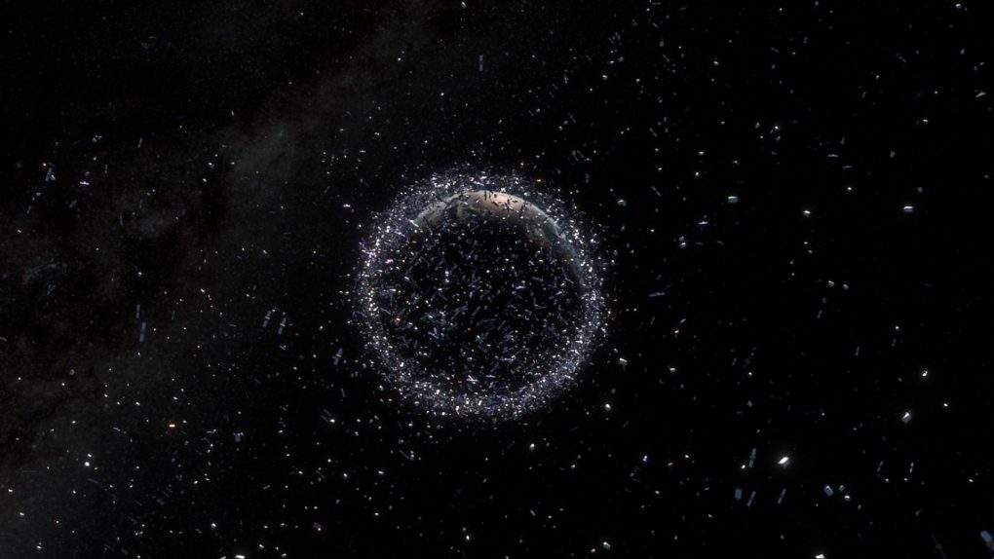
Mitigating Orbital Debris
Why is orbital debris a pressing issue?
Kessler Syndrome leading to collisions
Protection of operational objects in space and future missions

Slide 3
Mitigating Orbital Debris
Active Debris Removal (ADR)
Mitigation techniques, mostly in developmental stages
Can be divided into contact and noncontact ADRs
Important to assess which ADRs are most effective and feasible for the future of space exploration

Slide 4
Mitigating Orbital Debris
Contact-based ADRs – Robotic arms
Arm deorbits the debris or transfers it to another system for disposal
High accuracy, requires sophisticated GNC systems for successful docking
Northrop Grumman’s MEV/MRV shows success of this technology in a similar context

Slide 5
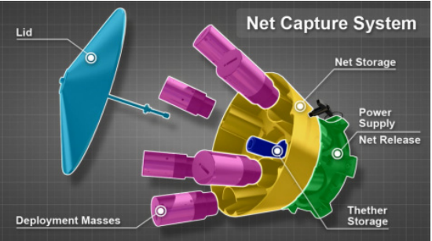
Mitigating Orbital Debris
Contact-based ADRs – Nets
Nets deploy from a spacecraft and tighten around object
ESA’s RemoveDEBRIS mission demonstrated this method
Challenges included precise deployment and ensuring debris remains contained

Slide 6
Mitigating Orbital Debris
Contact-based ADRs – Harpoon
Harpoons fire a projectile into debris, securing it with barbs or tethers
ESA’s RemoveDEBRIS mission successfully tested this method
Challenges include avoiding unintended fragmentation and ensuring target stability

Slide 7
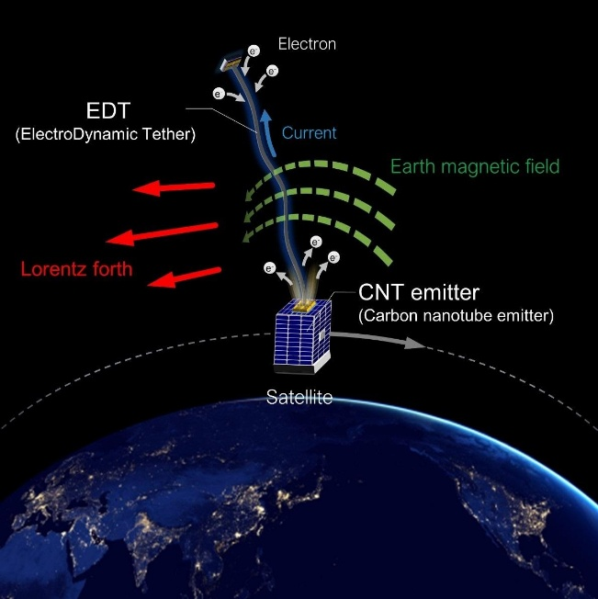
Mitigating Orbital Debris
Contact-based ADRs – Electrodynamic tethers (EDTs)
EDTs use conductive tethers to generate Lorentz forces, enabling fuel-free deorbiting
Simulations done by JAXA
Challenges include ensuring tether reliability

Slide 8
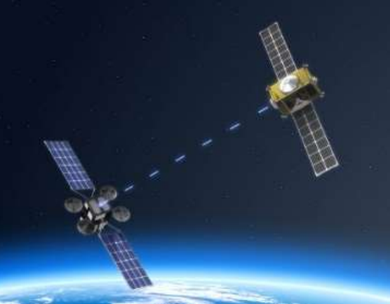
Mitigating Orbital Debris
Noncontact-based ADRs – Lasers
Lasers induce surface ablation, creating a force that alters a debris object’s orbit
ESA is developing a laser-equipped deorbit satellite, will start service in 2026
Challenges include high power demands and precise targeting

Slide 9
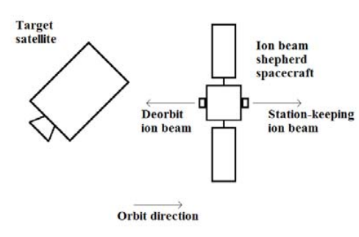
Mitigating Orbital Debris
Contact-based ADRs – Ion Beam Shepherd technique
Ion thrusters apply a continuous force to alter the orbit of debris
Half of onboard propellant needed for counteracting the force, limiting efficiency
Future developments may use ambient atmospheric gases as fuel

Slide 10
Mitigating Orbital Debris
Noncontact-based ADRs – Electromagnetic manipulation
An adaptable electromagnet can selectively target debris while avoiding operational satellites
Challenges include handling non-magnetic debris and optimizing energy consumption

Slide 11
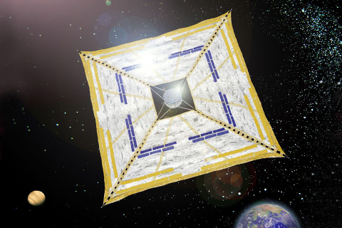
Mitigating Orbital Debris
Noncontact-based ADRs – Solar sails
Solar sails use solar radiation pressure to alter debris orbits for reentry
Inspired by missions like JAXA’s IKAROS
Challenges include deployment complexity and long-term durability in space

Slide 12
Mitigating Orbital Debris
Policy Frameworks for Space Debris Management
International collaboration is crucial, with growing support for binding regulations on debris mitigation
UN’s COPUOS guidelines promote debris prevention, proper disposal, and collision avoidance
ESA’s Space Surveillance and Tracking system enhances debris monitoring and collision prevention

Slide 13
Mitigating Orbital Debris
Conclusion
A combination of contact and non-contact ADR methods will be needed for effective debris removal
Global cooperation and stronger regulations are essential
By integrating technology and policy, we can protect Earth’s orbit for future space exploration

