Slide 1
Exploring Applications for Solar Electric Aircraft
Kai Komatsu
Georgia Institute of Technology
2025 AIAA Region II Student Conference, April 3 - 4 2025
Published by the American Institute of Aeronautics and Astronautics, Inc., with permission.

Slide 2
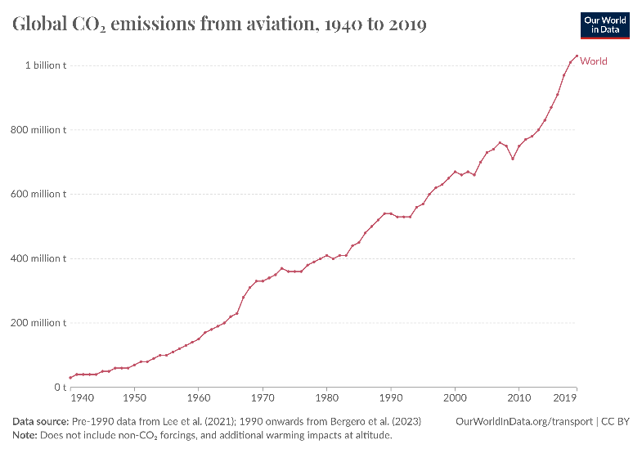
Background: Electric Aircraft
Motivation for growth of electric aircraft: ICAO goal of net-zero CO₂ emissions from commercial aviation by 2050, when it is expected to triple by then.
Aviation is responsible for 2.5% of global CO₂ emissions(2023) and growing faster than road, rail, and shipping
All-electric aircraft have limited range: regional air mobility market (Joby, Archer)
Notes:
Gas burned in internal combustion engine produces 30x energy than li-ion battery powering electric motor for same weight. Joby 100 mile range

Slide 3
Background: Solar Powered Aircraft
Solar aircraft design: similar to sailplanes; light glider design, minimize wing loading, maximize aspect ratio.
Disadvantages | Advantages
Low weight (limited payload capacity) | Long endurance
Long wingspan | Sweep large areas of land
Slow maximum airspeed | High altitude flight capability
Dependent on daylight hours and weather | Zero-emission
Notes:
Solar will always be an energy source of interest because it is a renewable source, accessible, zero-emission. Induced drag inversely proportional to AR.

Slide 4
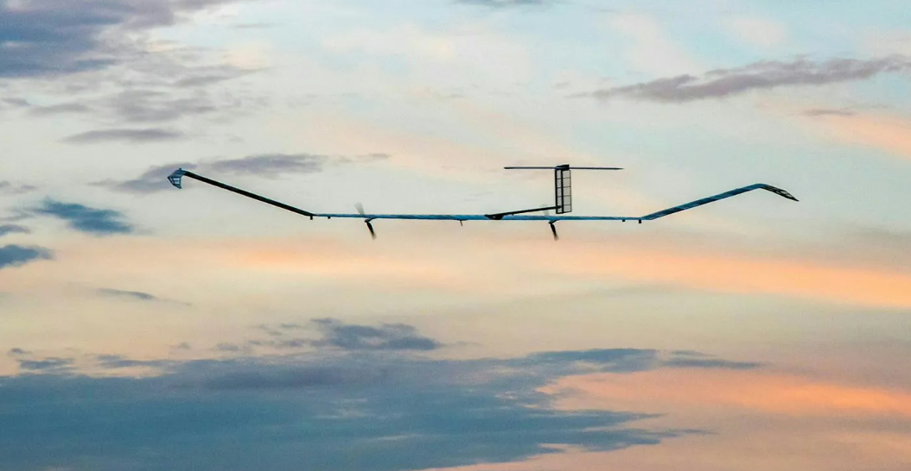
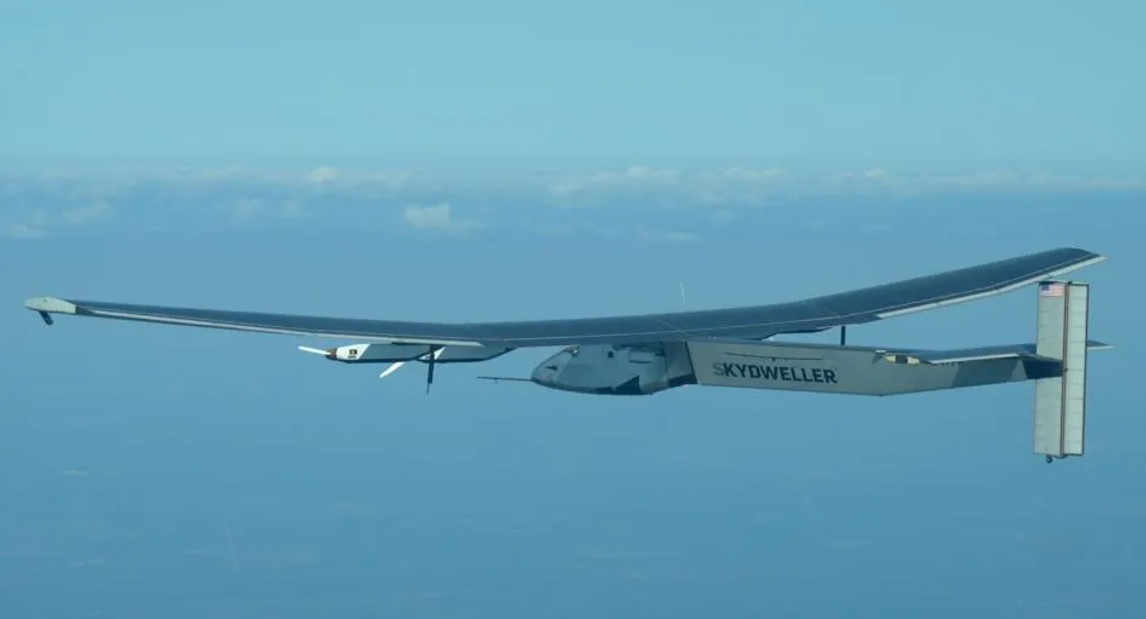
Background: Solar Powered Aircraft
Existing solar aircraft are used for atmospheric monitoring, communication relay systems, and surveillance/reconnaissance.
Airbus’s Zephyr High Altitude Platform Station
Skydweller, developed by US Navy and Skydweller Aero
Notes:
Zephyr High Altitude Platform Station has demonstrated day and night endurance in the stratosphere, and is capable of high resolution imagery and video, which enables things like maritime surveillance, border monitoring, mapping, forest fires and emergency response. The U.S. Navy, with Skydweller Aero, has developed a solar-powered plane to do maritime surveillance of military ships, capable of flights lasting several weeks.

Slide 5
Where else can solar aircraft be viable?

Slide 6
Potential Application: Pipeline Inspection
The U.S. has over 190,000 miles of oil pipelines and over 2.4 million miles of natural gas pipelines
The U.S. Code of Federal Regulations, Title 49 section 195.412, requires operators to conduct inspection of the surface conditions on or adjacent to each pipeline right-of-way, at least 26 times each calendar year, at intervals no larger than 3 weeks
Currently, most energy companies use helicopters to conduct these inspections, as aerial inspections are safe and efficient

Slide 7
Potential Application: Pipeline Inspection
Viability for solar aircraft to replace helicopters for pipeline inspection:
Leverages the long endurance advantage of solar aircraft, while the weather dependency disadvantage can be avoided by choosing a sunny day.
Helicopter | Solar Plane
High cost (~$150,000/trip) | Low cost (~$50/hour operating cost)
Manned | Remotely piloted or autonomous
2.5 - 4 hour typical endurance | Up to months-long endurance

Slide 8
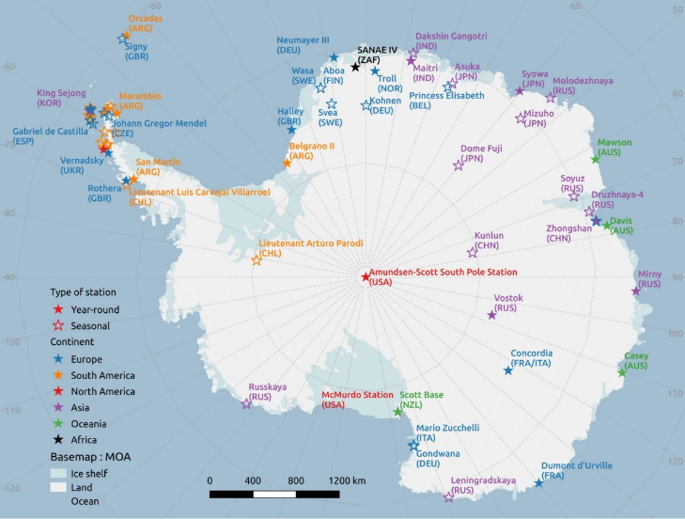
Potential Application: Antarctic Circle Operations
The Antarctic is home to over 70 research stations, operated by over 40 countries
4-5,000 people live in these stations in the summer; 1,000 people in the winter

Slide 9
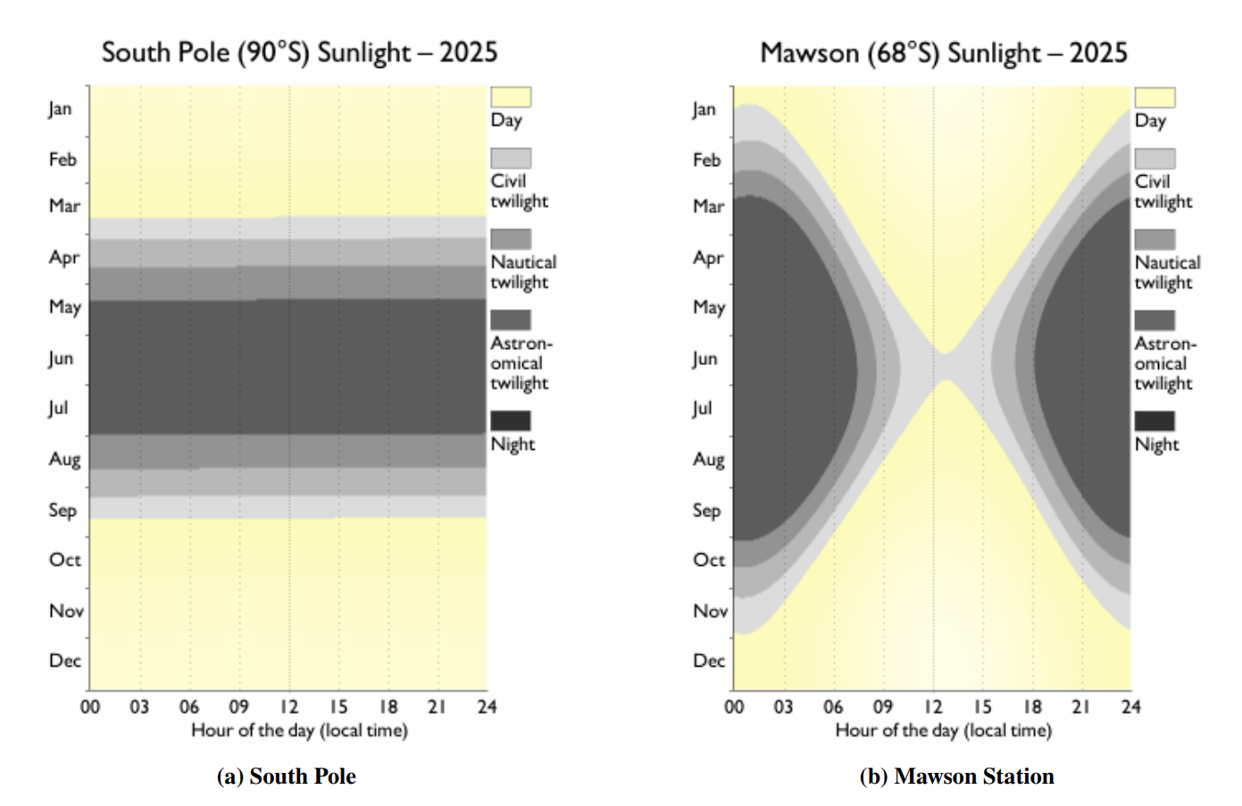
Potential Application: Antarctic Circle Operations
Within the Antarctic Circle in the southern hemisphere’s summertime, the sun remains above the horizon for days to months, known as the “midnight sun” phenomenon

Slide 10
Potential Application: Antarctic Circle Operations
Currently, various modes of transportation are used in Antarctica. Smaller, ski-equipped aircraft like Twin Otters, LC-130s, and helicopters are used to ferry people and cargo between stations, which are up to 1,000+ NM apart.
Viability for solar aircraft to transport cargo between stations:
Must be heavier to carry a payload of actual useful weight
Drastically shorter endurance/range capabilities than high altitude solar aircraft
Leveraging access to continuous power source, it could land anywhere, recharge battery, and takeoff again (“grasshopper” flight profile)
Viable for non-urgent, smaller cargo deliveries like resupplying seasonally-occupied research camps

Slide 11
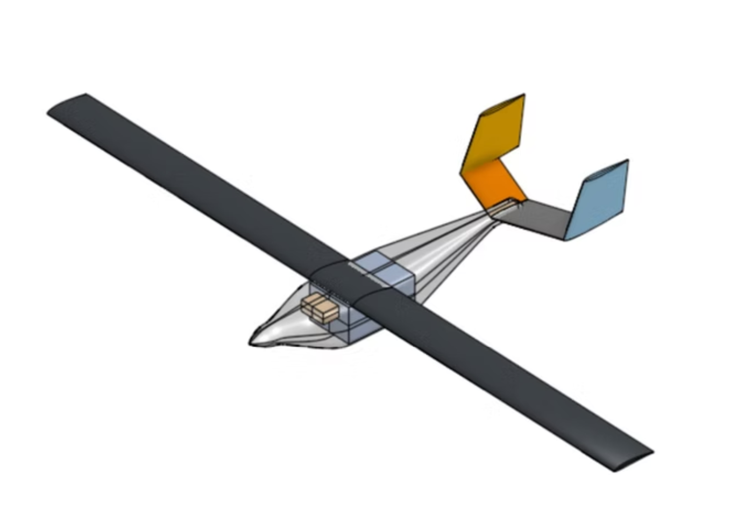
Conclusion and Future Work
Both applications would reduce carbon emissions by replacing traditional fuel-based aircraft in those cases with zero-emission aircraft.
Currently, my research group is working on building a subscale demonstrator of a solar-powered cargo plane designed for 30% payload fraction for the “grasshopper” mission.
Could be modified for desert and ocean variants
Notes:
. Overall goal of this paper was to facilitate interest, discussion, and expansion of solar aircraft for more uses. This research group is based out of the Georgia Institute of Technology in Atlanta, Georgia and is led by faculty advisor Dr. Brian German and graduate student Jeff Perry.

Slide 12
References
Slide 2: https://www.iea.org/energy-system/transport/aviation
https://ourworldindata.org/global-aviation-emissions#:~:text=Aviation%20accounts%20for%202.5%25%20of%20global%20CO2%20emissions&text=Most%20flights%20are%20powered%20by,to%20CO2%20when%20burned.
Slide 4: https://www.airbus.com/en/products-services/defence/uas/zephyr
https://www.forbes.com/sites/davidhambling/2024/10/09/us-navy-eternal-drone-could-signal-the-dawn-of-solar-flight/
Slide 6: https://www.flytbase.com/blog/bvlos-pipeline-inspection-using-nested-drone-system
https://www.ecfr.gov/current/title-49/subtitle-B/chapter-I/subchapter-D/part-195/subpart-F/section-195.412
Slide 7: https://www.elektra-solar.com/products/elektra-one-solar/
Slide 8: https://www.antarcticacruises.com/guide/research-stations-in-antarctica
Slide 9: https://www.antarctica.gov.au/about-antarctica/weather-and-climate/weather/sunlight-hours/
Slide 10: https://www.antarcticacruises.com/guide/how-do-you-get-around-in-antarctica

