Slide 1
Overview of Bell X-1 Inspired RC Aircraft: USC's Submission for Design Build Fly
Jared Cain, David Bradford, Patrick Bailey, Reese Massett, Connor Barefoot, Nick Carnes, Michael Cargill
University of South Carolina
AIAA Region II, 4/3/2025 - 4/4/2025
Copyright © by Jared Cain, David Bradford, Patrick Bailey, Reese Massett, Connor Barefoot, Nick Carnes, Michael Cargill Published by the American Institute of Aeronautics and Astronautics, Inc., with permission.

Slide 2
Table of Contents
About the Speakers
Overview of 2025 Design Build Fly Competition
Team Organization
Design
Manufacturing
Closing Remarks and Future Work

Slide 3
Table of Contents
About the Speakers
Overview of 2025 Design Build Fly Competition
Team Organization
Design
Manufacturing
Closing Remarks and Future Work

Slide 4
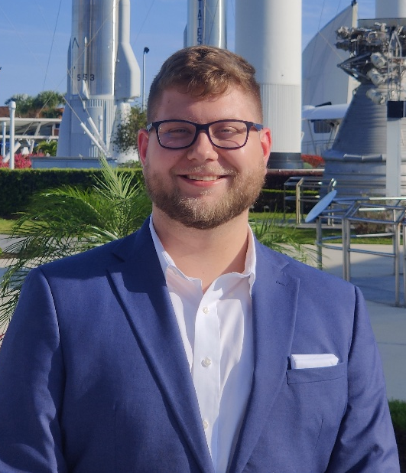
About the Speaker
Michael Cargill
Undergraduate Research Assistant
University of South Carolina
B.S. Aerospace Engineering (Junior)
Midlands Technical College
A.A.S. Machine Tool Technology
USC AIAA Chair (2024 – 2026)
Michael Cargill, A.A.S.

Slide 5
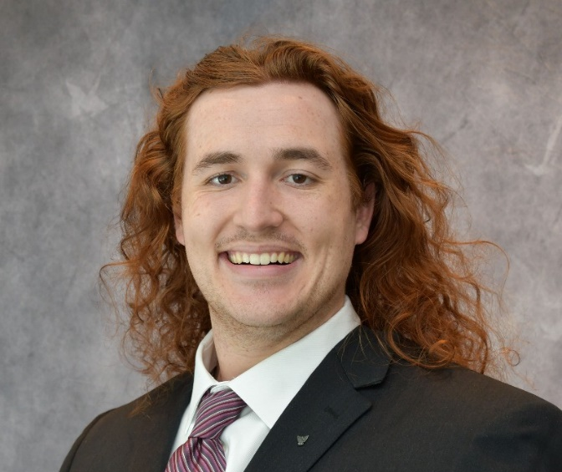
About the Speaker
Patrick Bailey
Graduate Research Assistant
University of South Carolina
B.S. Aerospace Engineering (2023)
M.S. Mechanical Engineering (2025)
AIAA Graduate Advisor (2024 – 2025)
Patrick Bailey, B.S.

Slide 6
Table of Contents
About the Speakers
Overview of 2025 Design Build Fly Competition
Team Organization
Design
Manufacturing
Closing Remarks and Future Work

Slide 7
Overview of 2025 Design Build Fly Competition
Tribute to X-1 Bell supersonic aircraft
Teams are tasked with designing a “bomber” style aircraft
2 pylon payloads
1 internal payload
Deployable glider representative of the X-1
Three missions at different configurations

Slide 8
USC at Design Build Fly
First time competing in almost a decade
USC has never completed a mission
Initiative to increase member engagement
Integrated into curriculum
Aircraft Design
Senior Design

Slide 9
Table of Contents
About the Speakers
Overview of 2025 Design Build Fly Competition
Team Organization
Design
Manufacturing
Closing Remarks and Future Work

Slide 10
Team Organization
First USC DBF team formed since 2017
Consists of 32 undergraduate and graduate students
Aerospace Engineering
Mechanical Engineering
Project Manager oversees three teams
Aerodynamics
Structures
Electrical

Slide 11
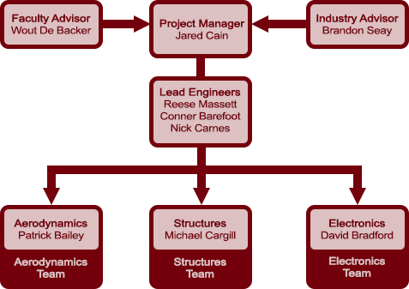
Team Organization

Slide 12
Table of Contents
About the Speakers
Overview of 2025 Design Build Fly Competition
Team Organization
Design
Manufacturing
Closing Remarks and Future Work

Slide 13
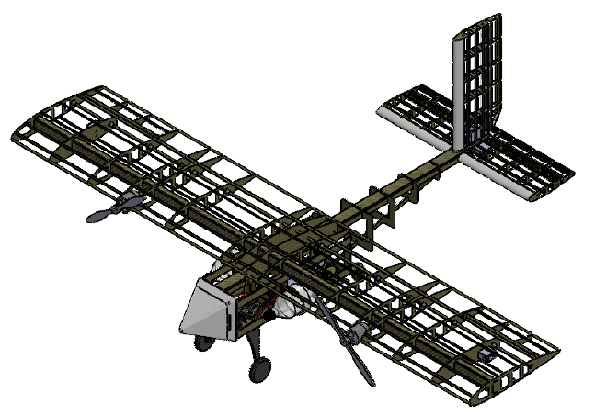
Design
Configuration
High Wing
Twin Propeller
Taildragger
Construction
Skin-on-Frame
Monokote style skin
CFRP Structure

Slide 14
Wing
NACA 2416
Higher C_{L}
Favorable stability characteristics
Rectangular Wing
Subsonic speeds
Structure
Thermoset CFRP C spar
Thermoplastic stringers and ribs

Slide 15
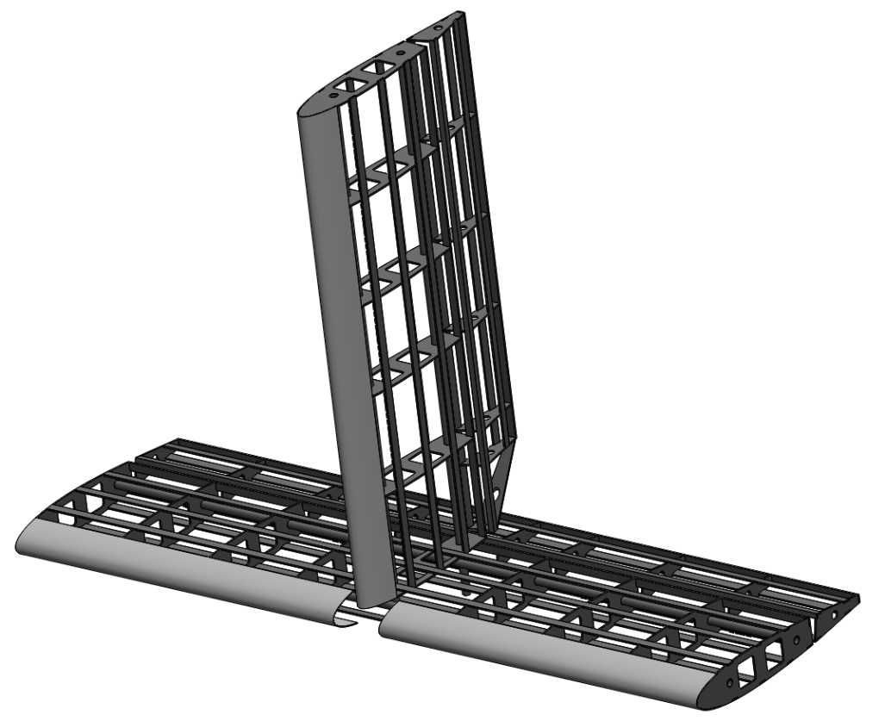
Tail
Conventional tail configuration
Similar construction to wing
3D printed leading edge

Slide 16
Fuselage
Simple rectangular cross section
Tapers towards tail
Sized to house electronics and payload
Hinged Nosecone allows access to interior
Hardpoints incorporated for pylon payloads
Construction
C Channel spine
CFRP bulkheads

Slide 17
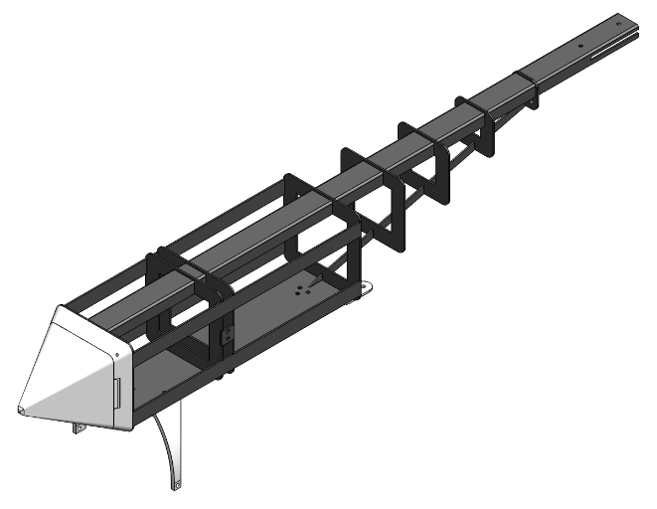
Fuselage

Slide 18
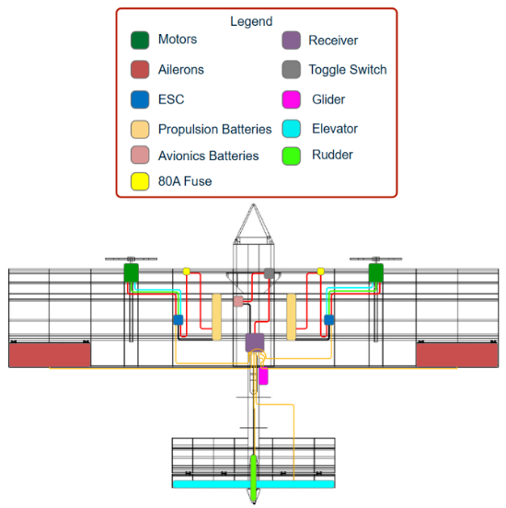
Electrical System
Propulsion
2 Power 60 Brushless motors
22.2V 1800mAh LiPo Battery
80-Amp Brushless Smart ESC
12x8 propellers
Flight Control
DX6 G3 Transmitter
AR637T DSMX Receiver
Spektrum S6020 Servos

Slide 19
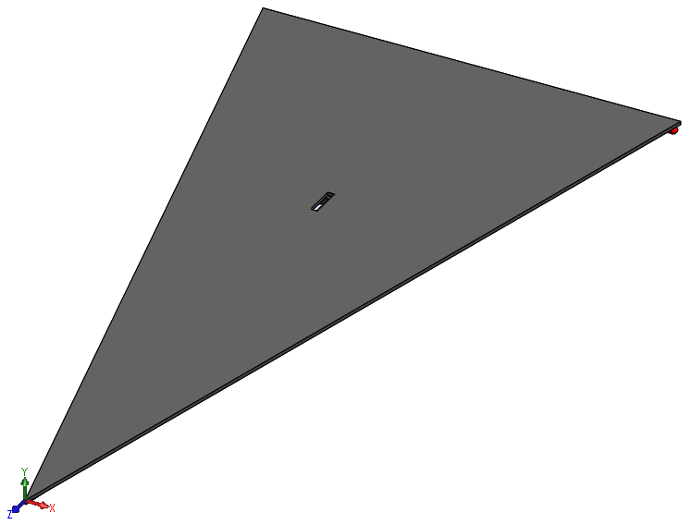
Glider
Composite paper airplane
Electrical
Circuit for strobe light control
Pull tab actuated via glider deployment

Slide 20
Table of Contents
About the Speakers
Overview of 2025 Design Build Fly Competition
Team Organization
Design
Manufacturing
Closing Remarks and Future Work

Slide 21
Material Selection
Composites
Aircraft Structure
Toray TC1225 UD Tape
Fibreglast 2120 Thermoset CFRP
Polymers
Aircraft Components
PLA
Monokote style film

Slide 22
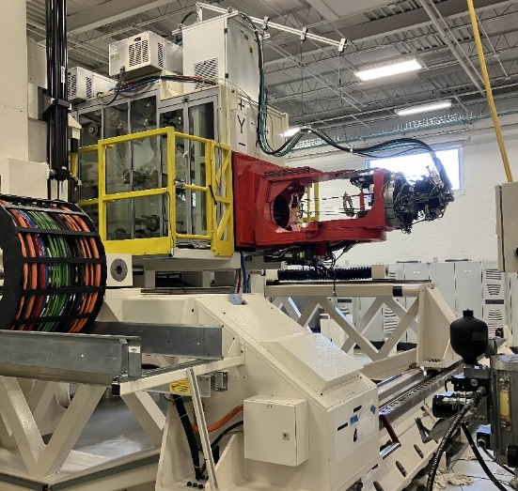
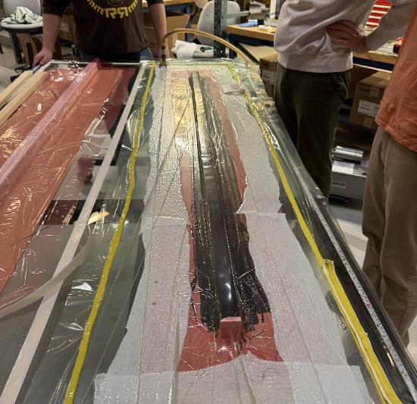
Composite Layup
Thermoplastic
AFP layup
8ply and 16ply
Quasi-isotropic
Thermoset
Hand layup on PVC tool
4ply
0/90 weave

Slide 23
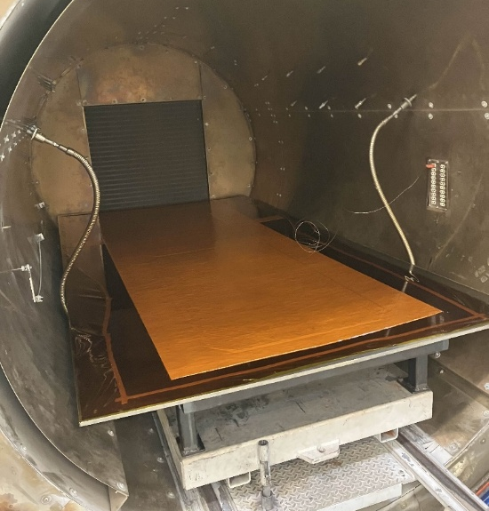
Autoclave Consolidation
AFP panels undergo autoclave consolidation
enhance mechanical properties
establish final material thickness

Slide 24
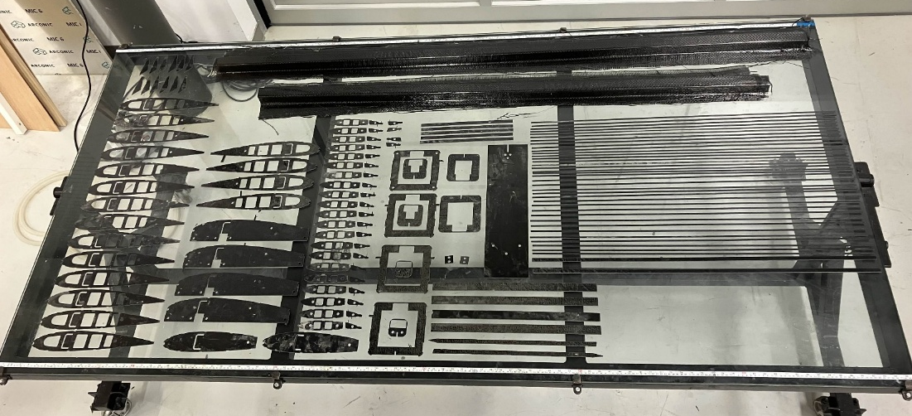
Water Jet Processing
Structural components are cut from panel using abrasive water jet
Easily process CFRP
Slight delamination upon piercing

Slide 25
Assembly
Aircraft is undergoing final assembly
Thickened 2120 resin system used as structural adhesive
Electronics to be integrated at this stage

Slide 26
Table of Contents
About the Speakers
Overview of 2025 Design Build Fly Competition
Team Organization
Design
Manufacturing
Closing Remarks and Future Work

Slide 27
Closing Remarks
Excited to return to DBF next week
Incredibly popular with members
Take lessons learned this year into following competitions
Will be returning in 2026

Slide 28
Closing Remarks
Questions?

