Slide 1

Star Elimination as a Means of Resident Space Object Identification for Space Situational Awareness
Evan Pavetto-Stewart and Thomas Alan Lovell
Embry-Riddle Aeronautical University
2025 Region II Student Conference, 3 April 2025 – 4 April 2025
Copyright © by Embry-Riddle Aeronautical University
Published by the American Institute of Aeronautics and Astronautics, Inc., with permission.

Slide 2
Motivation
A fundamental tenet of Space Situational Awareness (SSA) is to properly identify resident space objects (RSOs) within unresolved optical space imagery
In order to distinguish RSOs from the star field, a suggested practice is to perform multi-frame image collects and identify RSOs based on how the scene changes from frame to frame
Two common modes of imaging are described as follows:
  Inertial stare mode: stars remain stationary in the camera’s field of view, but RSOs move over time
  Orbit-following mode: targeted RSO will remain stationary in the camera’s field of view, but stars will move over time

Slide 3
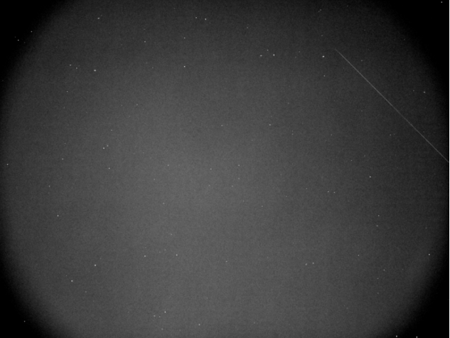
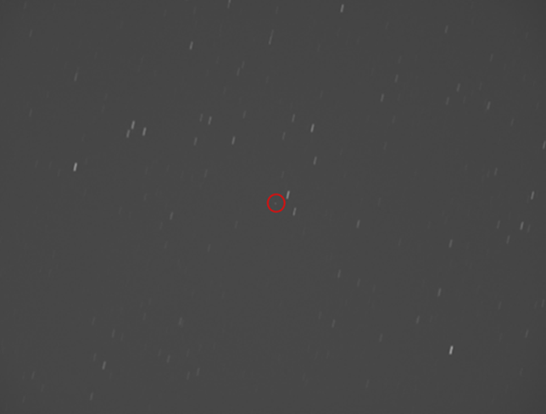
Background
Typical inertial stare image:
Typical orbit-following image:

Slide 4
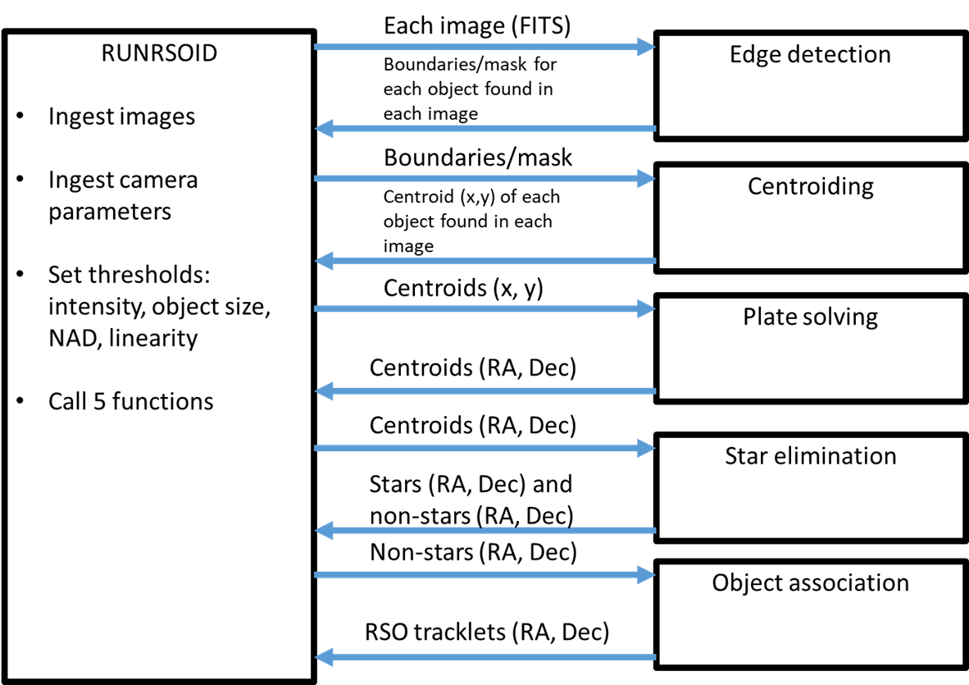
RSOID Methodology
Previous work developed an initial version of an RSO identification (RSOID) algorithm
In the present paper, the authors investigate the star elimination step of the process

Slide 5
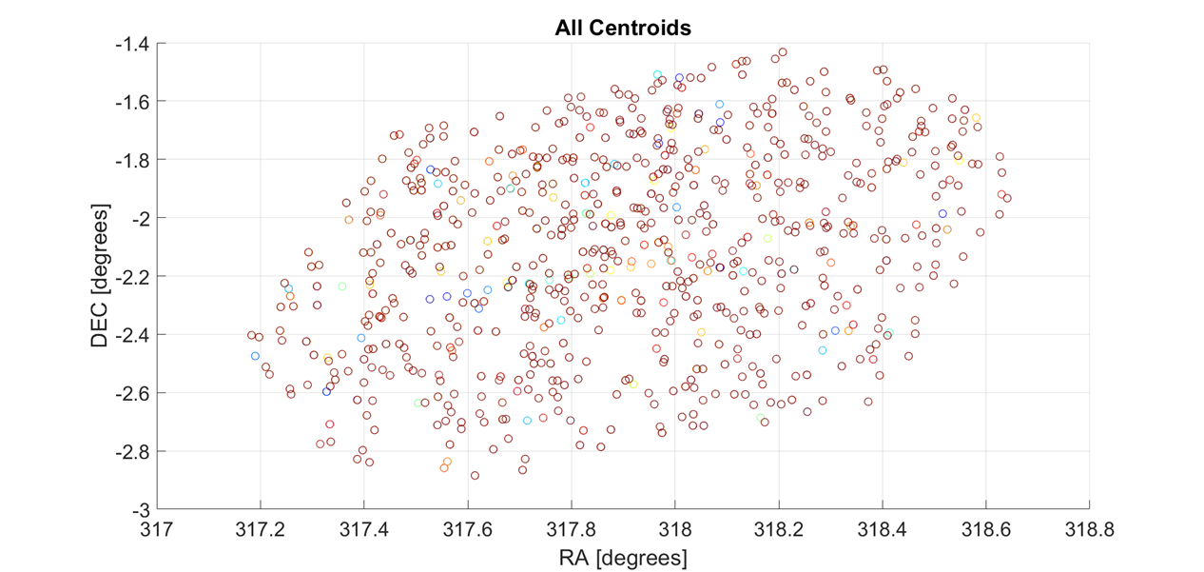
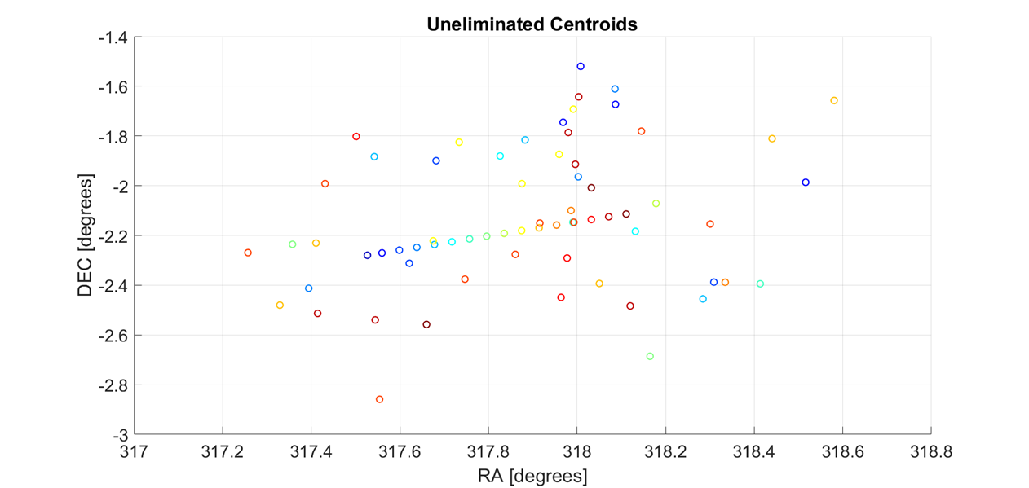
Star Elimination Example
Typical overlay of RA/Dec values of all centroids in a multi-frame collect:
Same collect after applying star elimination (RSO tracklet is apparent):

Slide 6
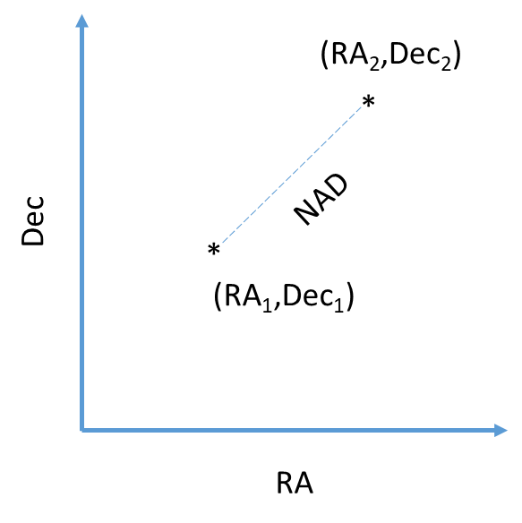
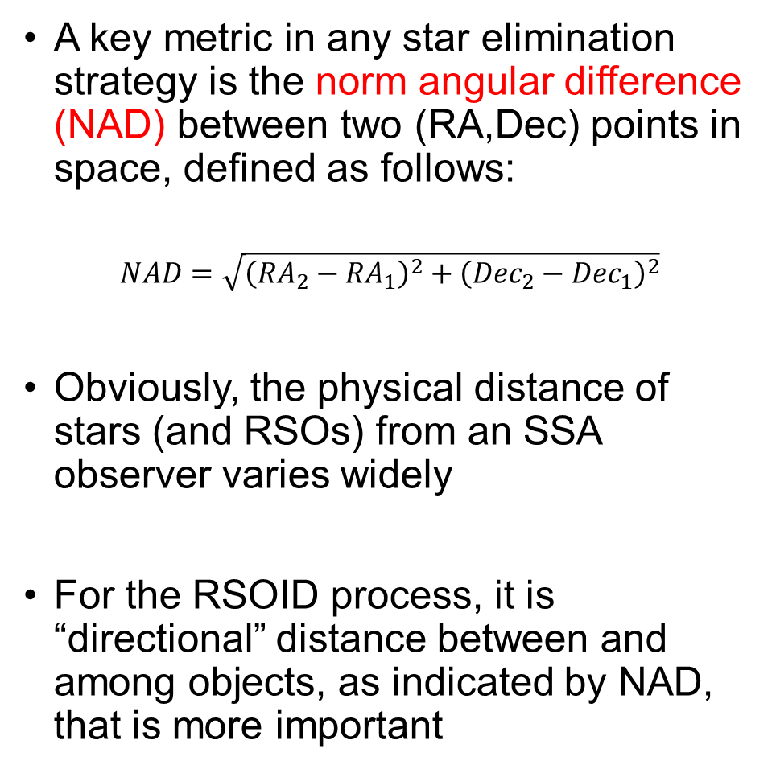
Norm Angular Difference
A key metric in any star elimination strategy is the norm angular difference (NAD) between two (RA,Dec) points in space, defined as follows:
$$NAD=\sqrt{{\left({RA}_{2}−{RA}_{1}\right)}^{2}+{\left({Dec}_{2}−{Dec}_{1}\right)}^{2}}$$
Obviously, the physical distance of stars (and RSOs) from an SSA observer varies widely
For the RSOID process, it is “directional” distance between and among objects, as indicated by NAD, that is more important

Slide 7
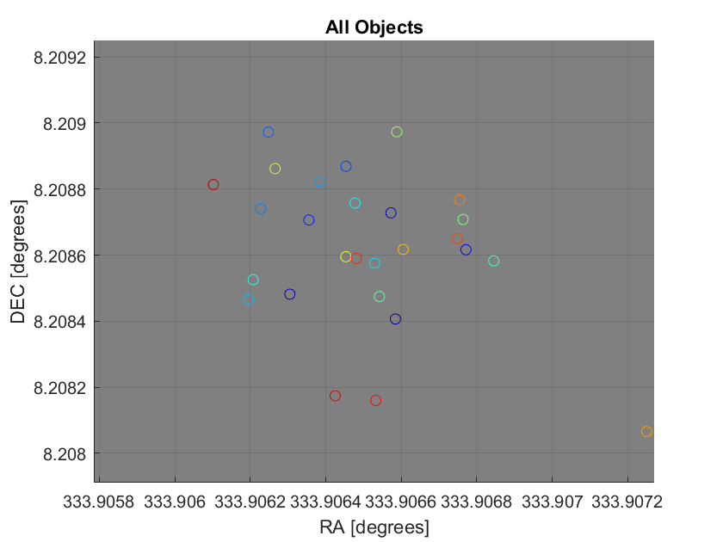
Star Elimination Strategies
Two candidate star elimination strategies have been investigated: Clustering and Catalog Comparison
Clustering is based on the assumption that the RA and Dec of each star in the universe remains constant over the course of a collect (i.e. a few minutes)
Ideally the centroid representing a particular star in Frame 1 of a collect would lie at the same RA and Dec as the centroid representing that star in Frame 2 of the collect, as well as in Frame 3, etc.
In reality, this will not be the case, due to the imperfect nature of the process → Each occurrence of a particular star will lie at a slightly different RA and Dec from one frame to the next

Slide 8
Star Elimination Strategies
It stands to reason that a threshold on NAD can be defined such that, if two centroids from different frames are closer than the threshold (i.e. their NAD is less than the threshold value), they belong to the same star
This allows the two centroids to be eliminated going forward
Clustering strategy involves taking each centroid in a collect and finding its “nearest neighbor” (in terms of NAD) across all other frames in the collect
If a centroid’s nearest neighbor is closer than the NAD threshold, both centroids are considered occurrences of the same star and are eliminated
Eliminated Centroids
Uneliminated Centroid
DEC
RA
NAD Threshold

Slide 9
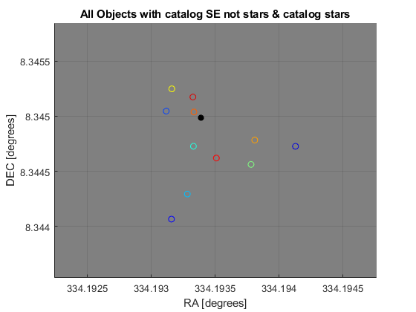
Star Elimination Strategies
With Clustering, if the NAD threshold is set too low, no centroids will be eliminated, whereas if it is set too high, ALL centroids will be eliminated
Catalog comparison strategy involves comparing the RA/Dec value of each centroid in a collect with the RA/Dec values in a star catalog → Any centroid within the NAD threshold of a catalogued star is eliminated
The authors possess both the Tycho-2 catalog (approx. 2.5 million stars) and a portion of the Gaia catalog (approx. 151 million stars)
As with clustering, results are very sensitive to choice of NAD threshold
Catalog Star

Slide 10
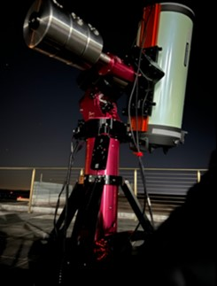
Results on Real Image Data
Numerous collects of unresolved space imagery have been obtained via an optical sensor configuration available through the authors’ university:
  Celestron RASA 11-inch telescope with an ASI 1600mm monochrome CMOS camera mounted on a Celestron CGE Pro mount
  Field of view is approximately 1.5° x 1.5°
Two particular collects are emphasized:
  31-frame inertial stare collect spanning 41 seconds (CASE 1)
  12-frame object-following collect spanning 23 seconds (CASE 2)

Slide 11
Results on Real Image Data
For CASE 1, table below shows that there are approximately 200 centroids in each frame
Tycho-2 catalog only accounts for about half of the objects in each frame, while the Gaia catalog contains over 10 times this number(!)
For this collect, we conclude that Tycho-2, at best, could eliminate about half the centroids, while Gaia LITE could potentially eliminate all of them

Slide 12
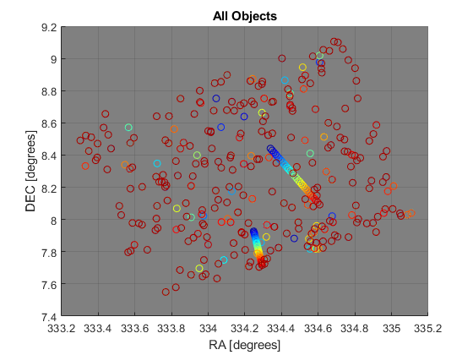
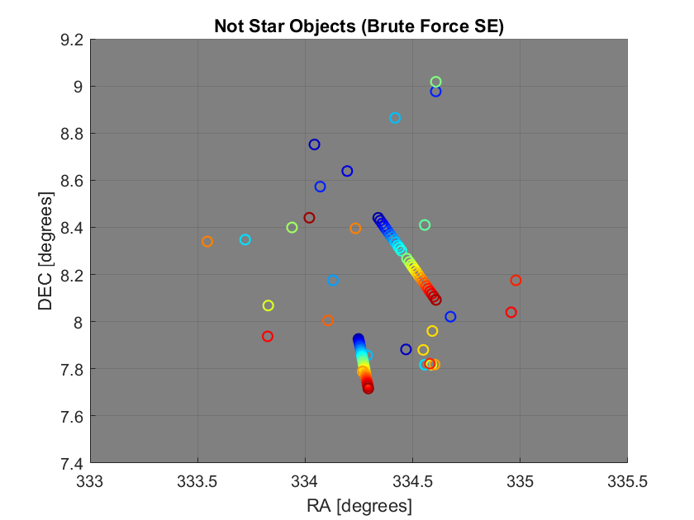
Results on Real Image Data
First we apply the clustering strategy to this collect, with the NAD threshold set to 0.005°
Below is an overlay of all centroids in the collect, followed by the same collect after applying star elimination via clustering
While vast majority of centroids have been eliminated, several do remain → 2 RSOs clearly seen

Slide 13
Results on Real Image Data
Examining this result, several of the centroids that remain (in addition to the RSOs) are stars whose nearest neighbor is slightly outside the NAD threshold
Thus raising the NAD threshold could potentially eliminate more centroids → too high of a threshold could eliminate centroids pertaining to the RSOs (undesirable)
Some centroids may be collections of noisy pixels (i.e. false objects); impervious to any threshold because they do not possess any nearest neighbors as stars do (unless the threshold is set really high)

Slide 14
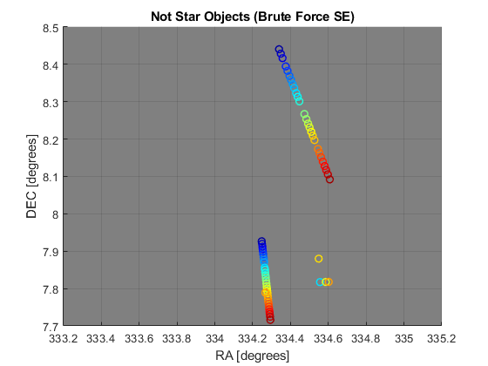
Results on Real Image Data
Now we apply the catalog comparison strategy to this collect, using the Gaia catalog (NAD threshold again set to 0.005°)
Below is an overlay of all centroids in the collect, followed by the same collect after applying star elimination via catalog comparison
Only a small number of non-RSO centroids remain

Slide 15
Results on Real Image Data
The few centroids that remain were also left by the clustering strategy
The large volume of stars in the Gaia catalog implies that these remaining centroids are “noisy” (i.e. false) objects
NAD threshold appears to be in a proper range (not too high or low)

Slide 16
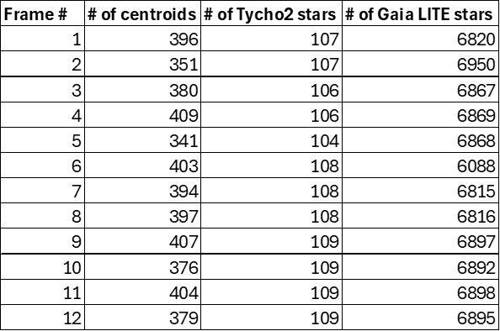
Results on Real Image Data
For CASE 2, table below shows that there are approximately 400 centroids in each frame
Again, the difference between the number of Tycho-2 stars and number of Gaia stars is massive

Slide 17
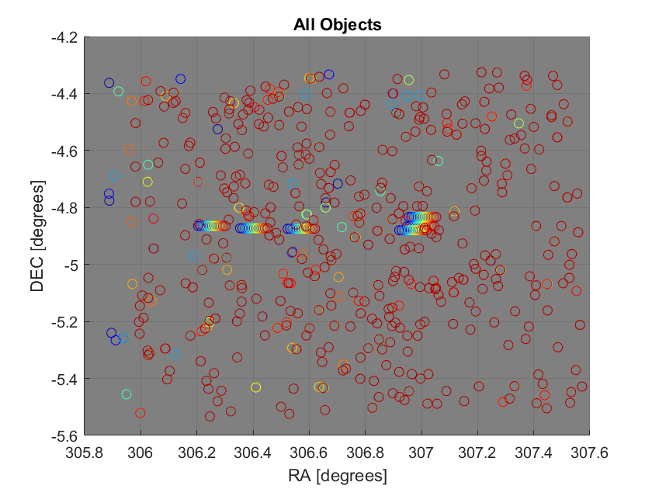
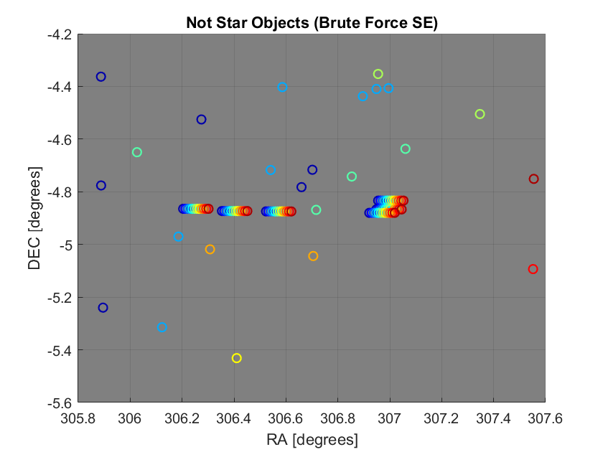
Results on Real Image Data
First we apply the clustering strategy to this collect, with the NAD threshold set to 0.005°
Below is an overlay of all centroids in the collect, followed by the same collect after applying star elimination via clustering
While vast majority of centroids have been eliminated, several do remain → 6 RSOs clearly seen

Slide 18
Results on Real Image Data
As with CASE 1, raising the NAD threshold could potentially eliminate more centroids
Because CASE 1 is an inertial stare collect, all frames span the same RA/Dec range
For CASE 2 this is not the case → left edge of Frame 1 and right edge of Frame 12 have no overlap with any other frames → clustering strategy cannot eliminate these centroids

Slide 19
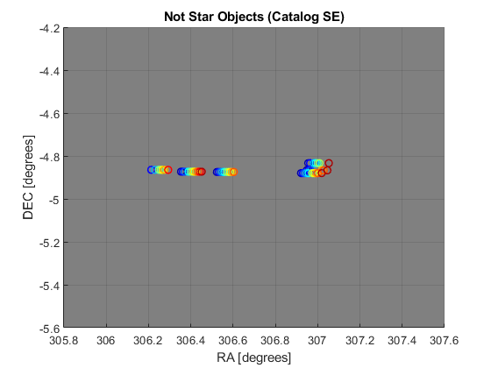
Results on Real Image Data
Now we apply the catalog comparison strategy to this collect, using the Gaia catalog (NAD threshold again set to 0.005°)
Below is an overlay of all centroids in the collect, followed by the same collect after applying star elimination via catalog comparison
ALL stars eliminated, plus some of the RSO centroids
Unlike the clustering strategy, catalog comparison CAN (and does) eliminate the centroids on the edges of Frame 1 and Frame 12
[non-star plot goes here]

Slide 20
Results on Real Image Data
In addition to NAD threshold, here another parameter of interest is limiting magnitude of the Gaia database → number of Gaia stars utilized for star elimination can be made to vary as a function of the largest (i.e. dimmest) magnitude
For example, our entire Gaia database is approx. 151 million stars with a limiting magnitude of 17; if we limit the magnitude to 14, that number reduces to 100 million
This limiting magnitude should be consistent with the zero point of our images (i.e. magnitude of the dimmest object found in each image)

Slide 21
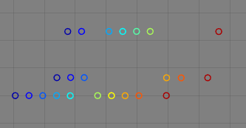
Results on Real Image Data
If limiting magnitude < zero point, there will be stars in the images that catalog comparison CANNOT eliminate (this is the case if we use the Tycho-2 catalog)
If limiting magnitude > zero point (as with the Gaia catalog), there will be “extraneous” stars in the catalog that do not match with any star in the images → these could inadvertently eliminate RSO centroids (undesirable)
This could in fact be the case with the current result
Determination of the zero point of a given collect (and how that affects the choice of limiting magnitude for catalog comparison) definitely warrants further study

Slide 22
Conclusion and Future Work
This paper has showcased a portion of a resident space object identification algorithm known as star elimination
Premise is to process a multi-frame collect of unresolved space imagery to identify Earth-orbiting space objects among the celestial objects (e.g. stars)
Here, two star elimination strategies have been laid out, with results shown on collects of real space imagery
The method is effective at removing the vast majority of stars, but occasionally at the expense of removing some of the resident space object centroids as well
Future work will involve investigating the sensitivity of the results to the choice of “norm angular difference” threshold, as well as development of an adaptive thresholding scheme
Increasing the reliability of this algorithm will aid in collision avoidance and trajectory planning in space situational awareness applications.

Slide 23
Thank you!
Evan Pavetto-Stewart and Thomas Alan Lovell
Embry-Riddle Aeronautical University
2025 Region II Student Conference, 3 April 2025 – 4 April 2025
Copyright © by Embry-Riddle Aeronautical University
Published by the American Institute of Aeronautics and Astronautics, Inc., with permission.

