Slide 1


Simulation of Fluid Sloshing in High-Acceleration Environments for Aerospace Applications
AIAA Region II Student Conference
Connor Perrine, Hesha Amin

Slide 2
Outline
Introduction
Background of Fluid Sloshing
Experimental Setup
Results and Findings
Conclusion

Slide 3
Introduction

Slide 4
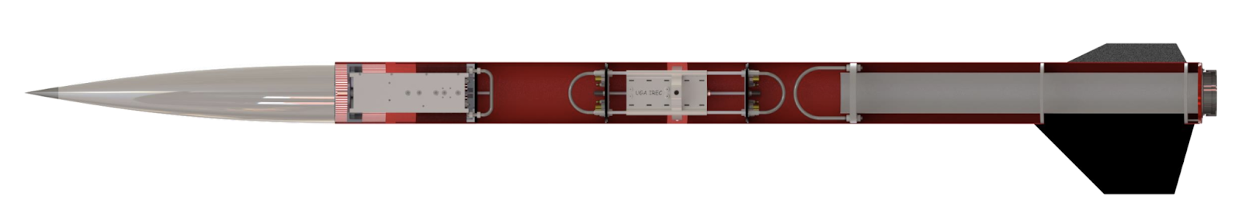
Experiment and Simulation
University of Georgia’s International Rocketry Engineering Competition (IREC) Rocket with fluid sloshing experiment payload
Uses ANSYS to simulate the sloshing motion under acceleration data from liftoff to apogee
Fig. 1 UGA IREC Rocket

Slide 5
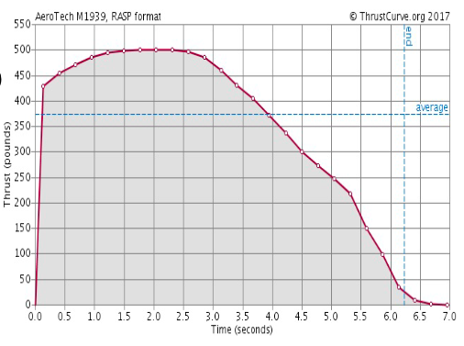
UGA IREC Rocket and Fluid Sloshing Payload
Rocket flown on a M1939W solid rocket motor to 8,971 feet
500lb of thrust, 2302lb-s of impulse
Apogee at T+24.4 seconds
15cm tall, 8cm diameter cylindrical container, filled 60% with water and 40% ambient air
Fig. 2 Motor Thrust Graph
Notes:
Explain the rocket data used and the IREC competition

Slide 6
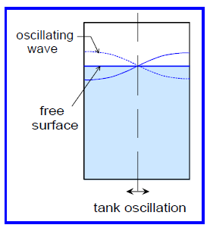
Fluid Sloshing
Refers to the oscillation of a fluid’s free surface inside a container
Sloshing is common in all places, especially in aerospace applications
Creates many problems in stability, vibrations, and acoustics
Commonly mitigated by baffles and pressurized tanks
Fig. 3 Sloshing Induced by Tank Motion [1]

Slide 7
Fluid Sloshing

Slide 8
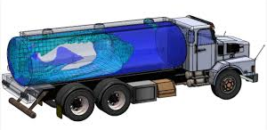
How Does Sloshing Occur?
Interplay of Gravity, Inertia and Surface Tension
Interaction between the liquid and gas at free surface
Influences the amplitude, frequency, and damping of slosh waves
Fig. 4 Sloshing Inside Truck Fuel Container

Slide 9
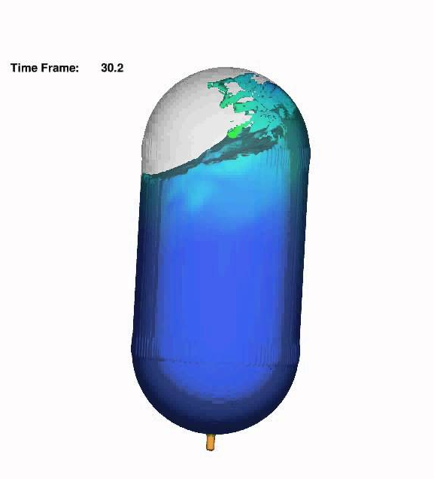
How Does Sloshing Occur?
Severity of sloshing depends on:
  External Accelerations
  Tank Geometry
  Fill Level
Baffles are used to lessen wave formation
Fig. 5 Sloshing Tank

Slide 10
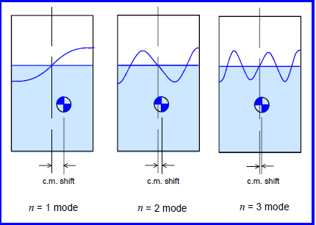
Why is Sloshing Important?
Movement creates unwanted dynamic loads
Changes the Center of Mass
Vibrations close to fluid’s natural frequency amplify stresses and strains
Fig. 6 Slosh Modes with Center of Mass Shift Shown [1]

Slide 11
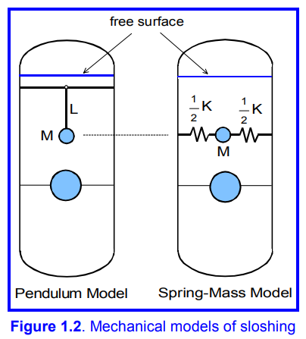
Mathematical Modeling
Pendulum Model
  Fluid is represented by oscillating mass
Spring-Mass Model
  Fluid is represented by linear springs
Conservation of Mass and Momentum
Navier-Stokes Equation
Fig. 7 Fluid Sloshing Modeling Methods [1]

Slide 12
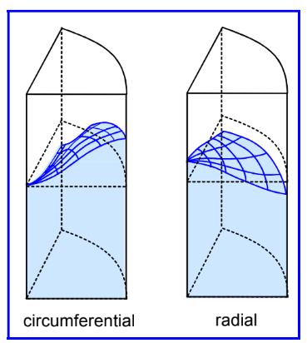
Mathematical Modeling
Circumferential
  Wave motion aligns with the circumference of the tank
Radial
  Wave motion aligns with the radius
Fig. 8 Fluid Sloshing in Cylindrical Tank [1]

Slide 13
Mathematical Modeling
Computational Fluid Dynamics (CFD) is used to calculate and model fluid movement
Different techniques
  Volume of Fluid (VoF)
  Smoothed Particle Hydrodynamics (SPH)
  Reynolds-Averaged Navier-Stokes (RANS)
VoF is commonly used in aerospace related fluid analysis

Slide 14
Experiment and Simulation

Slide 15
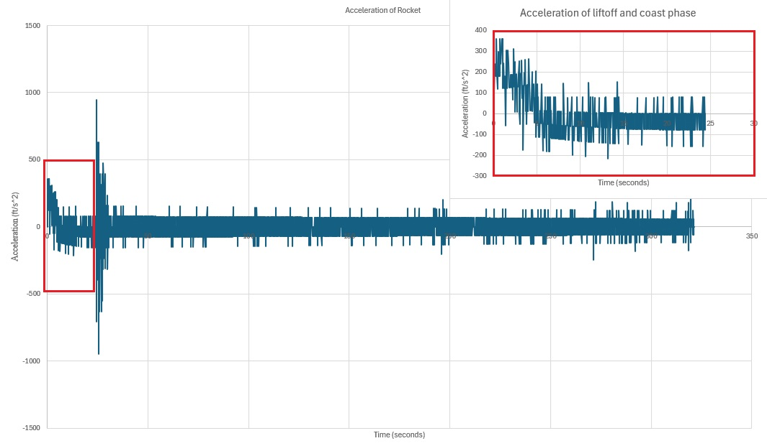
Fig. 9 Acceleration Graph of UGA IREC Rocket

Slide 16
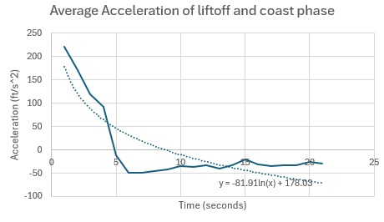
Fig. 10 Average Acceleration during Liftoff and Coast

Slide 17
ANSYS Modeling
ANSYS – Free industry standard software provided to students
2-Dimensional cross section
Open System Tank
Transient, Multiphase, Volume of Fluid
Time step 0.005 seconds
Arbitrary Function: -0.5[ft/s^2]*sin(1[rad/s]*t)

Slide 18

Simulation
Simulated tank with settled liquid (t=0)
15cm tall, 8cm diameter cylindrical container, filled 60% with water and 40% ambient air
Red: Water
Blue: Air
Green/Yellow: Interface
Fig. 11 Water in Tank at Ignition

Slide 19
Results

Slide 20
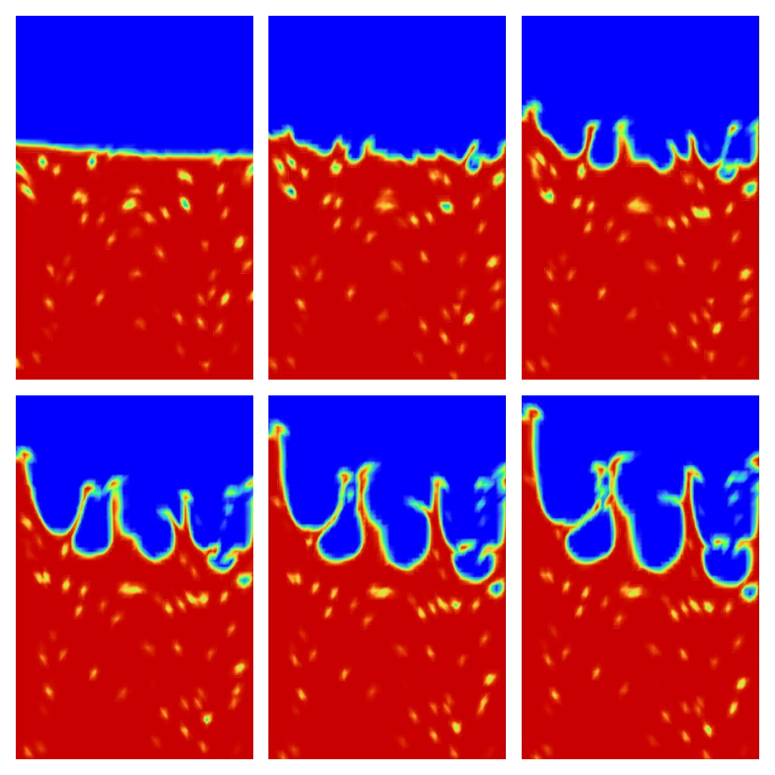
Results of ANSYS Simulation
20 iterations of acceleration data, first 2 simulate at rest, 18 simulate fluid sloshing
Sporadic sloshing
Uneven distribution of acceleration forces
Fig. 12 First Six Iterations of the Sloshing Simulation

Slide 21
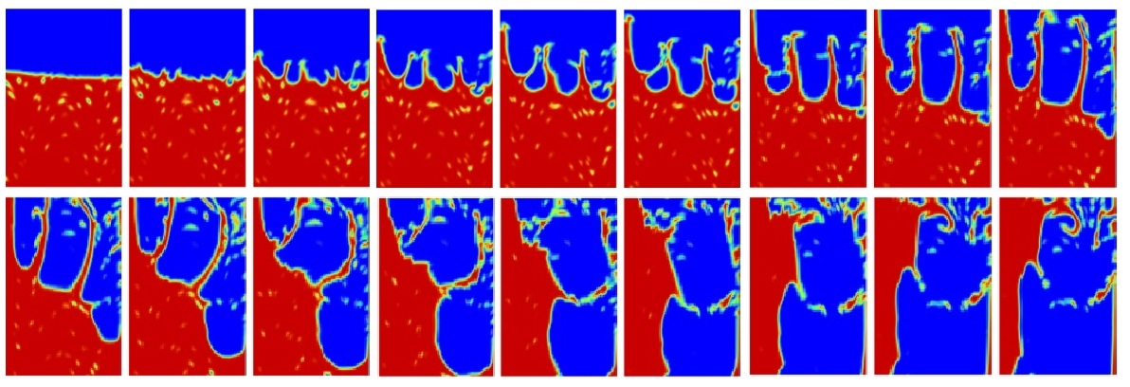
Fig. 13 18 Iterations of Fluid Sloshing

Slide 22
Analysis of Results
High-acceleration environments create highly sporadic sloshing
Correlation between frequency of applied vibrations and resulting sloshing
Vibrations cause fluid to move laterally while accelerations cause fluid to move vertically

Slide 23
Future Steps in Sloshing
Furthers understanding of Fluid Sloshing
Learn about ways to change simulations to improve results
  3D Tank
  Closed system
  More sophisticated mesh
  Expanded parameters
Understanding sloshing behavior is essential to designing methods of mitigation

Slide 24
Conclusion

Slide 25
Conclusions
Fluid Sloshing is extremely common in aerospace applications and lead to detrimental failures if not accounted for
High-accerleration environments create very sporadic sloshing movement, causing large stresses and strains on a vehicle
Understanding how sloshing occurs using CFD analysis allows engineers to better design methods to mitigate wave formation and severity

Slide 26
Thank You

