Slide 1
Development of an LQR Controller for a Jet Vanes Thrust-Vectored Rocket
Patrick Barry, Karsten Caillet, David Reynolds, Albert Zheng
AIAA 2025 Region II Student Conference
4/3/2025 – 4/4/2025
Copyright © by Guidance, Navigation, and Control Project Published by the American Institute of Aeronautics and Astronautics, Inc., with permission.

Slide 2
Jet Vanes Rocket
Current focus of the Guidance, Navigation, and Control (GNC) project within Ramblin’ Rocket Club
Active rocket control via jet vanes placed at exit of rocket motor nozzle
Besides motor itself, rocket is 100% designed and built by Georgia Tech undergraduates
Structure
Avionics
Software/Algorithms
CFD Simulations
Guidance, Navigation, and Control
Georgia Institute of Technology

Slide 3
Controller Validation: Monte Carlo Analysis
Dynamics & Modeling
LQR
Controller Development
Guidance, Navigation, and Control
Georgia Institute of Technology

Slide 4
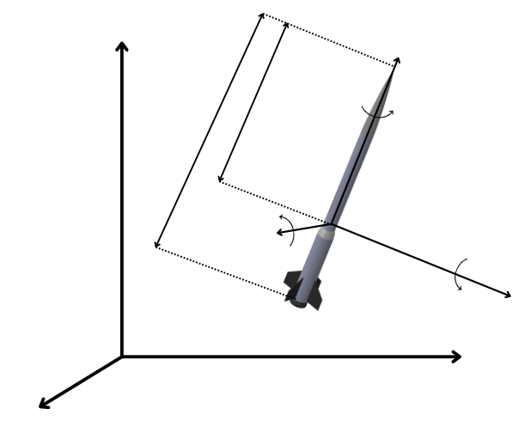
Dynamics and Modeling
Motivation
Basis for controller linearization
Validate controller performance
Open source simulations are open-loop
$$x^{i}$$
$$x^{b}$$
$$p$$
$$r_{CG}$$
$$l$$
$$q$$
$$y^{b}$$
$$r$$
$$z^{b}$$
$$z^{i}$$
$$y^{i}$$
Guidance, Navigation, and Control
Georgia Institute of Technology

Slide 5
Dynamics and Modeling
Motivation
Basis for controller linearization
Validate controller performance
Open source simulations are open-loop
Assumptions
Flat Earth
$$x^{i}$$
$$x^{b}$$
$$p$$
$$r_{CG}$$
$$l$$
$$q$$
$$y^{b}$$
$$r$$
$$z^{b}$$
$$z^{i}$$
$$y^{i}$$
Guidance, Navigation, and Control
Georgia Institute of Technology

Slide 6
Dynamics and Modeling
Motivation
Basis for controller linearization
Validate controller performance
Open-source simulations are open-loop
Assumptions
Flat Earth
Frames
Flat Earth frame $i$
Body frame $b$
$$x^{i}$$
$$x^{b}$$
$$p$$
$$r_{CG}$$
$$l$$
$$q$$
$$y^{b}$$
$$r$$
$$z^{b}$$
$$z^{i}$$
$$y^{i}$$
Guidance, Navigation, and Control
Georgia Institute of Technology

Slide 7
Dynamics and Modeling
Find 6-DOF Equations of Motion:
$$x^{i}$$
$$x^{b}$$
$${\dot{\vec{ω}}}_{bi}^{b}=I_{b}^{−1}({\vec{M}}^{b}−{\vec{ω}}_{bi}^{b}×I_{b}{\vec{ω}}_{bi}^{b})$$
$$p$$
$$v^{b}$$
$$r_{CG}$$
$$l$$
$$q$$
$$y^{b}$$
$$r$$
$$z^{b}$$
$$z^{i}$$
$$y^{i}$$
Guidance, Navigation, and Control
Georgia Institute of Technology

Slide 8
Dynamics and Modeling
Find 6-DOF Equations of Motion:
$$x^{i}$$
$$x^{b}$$
$${\dot{\vec{ω}}}_{bi}^{b}=I_{b}^{−1}({\vec{M}}^{b}−{\vec{ω}}_{bi}^{b}×I_{b}{\vec{ω}}_{bi}^{b})$$
$$p$$
$$v^{b}$$
$$r_{CG}$$
$$\dot{{\vec{v}}^{b}}=\frac{{\vec{F}}_{b}}{m}−{\vec{ω}}_{bi}^{b}×{\vec{v}}^{b}$$
$$l$$
$$q$$
$$y^{b}$$
$$r$$
$$z^{b}$$
$$z^{i}$$
$$y^{i}$$
Guidance, Navigation, and Control
Georgia Institute of Technology

Slide 9
Dynamics and Modeling
Find 6-DOF Equations of Motion:
$$x^{i}$$
$$x^{b}$$
$${\dot{\vec{ω}}}_{bi}^{b}=I_{b}^{−1}({\vec{M}}^{b}−{\vec{ω}}_{bi}^{b}×I_{b}{\vec{ω}}_{bi}^{b})$$
$$p$$
$$v^{b}$$
$$r_{CG}$$
$$\dot{{\vec{v}}^{b}}=\frac{{\vec{F}}_{b}}{m}−{\vec{ω}}_{bi}^{b}×{\vec{v}}^{b}$$
$$l$$
$$q$$
$${\dot{\vec{q}}}_{bi}=\frac{1}{2}\left[\begin{aligned}−pq_{x}−qq_{y}−rq_{z} \\ pq_{w}+rq_{y}−qq_{z} \\ qq_{w}−rq_{x}+pq_{z} \\ rq_{w}+qq_{x}−pq_{y}\end{aligned}\right]$$
$$y^{b}$$
$$r$$
$$z^{b}$$
$$z^{i}$$
$$y^{i}$$
Guidance, Navigation, and Control
Georgia Institute of Technology

Slide 10
Dynamics and Modeling
Find 6-DOF Equations of Motion:
$$x^{i}$$
$$x^{b}$$
$${\dot{\vec{ω}}}_{bi}^{b}=I_{b}^{−1}({\vec{M}}^{b}−{\vec{ω}}_{bi}^{b}×I_{b}{\vec{ω}}_{bi}^{b})$$
$$p$$
$$v^{b}$$
$$r_{CG}$$
$$\dot{{\vec{v}}^{b}}=\frac{{\vec{F}}_{b}}{m}−{\vec{ω}}_{bi}^{b}×{\vec{v}}^{b}$$
$$l$$
$$q$$
$${\dot{\vec{q}}}_{bi}=\frac{1}{2}\left[\begin{aligned}−pq_{x}−qq_{y}−rq_{z} \\ pq_{w}+rq_{y}−qq_{z} \\ qq_{w}−rq_{x}+pq_{z} \\ rq_{w}+qq_{x}−pq_{y}\end{aligned}\right]$$
$$y^{b}$$
$$r$$
$$z^{b}$$
$$\dot{{\vec{p}}^{i}}={\vec{q}}_{bi}^{∗}⊗{\vec{v}}^{b}⊗{\vec{q}}_{bi}$$
$$z^{i}$$
$$y^{i}$$
Guidance, Navigation, and Control
Georgia Institute of Technology

Slide 11
Dynamics and Modeling
Find ${\vec{F}}^{b}$ and ${\vec{M}}_{cg}^{b}$ :
$$x^{i}$$
$$x^{b}$$
$${\vec{F}}_{G}^{i}=\left[\begin{aligned} −g \\ 0 \\ 0\end{aligned}\right]$$
$$p$$
$$v^{b}$$
$${\vec{F}}_{G}^{b}={\vec{q}}_{bi}⊗{\vec{F}}_{G}^{i}⊗{\vec{q}}_{bi}^{∗}$$
$$r_{CG}$$
$$l$$
$$q$$
$$y^{b}$$
$$r$$
$$z^{b}$$
$$F_{G}$$
$$z^{i}$$
$$y^{i}$$
Guidance, Navigation, and Control
Georgia Institute of Technology

Slide 12
Dynamics and Modeling
Find ${\vec{F}}^{b}$ and ${\vec{M}}_{cg}^{b}$ :
$$x^{i}$$
$$x^{b}$$
$${\vec{F}}_{G}^{i}=\left[\begin{aligned} −g \\ 0 \\ 0\end{aligned}\right]$$
$$p$$
$$v^{b}$$
$${\vec{F}}_{G}^{b}={\vec{q}}_{bi}⊗{\vec{F}}_{G}^{i}⊗{\vec{q}}_{bi}^{∗}$$
$$r_{CG}$$
$$l$$
$${\vec{F}}_{A}^{b}=L\left[\begin{aligned}sin⁡(α) \\ −cos⁡(α) \\ 0\end{aligned}\right]+D\left[\begin{aligned}−cos⁡(α) \\ −sin⁡(α) \\ 0\end{aligned}\right]$$
$$q$$
$$CG$$
$$y^{b}$$
$$CP$$
$$CG0$$
$$r$$
$${\vec{M}}_{A,cg}^{b}={\vec{M}}_{A,cg0}^{b}+{\vec{F}}_{A}^{b}×({\vec{r}}_{cg}^{b}−{\vec{r}}_{cg0}^{b})$$
$$z^{b}$$
$$F_{D}$$
$$F_{G}$$
$$z^{i}$$
$$y^{i}$$
Guidance, Navigation, and Control
Georgia Institute of Technology

Slide 13
Dynamics and Modeling
Find ${\vec{F}}^{b}$ and ${\vec{M}}_{cg}^{b}$ :
$$x^{i}$$
$$x^{b}$$
$${\vec{F}}_{G}^{i}=\left[\begin{aligned} −g \\ 0 \\ 0\end{aligned}\right]$$
$$p$$
$$v^{b}$$
$${\vec{F}}_{G}^{b}={\vec{q}}_{bi}⊗{\vec{F}}_{G}^{i}⊗{\vec{q}}_{bi}^{∗}$$
$$r_{CG}$$
$$l$$
$${\vec{F}}_{A}^{b}=L\left[\begin{aligned}sin⁡(α) \\ −cos⁡(α) \\ 0\end{aligned}\right]+D\left[\begin{aligned}−cos⁡(α) \\ −sin⁡(α) \\ 0\end{aligned}\right]$$
$$q$$
$$CG$$
$$y^{b}$$
$$CP$$
$$CG0$$
$$r$$
$${\vec{M}}_{A,cg}^{b}={\vec{M}}_{A,cg0}^{b}+{\vec{F}}_{A}^{b}×({\vec{r}}_{cg}^{b}−{\vec{r}}_{cg0}^{b})$$
$$z^{b}$$
$$F_{D}$$
$$F_{G}$$
$${\vec{F}}_{T}^{b}=\left[\begin{aligned} T(t) \\ 0 \\ 0\end{aligned}\right]$$
$$F_{T}$$
$$z^{i}$$
$$y^{i}$$
Guidance, Navigation, and Control
Georgia Institute of Technology

Slide 14
Dynamics and Modeling
Find ${\vec{F}}^{b}$ and ${\vec{M}}_{cg}^{b}$ :
$$x^{i}$$
$$x^{b}$$
$${\vec{F}}_{G}^{i}=\left[\begin{aligned} −g \\ 0 \\ 0\end{aligned}\right]$$
$$p$$
$$v^{b}$$
$${\vec{F}}_{G}^{b}={\vec{q}}_{bi}⊗{\vec{F}}_{G}^{i}⊗{\vec{q}}_{bi}^{∗}$$
$$r_{CG}$$
$$l$$
$${\vec{F}}_{A}^{b}=L\left[\begin{aligned}sin⁡(α) \\ −cos⁡(α) \\ 0\end{aligned}\right]+D\left[\begin{aligned}−cos⁡(α) \\ −sin⁡(α) \\ 0\end{aligned}\right]$$
$$q$$
$$CG$$
$$y^{b}$$
$$CP$$
$$CG0$$
$$r$$
$${\vec{M}}_{A,cg}^{b}={\vec{M}}_{A,cg0}^{b}+{\vec{F}}_{A}^{b}×({\vec{r}}_{cg}^{b}−{\vec{r}}_{cg0}^{b})$$
$$z^{b}$$
$$F_{D}$$
$$F_{G}$$
$${\vec{F}}_{T}^{b}=\left[\begin{aligned} T(t) \\ 0 \\ 0\end{aligned}\right]$$
$$CG\left(t_{0}\right)→CG\left(t_{f}\right)$$
$$I^{b}\left(t_{0}\right)→I^{b}\left(t_{f}\right)$$
$$F_{T}$$
$$z^{i}$$
$$y^{i}$$
Guidance, Navigation, and Control
Georgia Institute of Technology

Slide 15
Controller Validation: Monte Carlo Analysis
Dynamics & Modeling
LQR
Controller Development
Guidance, Navigation, and Control
Georgia Institute of Technology

Slide 16
Controller Goals and Architecture
t = 1s
to
t = 5s
t = 5s
to
t = 10s
t = 10s
to
burnout
t < 1s
No control until t = 1s after launch.
Active Stabilization:
0° roll, 0° yaw.
Yaw Maneuver: Hold at 5°.
Maintain 0° roll.
Yaw back to 0°.
Maintain 0° roll.
Rocket
$$r$$
+
-K
$$\overset{⃑}{u}$$
$$\overset{⃑}{x}$$
-
Guidance, Navigation, and Control
Georgia Institute of Technology
Sensors

Slide 17
Linear Quadratic Regulator (LQR) Control
Goal: establish a feedback control law based on the current state, $\overset{⃑}{x}$.
$K$ is an “optimal gain matrix.”
$\overset{⃑}{u}$ is a control input vector.
Gain matrix $K$ found by minimizing a cost function $J$.
Quadratic cost function is subject to linear dynamics.
Note that this requires a linear, time-invariant dynamical system - which a rocket is not.
Guidance, Navigation, and Control
Georgia Institute of Technology

Slide 18
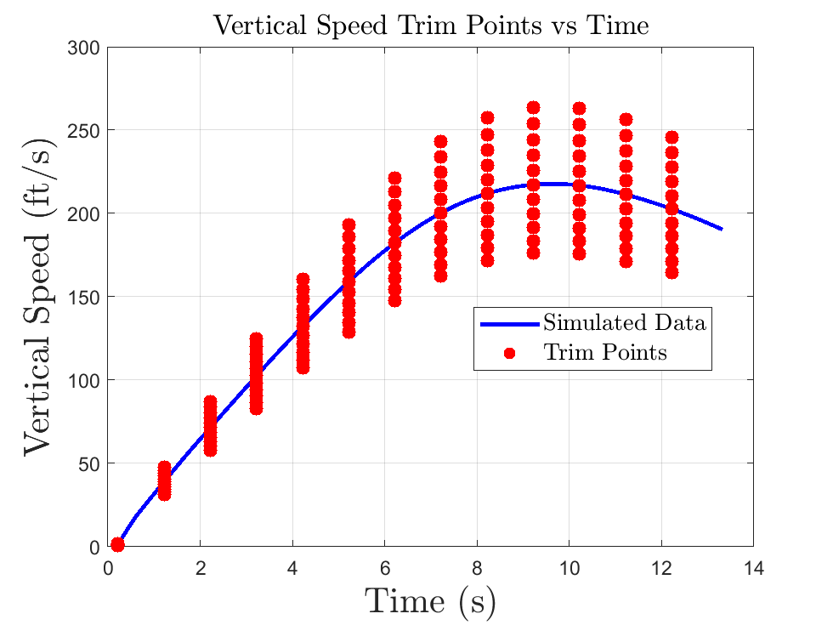
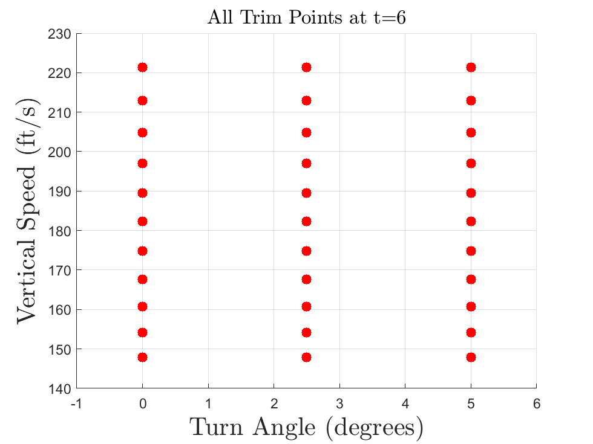
Trim Point Concept
Trim points are points in state space that satisfy the form $\dot{\overset{⃑}{x}}=f(\overset{⃑}{x},\overset{⃑}{u})$
Trim points were chosen based on the simulated trajectory with no control
The current model has 429 trim points
Variable | Number of Variations | Definition
Vertical Speed | 11 | Change in aero force magnitude by 8%
Turn Angle | 3 | 0°, 2.5°, 5°
Time | 13 | 1 every second
Guidance, Navigation, and Control
Georgia Institute of Technology
Notes:
LQR only works with time invariant and linear systems
We need a way to control the rocket. We do that with trim points
What is a trim point?
Points in state space that are dynamically feasible (x_dot = f(x,u))
We can linearize the dynamics around that point and assume it is linear
Use LQR to get a K matrix
TP Generation / Variation
Trim points around simulated trajectory with no control
13 Batches
Each batch as 33 trim points
Example at time 6

Slide 19
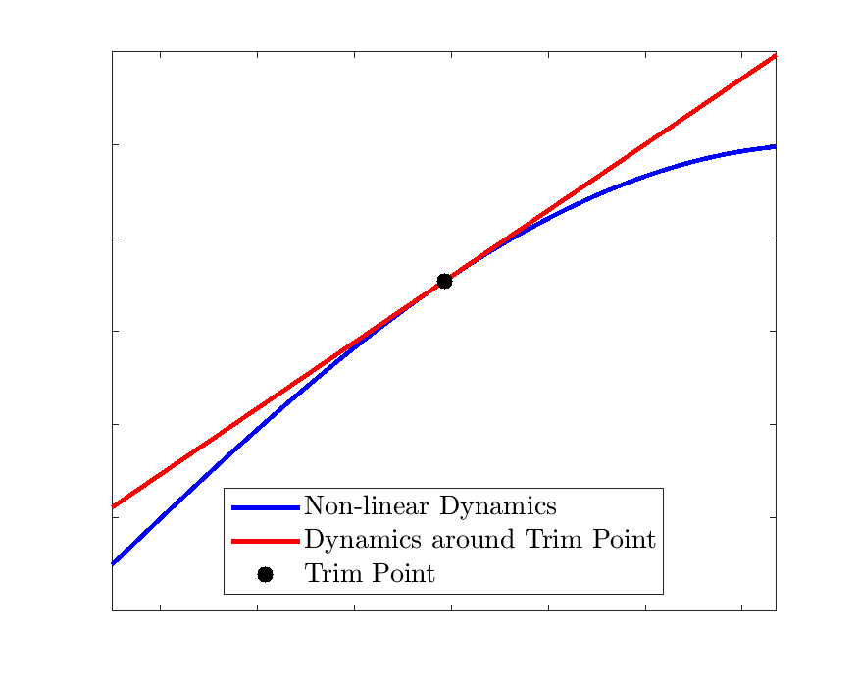
Trim Point Formulation
Dynamics
Trim Point
Given
$$\dot{\overset{⃑}{x}}=f(\overset{⃑}{x}, \overset{⃑}{u})$$
$${\dot{\overset{⃑}{x}}}_{0},{\overset{⃑}{x}}_{0},{\overset{⃑}{u}}_{0}$$
Calculate Jacobian
$$A=\frac{∂f({\overset{⃑}{x}}_{0})}{∂\overset{⃑}{x}}$$
$$B=\frac{∂f({\overset{⃑}{u}}_{0})}{∂\overset{⃑}{u}}$$
Dynamics around Trim Point
$$\dot{\overset{⃑}{x}} −{\dot{\overset{⃑}{x}}}_{0}=A\left(\overset{⃑}{x}−{\overset{⃑}{x}}_{0}\right)+B(\overset{⃑}{u}−{\overset{⃑}{u}}_{0})$$
Simplified equation
$$Δ\dot{\overset{⃑}{x}}=AΔ\overset{⃑}{x}+BΔ\overset{⃑}{u}$$
Gain Matrix
$$K=lqr(A,B,Q,R)$$
Guidance, Navigation, and Control
Georgia Institute of Technology
Notes:
Given
We know dynamics and Trim Points
Calculate Jacobian
This linearizes the dynamics around the trim point
Dynamics
Linear system. This represents the dynamics around the trim point
Simplified equation
Delta is the deviation from the trim points
Controller
To get our K we use the LQR function in MATLAB given our A, B, Q, R
Q and R matrices are the cost associated with the state and control

Slide 20
Trim Point Formulation
Trim points were chosen based on the simulated open loop trajectory with no control
A set of variations were added based on vertical speed and turn angle
The current model has 429 trim points (11 vertical speed, 3 turn, 13 time)
Variation | Number of Trim Points | Definition
Vertial Speed | 11 | 8% of moment aero moment change
Turn Angle | 3 | 0°, 2.5°, 5°
Time | 13 | 1 every second

Slide 21
Linearization for A and B Matrices
To run linear control, linear dynamics are needed
The system is dynamically feasible if the function F is equal to zero
The Taylor expansion is taken around the trim point
The result is the linear equation where the delta is the deviation from the trim point
This process is done for every trim point

Slide 22
Controllability and Gain Matrix Generation
Controllability: the ability to bring the system from any initial state to any final state via the control inputs to the system over any given amount of time
can check the rank of a “controllability matrix;” more intuitive to examine the state and control vectors
Not every aspect of the nominal rocket state vector is able to be controlled (q₀) - so it is removed to generate gain matrices
A given gain matrix $K$ can be derived from $A$, $B$, $Q$, $R$.
Priority given to feasibly controlled states (roll and yaw components of state vector) and truly controlled control inputs (roll and yaw moments)
Can derive K from Algebraic Riccati Equation, which is abstracted away in MATLAB
Gain matrix found for every trim point

Slide 23
Controllability and Gain Matrix Generation
Controllability: a necessary condition for using LQR
rank of a “controllability matrix;” can also examine the state and control vectors
Remove $q_{0}$ from state vector for controllability
A gain matrix $K$ can be derived from $A$, $B$, $Q$, $R$.
Priority given to feasibly controlled $x_{i}$(roll and yaw components of state vector) and truly controlled $u_{i}$(roll and yaw moments) in $Q$, $R$matrices.
Gain matrix found for every trim point
Guidance, Navigation, and Control
Georgia Institute of Technology

Slide 24
Gain Scheduling
Gain matrix is “optimal” only at trim point
“LQR Gain Selector” algorithm written to ameliorate difference in rocket state from trim point
Computes Euclidean distance from trim point
Finds “closest” trim point
Returns appropriate gain matrix
Rocket State
Guidance, Navigation, and Control
Georgia Institute of Technology
Trim Points

Slide 25
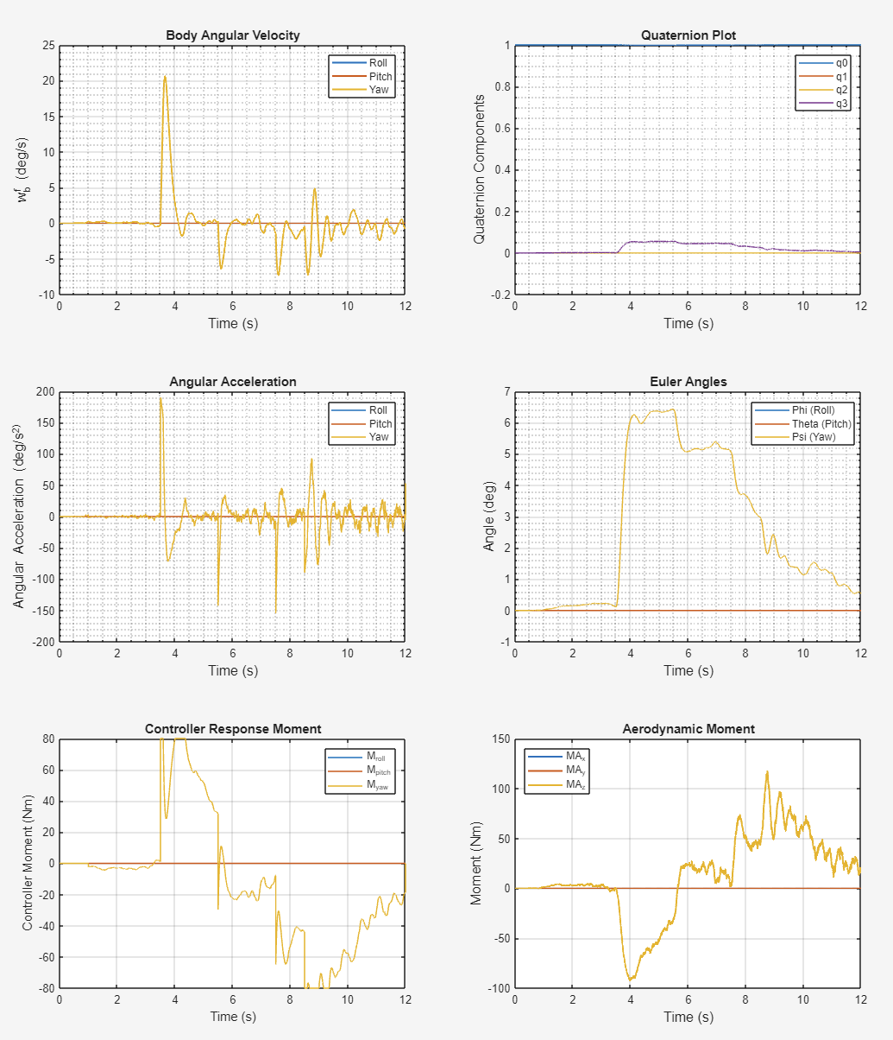
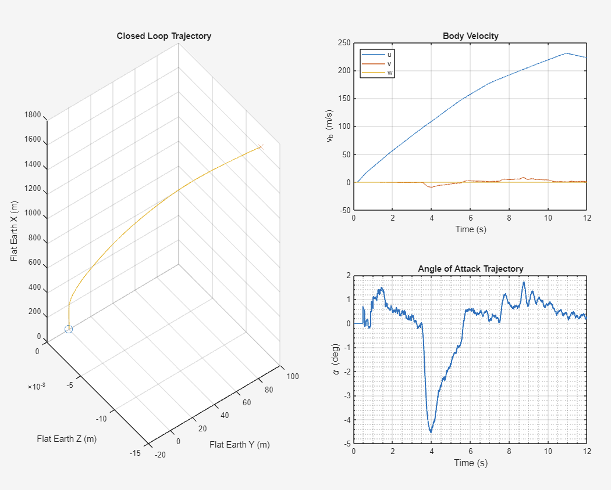
Closed Loop Simulation Dashboard
Guidance, Navigation, and Control
Georgia Institute of Technology

Slide 26
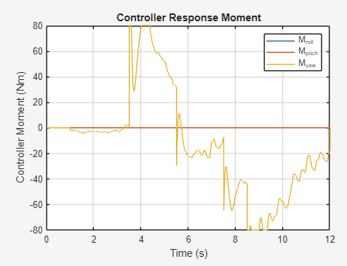
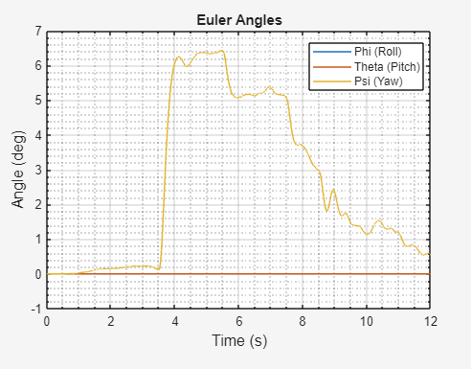
Closed Loop Simulation Dashboard
Guidance, Navigation, and Control
Georgia Institute of Technology

Slide 27
Controller Validation: Monte Carlo Analysis
Dynamics & Modeling
LQR
Controller Development
Guidance, Navigation, and Control
Georgia Institute of Technology

Slide 28
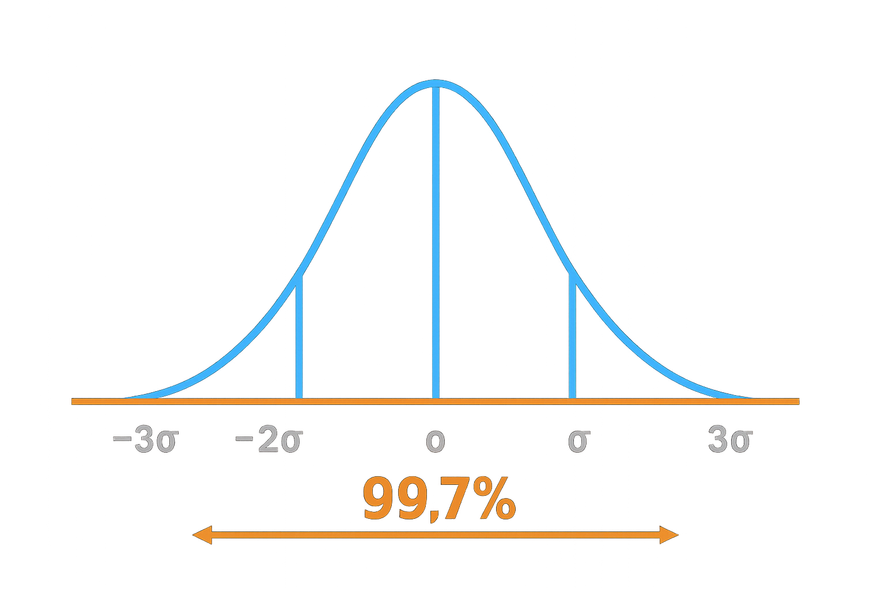
Monte Carlo Analysis
Evaluate controller stability and performance under a wide range of flight conditions
The varied parameters include:
Rocket mass
Inertia
CG location
Thrust curve
Burn time
Wind
3σ (99.7% of all values) of each parameter =±10% of its mean.
Guidance, Navigation, and Control
Georgia Institute of Technology

Slide 29
Monte Carlo Analysis
1000 closed-loop control simulations with random parameters
Using Latin Hypercube Sampling (LHS) to ensure a good spread of simulated values
Guidance, Navigation, and Control
Georgia Institute of Technology

Slide 30
Monte Carlo: Validating the Controller
Guidance, Navigation, and Control
Georgia Institute of Technology

Slide 31
Notes:
Hector: we would like to thank our sponsors for the help they have provided in completing this study.

Slide 32
THANK YOU

