Slide 1
Print Quality Optimization of an Open-Source High-Temperature FDM 3D Printer for Thermoplastic Materials
Evan C. Garrison∗ and Luke C. Salisbury†
Mississippi State University, Mississippi State, MS, 39762
AIAA Region II Student Conference Region II AIAA April 3 - 4th, 2025
∗Undergraduate Researcher, Department of Aerospace Engineering, 501 Hardy Road, 321 Walker Hall, Drawer A, Mississippi State, MS 39762,AIAA Student Member 1810343.
†Undergraduate Researcher, Michael W. Hall School of Mechanical Engineering, 479-1 Hardy Road, 210 Carpenter Hall, Box 9552, Mississippi State, MS 39762, AIAA Student Member 1810424

Slide 2
Table of Contents
Introduction
Methodology
Mechanical Optimization
Thermal Optimization
Parameter Optimization
Conclusion and Future Work

Slide 3
I. Introduction

Slide 4
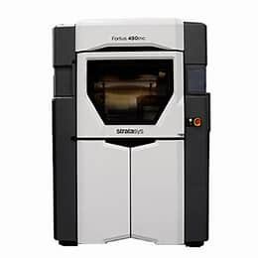
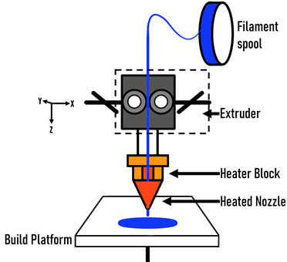
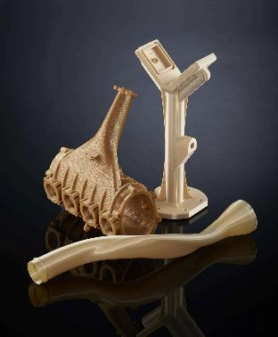
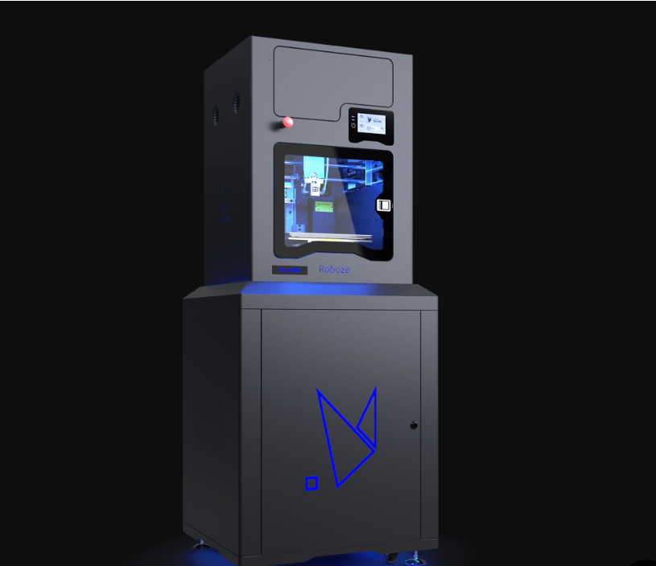
I. Introduction A. Background
Stratsys Fortum 450c
Fused Deposition Modelling
ULTEM™ 1010 (PEI)
[3]
Roboze Plus PRO
[1]
[2]
[4]
Notes:
Stereotypical printing system - Carriage system -Nozzle – Extruder
Polyetherimide – WHY CAN WE PRINT THIS – THE APPLICATIONS OF THIS MATERIAL – WHY IS IT IMPORTANT FOR A COST EFFECTIVE VERSION OF THIS

Slide 5
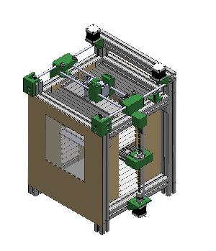
I. Introduction B. Open-Source High-Temperature FDM
As an alternative to the cost-prohibitive proprietary model for high-temperature FDM manufacturing, an open-source printer was developed by Charlote Thompson under Dr. Matthew Priddy at the Computational Mechanics & Materials Laboratory (CMML) at Mississippi State University.
Original Design Specifications:
Hotend Temperature: 490°C
Bed Temperature: 250°C
Chamber Temperature: 40°C
Print Space: 152mm x 152mm x 210mm (LxWxH)
Cost: $3000
Benefits
Modular
Affordable
Controllable
[5]
Notes:
Modularity – Control Mechanics and Software
Affordable – Software/Hardware/specifications not hidden behind paywalls/[corporate veils of doom] [do not say corporate veils of doom]

Slide 6
II. Methodology

Slide 7
II. Methodology
The original design and print parameters of the open-source high-temperature FDM printer was unable to print quality parts out of high-performance materials due to issues with bed adhesion , warping, and layer shifting. To address these issues, the thermal and mechanical systems along with the print parameters needed to be optimized.

Slide 8
II. Methodology
Thermal and Mechanical Optimization
Sources of variation and randomness were identified
New parts and processes were manufactured and tested to optimize their effectiveness
Their effectiveness was compared to the original design
Print Parameter Optimization
A full factorial design was used to characterize the effects of hotend temperature, bed temperature and mass flowrate on bed adhesion.
For each test, bed adhesion was ranked on a scale of 0-4
Data was processed using a MATLAB script that compared the data to a linear model and plotted the data on a four-variable interaction plot
Data was then analyzed to determine the print parameters with the best bed adhesion and print quality
Notes:
Discuss the methods of adhesion from 0 - 4

Slide 9
III. Thermal Optimization

Slide 10
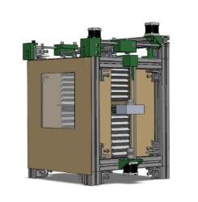
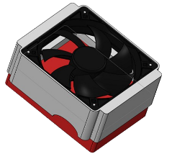
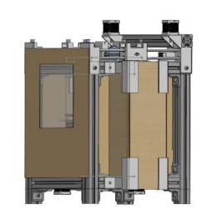
III. Thermal Optimization
Original Thermal Design
The original chamber design was unable to reach the required 70-90°C chamber temperature for ULTEM™ 1010
Changes:
Replaced all vertical bellows with rigid mineral wool insulation panels.
All chamber gaps were filled with cut mineral wool insulation
PETG Z-axis bed brackets were replaced with metal to maintain part geometry
A 120mm fan was attached to the ceramic heater to increase heat transfer
Forced Convection Heater
Optimized Thermal Design
Results: Max chamber temperature increased from 40 °C to 100°C
Notes:
Talk about the problems we solved with the
Issues with the original design
Thought process of the original design (why bellows)
We have reached much higher temperatures with the heater, however, the printer is not able to handle those tempertures
Discuss the stabilization time of the heater and how much quicker it is now (1-2 hours vs 10 minutes)

Slide 11
IV. Mechanical Optimization

Slide 12
IV. Mechanical Optimization
Original Mechanical Design
The CoreXY system was identified as a source of part quality discrepancies due to a lack of rigidity and PETG part heat degradation
Changes:
A second linear rod was added to increase printhead rigidity, reducing oscillations
PETG parts in the CoreXY frame were replaced with ABS to reduce frame geometry changes due to heat exposure from the chamber, increasing carriage travel precision and reducing friction
Optimized Mechanical Design
Results: These changes visibly reduced the magnitude of the visible oscillations in the printhead and the friction between the x-axis rods and the printhead carriage.
Notes:
Discuss the issues with the rigidity and how the position of the of the original carriage design hung down due to the weight of the extruder dragging down the carriage.
A second x-axis rod adds support
Engage with the pictures and explain to the audience the changes we made

Slide 13
V. Parameter Optimization

Slide 14
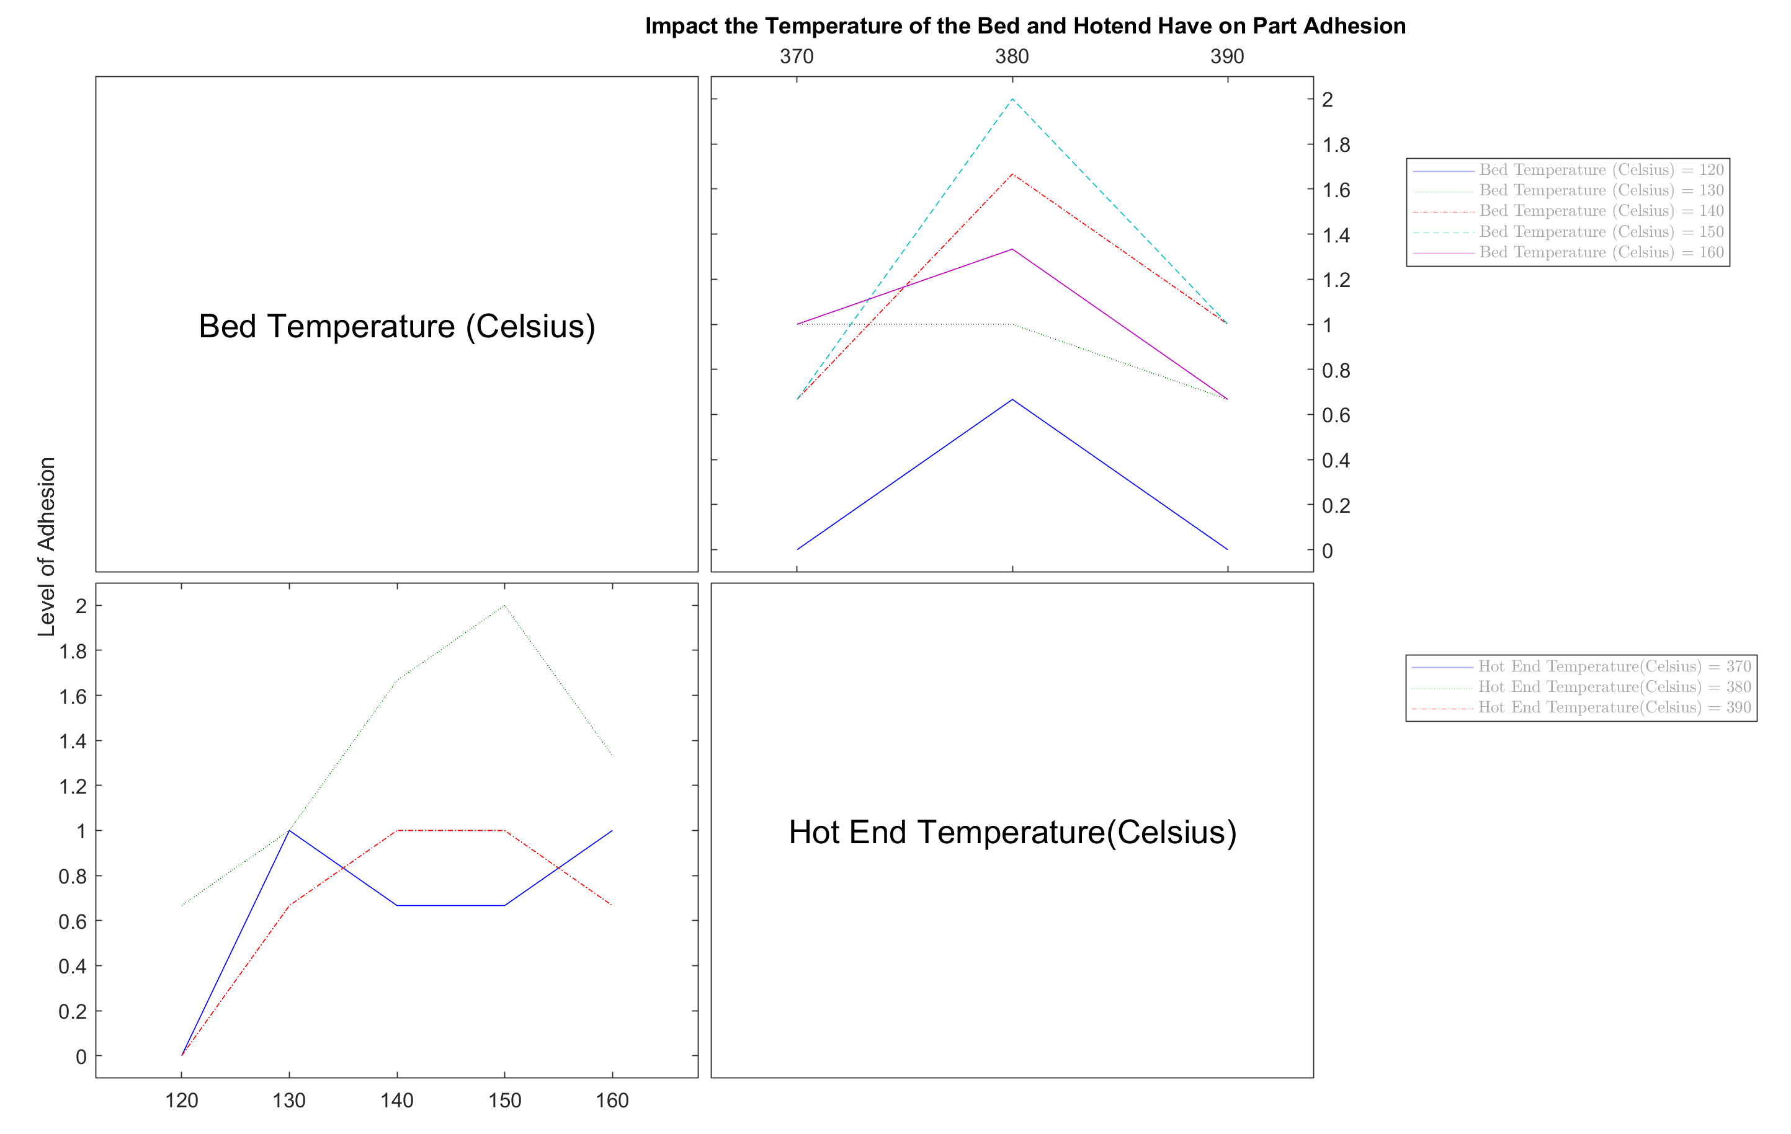
V. Parameter Optimization A. Hotend/Bed Temperature DOE
The first DOE analyzed the effect of hotend and bed temperature on ULTEM™ 1010 adhesion creating a total of 15 experimental groups, totaling 45 trials
Parameters Analyzed:
Hotend Temperatures: 370°C, 380 °C, 390°C
Bed Temperatures: 120°C, 130°C, 140°C, 150°C, 160°C
Results: Interaction plots showed bed adhesion increased with both hot end and bed temperature, with p-values of 1 and 0.94995, respectively. Bed adhesion was inconsistent below 140°C, guiding the second DOE setup.
Notes:
Discuss what the graphs mean, what the adhesion levels mean, and what improvement looks like

Slide 15
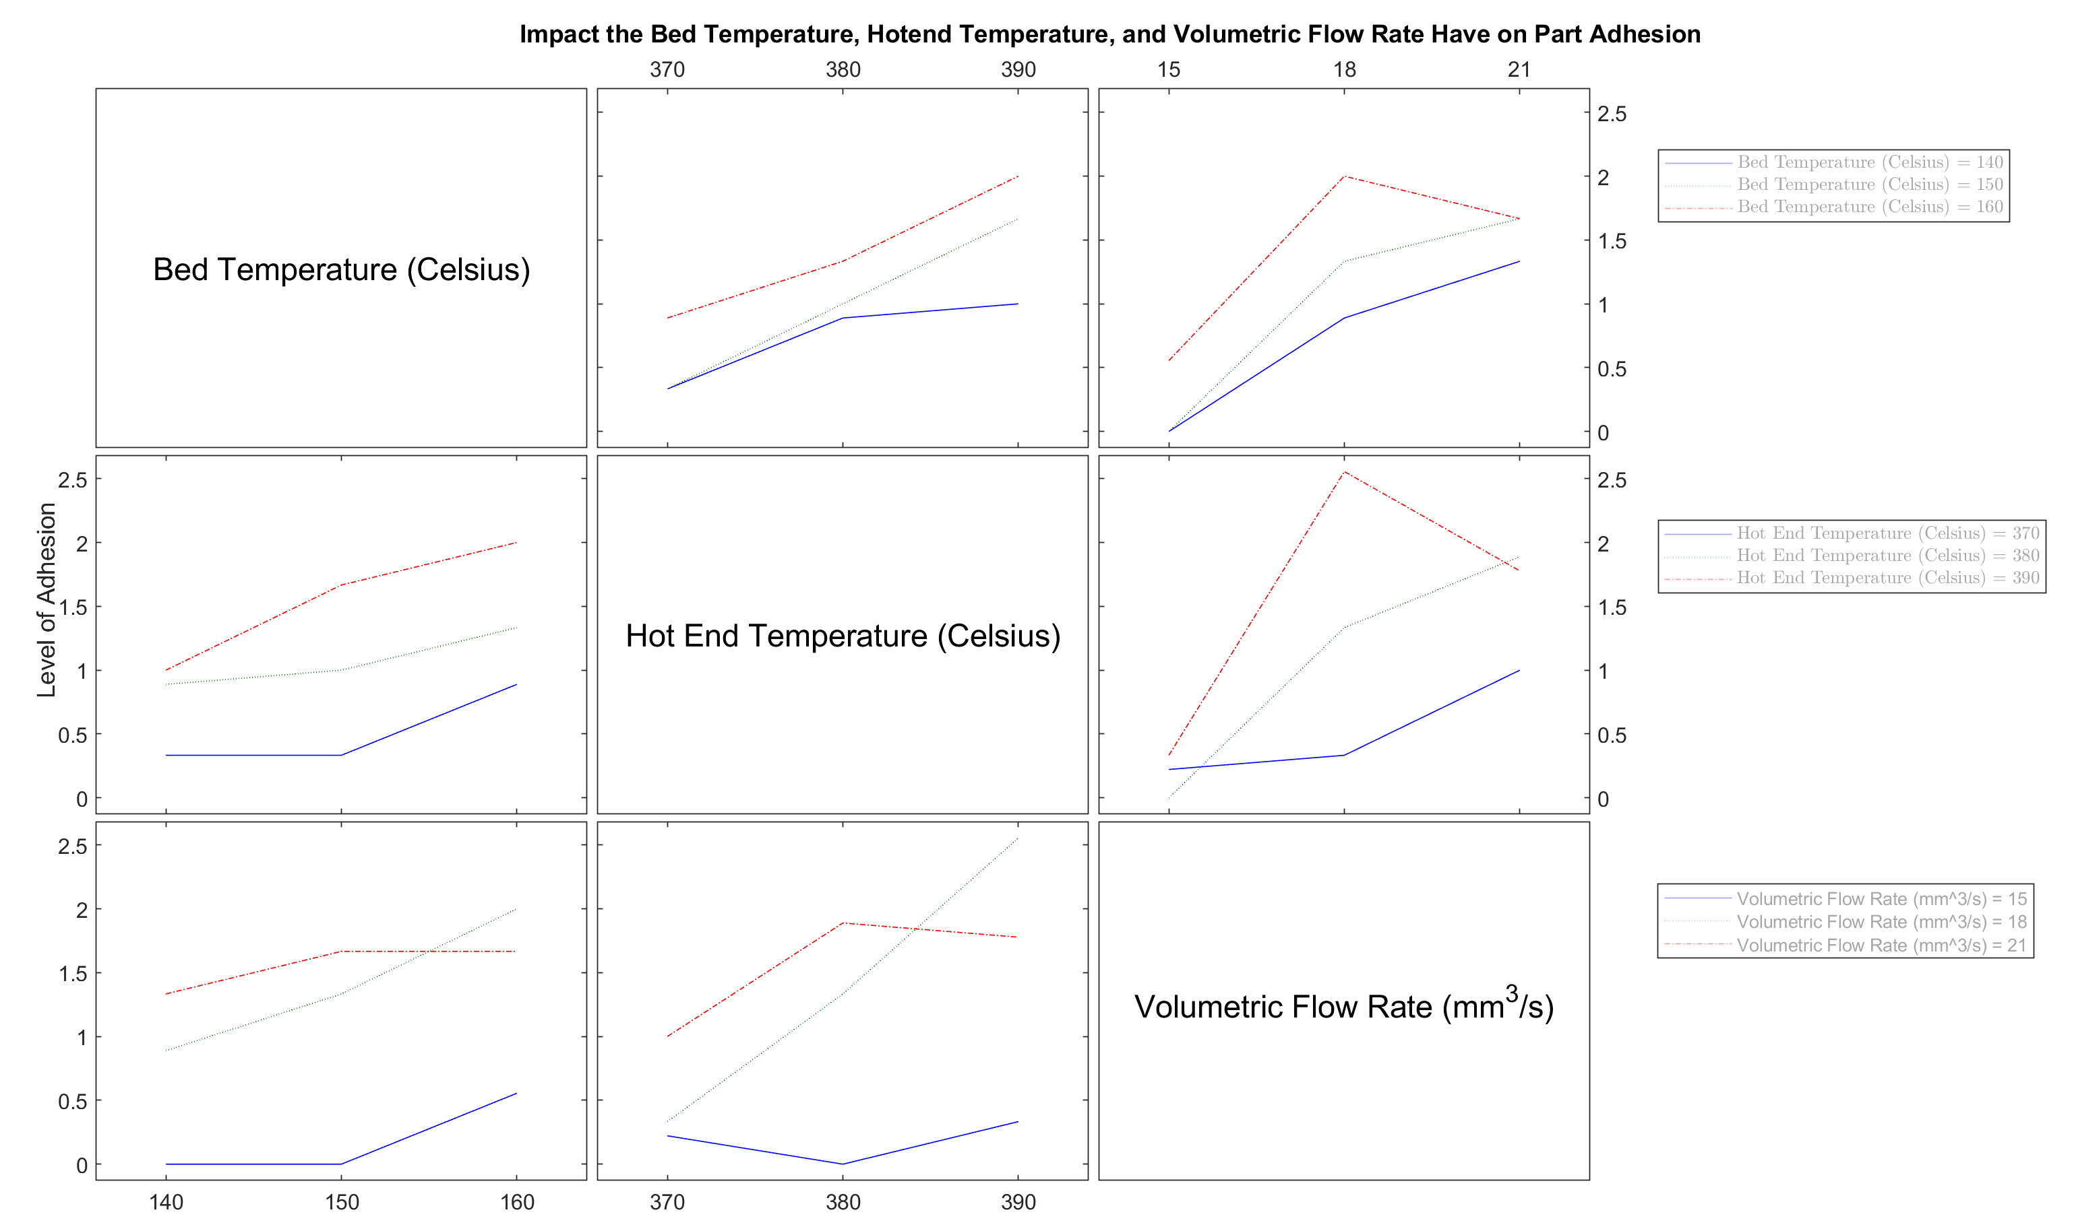
V. Parameter Optimization B. Hotend/Bed Temperature/Volumetric Flowrate DOE
The second DOE analyzed the effect of hot end, bed temperature and volumetric flowrate on ULTEM™ 1010 adhesion, creating a total of 27 experimental groups, totaling 81 trials
Parameters Analyzed:
Hotend Temperatures: 370°C, 380°C, 390°C
Bed Temperatures: 140°C, 150°C, 160°C
Volumetric flowrates: 15 mm³/s, 18 mm³/s, 21 mm³/s
The best adhesion results occurred with a volumetric flow rate of 18 mm³/s, a hot end temperature of 380°C, and a bed temperature of 160°C, though the relationship was not statistically significant.
Notes:
Discuss what the graphs mean, what the adhesion levels mean, and what improvement looks like
Why is it not statistically significant?
During the 21mm^3/s, there were known issues with the micro step/running the print
Don't say "see its changing"

Slide 16
VI. Conclusion and Future Work

Slide 17
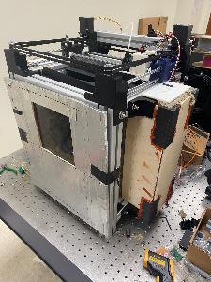
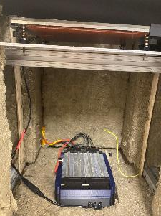
VI. Conclusion and Future Work A. Conclusion
Through the optimization of the thermal and mechanical systems as well as the print parameters, higher quality parts can be manufacturing using our open-source high-temperature FDM printer.
Current Printer Design
Optimized Print Samples

Slide 18
IV. Conclusion and Future Work A. Future Work
Addition of thermal window and IR camera for temperature gradient and distribution monitoring.​
Further print quality optimization looking specifically at extrusion width, print speed, and material of the bed.​
Mechanical testing of ULTEM™ 1010 specimens to fill gaps in literature
Manufacturing airfoils out of ULTEM™ 1010
Printing of other materials including PEEK and metal filaments.

Slide 19
VI. Discussion and Conclusion

Slide 20
Acknowledgements
Bagley College of Engineering and Micheal W. Hall School of Mechanical Engineering for their generous financial support
Dr. Matthew W. Priddy of the Micheal W. Hall School of Mechanical Engineering and Dr. Santanu Kundu of the Dave C. Swalm School of Chemical Engineering for their support guidance, mentorship, and laboratory resources
Charlotte Thompson for getting the project off the ground and continually offering support and mentorship

Slide 21
References
[1] https://www.xometry.com/resources/3d-printing/3d-print-warping-pla-petg-abs/
[2] https://mfg.trimech.com/ultem-1010-3d-printing-material/
[3] https://www.stratasys.com/en/3d-printers/printer-catalog/fdm-printers/fortus-450mc/
[4] https://www.roboze.com/en/3d-printers/roboze-plus-pro.html
[5] Thompson, C., “Design and Construction of an Open-Source High-Temperature FDM 3D Printer for Thermoplastic Materials,” ,2025. Unpublished.

Slide 22
Q&A Session

