Slide 1
Optimizing Fuel in Commercial Supersonic Flight
Marina R. Jenkins, Ryan B. Murdoch
University of Florida
AIAA Region II Student Conference, April 3-4, 2025
Copyright © by Marina R. Jenkins, Ryan B. Murdoch
Published by the American Institute of Aeronautics and Astronautics, Inc., with permission.

Slide 2
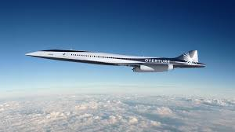
Introduction
Resurgence of Supersonic Commercial Transport
  Similar to the Concorde
  Flying Faster
  Traveling Farther
  Without the threat of sonic booms
[1]
A problem still remains…

Slide 3
Introduction
The traditional approach to fuel is flawed
  Fuel must have high energy density, economically sounds, stable.
  The jets must be lightweight enough to travel long distances at a high speed and large enough to carry a passenger load- while balancing economics and sustainability parameters.

Slide 4
Background
Global SST Programs
  Tu-144
U.S SST development
  Funding cut 1971
Creation of the Concorde
  Air France/ British Airways

Slide 5
Background
Sonic boom legislation
  1973
Eventual end of the Concorde program
  2003
New companies/Research
  Hermes
  Boom Supersonic

Slide 6
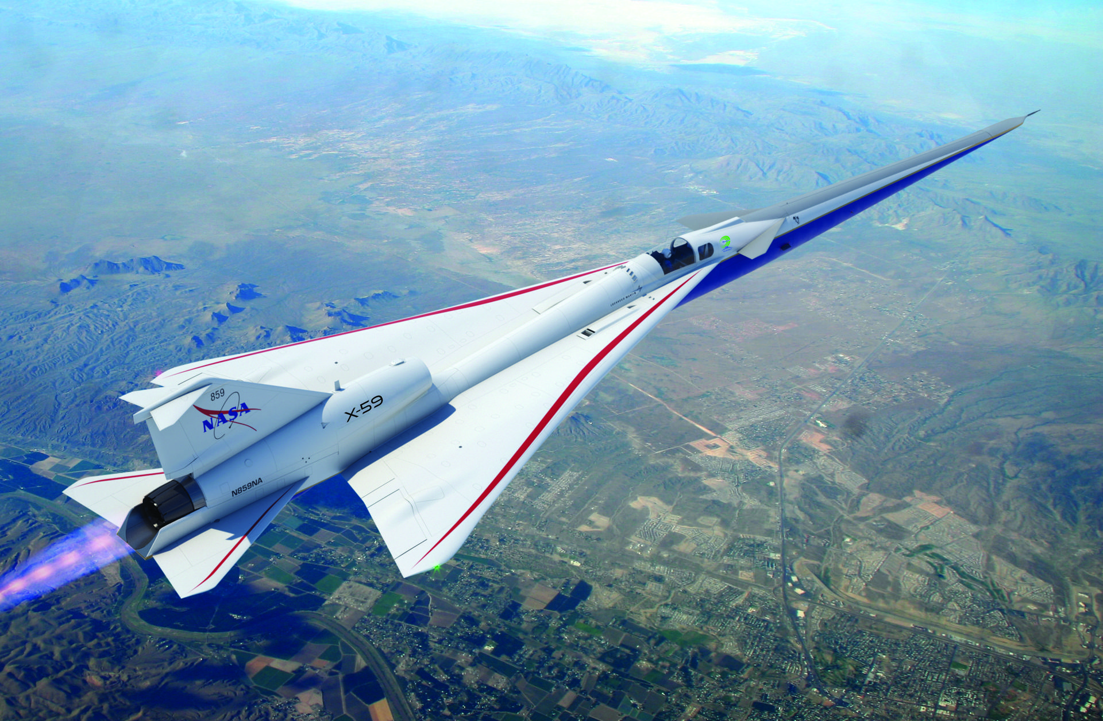
Motivation
Efficiency, Accessibility, and Safety
In order to succeed in regard to these goals, fuel use must be optimized
[2]
‌

Slide 7
Problems
  We optimized fuel via the following parameters:
    Cost
    Storage
    Aircraft Payload
    Environmental impacts
    Health Effects
  These parameters were broken into Production and Consumption stages

Slide 8
Fuel Types
We selected the following fuel types:
Kerosene based fuels
  Jet-A
  JP-8
Sustainable Aviation Fuels (SAFs)
Hydrogen

Slide 9
Kerosene Based Fuels
Refined from crude oil then distilled.
Jet-A
  Most common jet fuel
JP-8
  Standard for military use
These act as a control due to the history of their use.

Slide 10
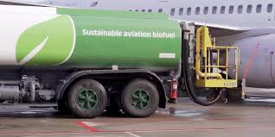
Fuel Types
SAFs
  Derived from renewable resources
  Typically used as a 50% blend with kerosene based fuels
  HEFA, ATJ, etc. production technologies
[3]

Slide 11
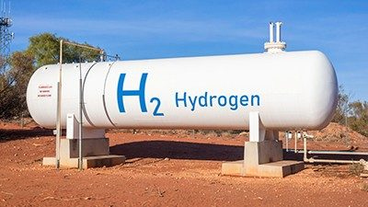
Fuel Types
Hydrogen
  Hydrogen internal combustion engines (H2ICE) burn hydrogen in gas-turbine engines
  High energy density
  Low volumetric density
  Produced through multiple methods with varying CO2 outputs.
  Hydrogen Fuel Cells Convert hydrogen and oxygen into electricity
[4]

Slide 12
Methods
The fuel performance was evaluated within each parameter, split between production and consumption.
We produced a matrix depicting their performances

Slide 13
Methods: Sustainability
  Evaluated by magnitude of carbon emissions
    grams per megajoule of fuel
  Determines:
    Environmental impacts in producing and consuming the fuel

Slide 14
Methods: Ease of Storage
Safe storage temperature range, (Celsius)
Range determined by the flash and freeze point
Hydrogen is assumed to be kept at its liquid state

Slide 15

Methods: Specific Cost
Comparing the price of these fuels is difficult!
-Hydrogen
Cost USD per megajoule of energy
These units allow for a comparison of fuels of different characteristics

Slide 16
Methods: Health Impacts
Production Stage: Minimal Risk Level
  Inhalation toxicity
Consumption Stage: Particulate Attributed Premature Deaths
  Nitrogen Dioxide(s) (Nox) attributed premature mortalities
  Nox attributes to 91% of premature deaths from particulate emmisions

Slide 17
Methods: Payload Capabilities
Determined by:
Density (kg/L)
Gravimetric Energy Density (MJ/kg)
Volumetric Energy Density (MJ/L)
All three must be proportional enough to sustain supersonic flight

Slide 18
Production Results

Slide 19
Production Results: Ease of Storage
  SAFs are similar to Kerosene based fuels
    Interchangeability
  Hydrogen is difficult to store
    Requires cryogenic temperatures

Slide 20
Production Results: Specific Cost
  Kerosene based fuels are the cheapest
    Crude Oil refining produces many fuel types driving the price of fuels down.
    Jet A (42.2), JP-8 (43.84)
  Hydrogen varies (25 -59)
  SAFs are expensive (70.4)

Slide 21
Production Results: Sustainability
Due to the generalization of SAFs and Hydrogen fuels, minimum possible emissions was used
  SAFs and Hydrogen perform better than kerosene-based fuel
  (17 g/MJ)
  Depending on production methods both can emit no carbon emissions

Slide 22
Production Results: Health Effects
  Minimal risk levels:
  Kerosene Based Fuels: 2.5 average
  SAFs: lower relative to kerosene based
  Hydrogen: no minimal risk level/nontoxic

Slide 23
Consumption Results

Slide 24
Consumption Results: Payload Capabilities
SAFs are very similar to Kerosene based fuels in terms of VED, GED, and ED (around 30-40 for each)
Gravimetrically hydrogen contains a high energy density (120)
  Hydrogens volumetric density is extremely low (8.5)
Unique density parameters result in…?

Slide 25
Consumption Results: Health Effects
  Little to no difference in NOx emissions between Kerosene based and SAFs
  Hydrogen powered aircraft can contribute to a 86% reduction in Nox levels
  Due to SST flight elevation, their particulate emissions impact ozone and climate

Slide 26
Consumption Results: Sustainability
  Kerosene based fuels and SAFs have significant Carbon emissions in consumption (73 g/MJ)
  Hydrogen emits no Carbon emissions

Slide 27
Limitations
  Cost collection,
    Variable, unreliable
  Broadness of SAF creation
    Methods and implementations

Slide 28

Conclusion
  Metric for synthesizing the optimization of SST fuels
    Applicable for non-SST
  No singular best fuel
    Willingness of companies to balance
    Sustainability and economics
    Mix of multiple fuel types
[5]

Slide 29
References
[1]“Boom Supersonic and Collins Aerospace Sign Expanded Agreement for Major Aircraft Systems for Overture,” ‎@CollinsAero, 2025. https://www.collinsaerospace.com/news/news/2022/07/boom-supersonic-collins-aerospace-sign-expanded-agreement-for-major-aircraft-systems-overture (accessed Apr. 03, 2025).
[2] D. Dinius, “Supersonic Technologies - NASA,” NASA, Dec. 07, 2021. https://www.nasa.gov/centers-and-facilities/armstrong/supersonic-technologies/
[3] “Taking Off Soon: A New Kind of Sustainable Aviation Fuel (SAF),” www.honeywell.com. https://www.honeywell.com/us/en/news/2021/09/taking-off-soon-a-new-kind-of-sustainable-aviation-fuel-saf
[4] “Storing hydrogen fuel in salts — a step toward ‘cleaner’ energy production,” American Chemical Society. https://www.acs.org/pressroom/newsreleases/2022/october/storing-hydrogen-fuel-in-salts.html
[5] S. Hull, “What to do when babies cry on a plane - The Points Guy,” The Points Guy, Jun. 15, 2023. https://thepointsguy.com/airline/travel-etiquette-when-babies-cry-on-planes/ (accessed Apr. 03, 2025).
‌
‌

